Slide 1



SenSyn - Senior Synergy: Empowering Lifelong Learning and Healthy living with Community Events

Slide 2

Module 1: DIGITAL LITERACY

Slide 3


Introduction: Digital Technology Today
Assess
Recall
Consider
Your attitude on digital technology: positive, negative, or neutral?
How has your thinking changed throughout your life?
What influences your current opinion on digital technology?

Slide 4

Introduction: ‘’ Blast from the past’’
Close your eyes for a moment and take a journey into
the past...
Try to recall the various devices and technologies you
encountered throughout your life.
Anyone who wishes can share their earliest memory of technology: the first TV you had at home, the first time you used a telephone, or your first encounter with a computer.
What was that encounter like, what did the devices look like, what was different, and how were they used?
What is easier today, and what is more difficult when we talk about technology?

Slide 5
Understanding and shaping attitudes towards digital technology
Digital literacy = one of the key skills in today's world, and it is defined as the ability to use digital technologies for communication, work, learning, and accessing information.
For older adults, it is important to understand and acknowledge their attitude towards digital technology — whether positive or negative — in order to provide them with support and make it easier for them to adopt new skills.

Slide 6

Revealing your attitude towards digital technology
Positive attitude
I actively seek information about technology, attend courses, or learn about new devices.
I regularly use smartphones, computers, or the internet for communication, online shopping, social media, or research.
I feel satisfaction when using applications (e.g., for health) and I adapt to new devices or applications.

Slide 7
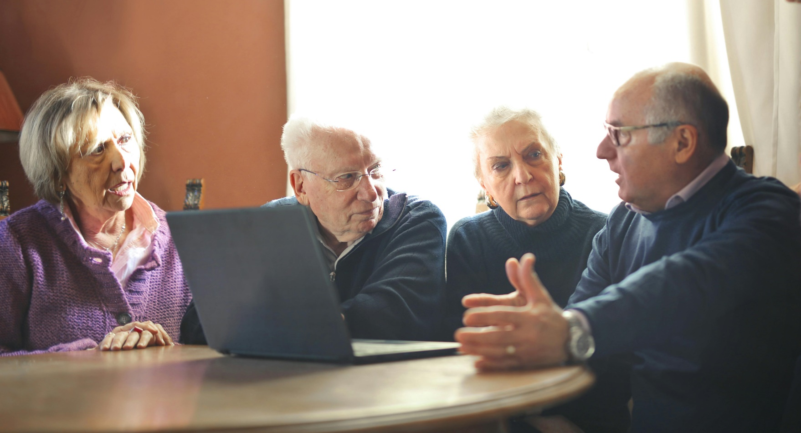
Revealing your attitude towards digital technology
Negative attitude
  You often feel stress, frustration, or dissatisfaction when using technology
  Učenje novih tehnologija smatrate prekompliciranim
  You feel fear regarding privacy or security issues.

Slide 8
Revealing your attitude towards digital technology
Neutral attitude
  You do not have a strong stance on technology, but you are open to using it without express enthusiasm or resistance.
  You use technology only when necessary, without the desire for further learning or exploration.
  You approach technology as a means to achieve a specific goal (e.g., paying bills online) without expressing a strong opinion about the technology itself.

Slide 9
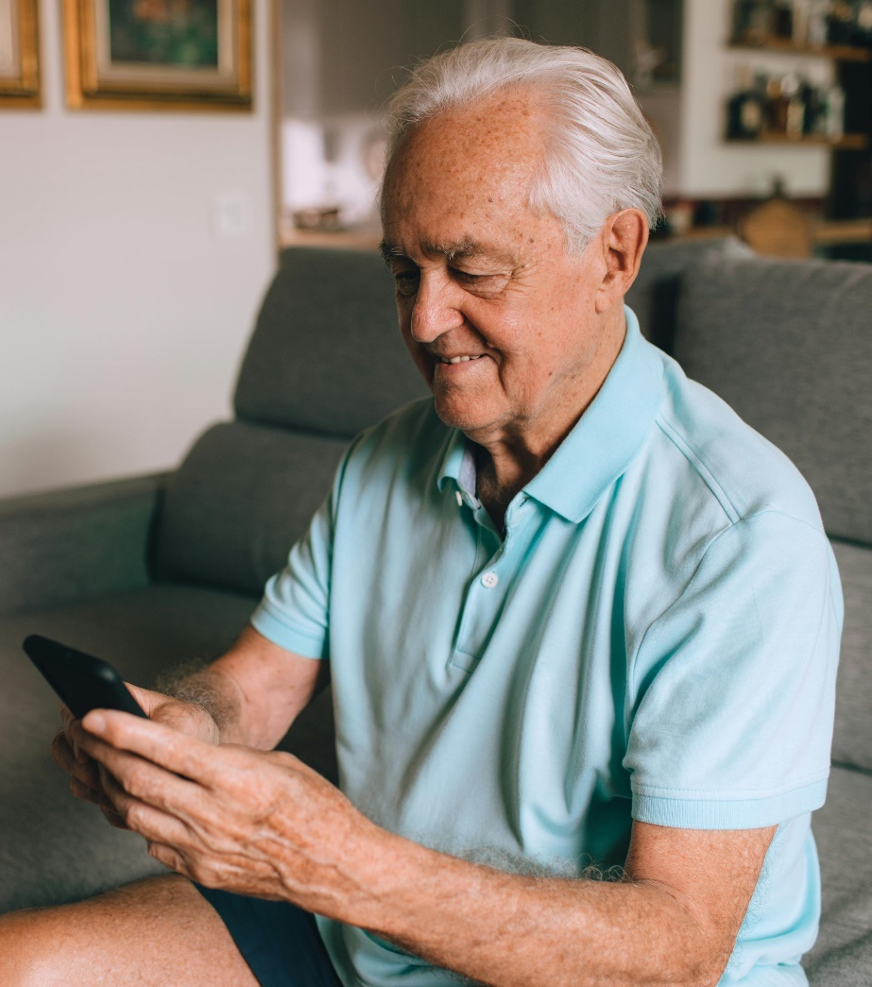
Self-assessment
Reflect on how you feel about digital technology: positively, negatively, or indifferent?
Keep in mind that your previous experiences influence your current attitude.
A positive attitude encourages proactivity and facilitates the adoption of new, useful habits.

Slide 10
Creating a healthy attitude towards digital technology
For a positive attitude
Maintain curiosity and a proactive approach.
Continue to educate yourself and seek new useful solutions offered by technology.
For a neutral attitude
Increase engagement.
Consider occasionally setting small goals in digital literacy to boost your confidence.
For a negative attitude.
Confronting fear
Try to accept the support offered (by loved ones or society).
Gradually overcome the fear of new technologies through education
A perspective from another angle
Try to view technology as a useful tool, rather than a source of stress or a threat to your security.

Slide 11
1. BASICS OF DIGITAL LITERACY
PERSONAL COMPUTER
PC
COMPUTER
Hardware and software
Hardware consists of all the electronic, electrical, and mechanical parts that make up a computer, i.e., everything we can physically touch
Software consists of all the programs that can run on a computer and enable the computer to operate

Slide 12
HARDWARE
PERSONAL COMPUTERS
The computer is designed to perform various tasks.
Two platforms: IBM standard and Apple standard
LAPTOPS
We have several types:
Laptop
Notebook
Tablet
Lightweight, portableThey have a battery

Slide 13
COMPUTER ELEMENTS
BASIC | INPUT | OUTPUT | INPUT/OUTPUT
computer case | Mouse | Monitor | Touchscreen
Mainboard | keyboard | printer | Multifunkcionalni Uređaji
Microprocessor | Scanner | speakers | fax scanner copier
Power supply | Sensory mat
hard disk drive (HDD) | game controller, Joystick
Memory | digital camera
Graphics card | microphone
Audio card | Web camera
 | bar code scanner

Slide 14
relationships between units of memory capacity
0 ili 1 | 1 bit | 1 bit | 1 b
8 bit | 1 bajt | 1 Byte | 1 B
1.024 B | 1 kilobayte | 1 Kilo Byte | 1 KB
1.024 KB | 1 megabayte | 1 Mega Byte | 1 MB
1.024 MB | 1 gigabayte | 1 Giga Byte | 1 GB
1.024 GB | 1 terabayte | 1 Tera Byte | 1 TB

Slide 15
Numbers and Parts
HDD Hard disk drive
From 500 GB to 10 + Terabaytes
An SSD (Solid State Drive) based on flash memory as a USB stick range from 128 GB to 2 TB
RAM (Random Access Memory) from 4 GB to 32 GB and more
CD 700 mb
DVD 4,7 GB
BLUE RAY
USB stick , cards from 1 –to 32 GB
Devices and media for permanent data storage
Portable HDD
Usb stick
CD DVD media

Slide 16
SOFTWARE
It consists of all the programs and data that are found on a computer or some external media.
We distinguish two basic types of software:
1) Operating software (WINDOWS, OSX , LINUX...)
2) User programs

Slide 17
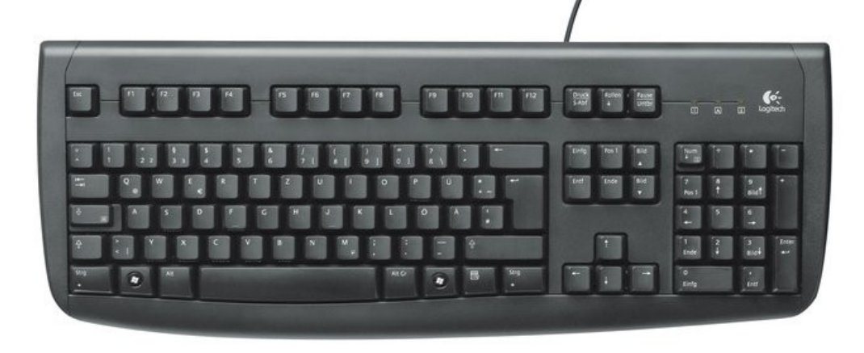
Keyboard
The keyboard is a standard, essential input device for a PC that allows the user to control the computer by transmitting commands and messages.
It usually has around 100 keys

Slide 18
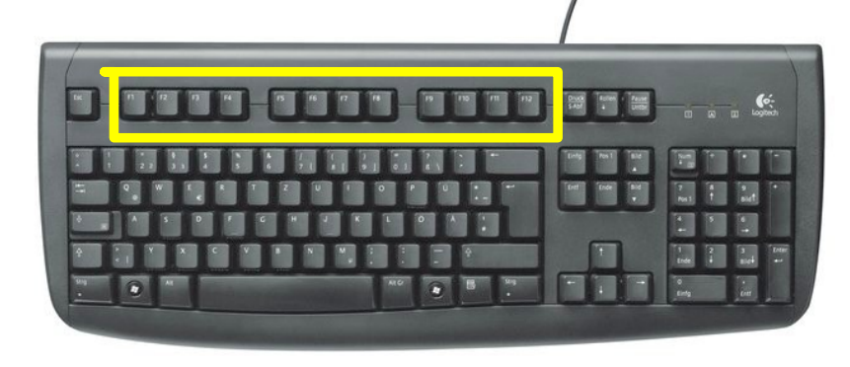
Function keys
Function keys are located at the top of the keyboard
They serve as switches for certain actions
F1 launches HELP
Individual programs can assign a function to each key

Slide 19
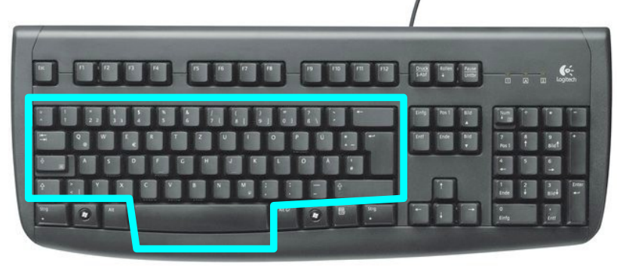
Alphanumeric section
A - Z, 0 - 9, Punctuation marks, special characters
Tab: Shift the insertion point to the right by several spaces
BackSpace: Delete the character to the left of the cursor
Caps Lock: Toggles the permanent activation of uppercase/lowercase letters,
Shift: Temporarily activates a) uppercase letters or b) the characters on the upper half of the numeric keys
Enter: Key for confirming input or sending a command to the computer for processing.,
Space bar: inserts a blank space

Slide 20
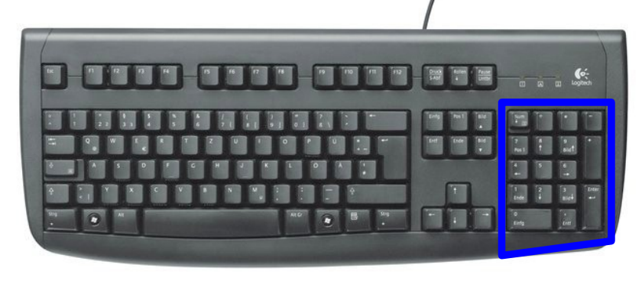
Numeric section
Separate part of the keyboard (typing only with the right hand): digits 0- 9
decimal point, addition(+), subtraction (-), multiplication (*), and division (/)
Enter: same function as Enter on the alphanumeric keyboard.

Slide 21
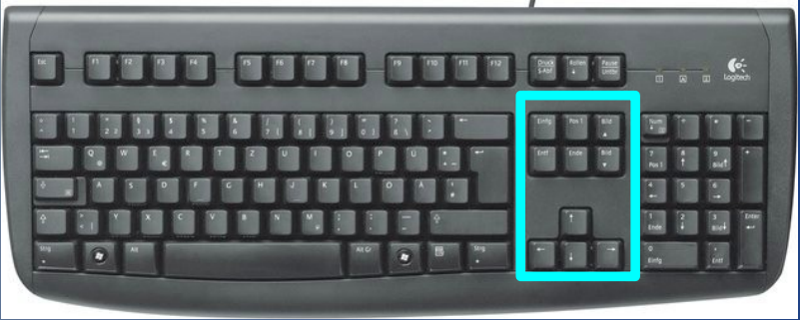
Arrow keys
Insert: Toggles the insertion of characters at the cursor's position
Delete: Deletes the character at the cursor's position.
Home: Positions the cursor in the top left corner of the screen
End: Positions the cursor in the bottom right corner of the screen

Slide 22
Arrow keys
PageUp: Scrolls the text backward by the size of the screen
PageDown: Scrolls the text forward by the size of the screen
Arrow keys ← ↑ ↓ → For moving the cursor in all directions
Cursor: a blinking indicator of the text input position

Slide 23
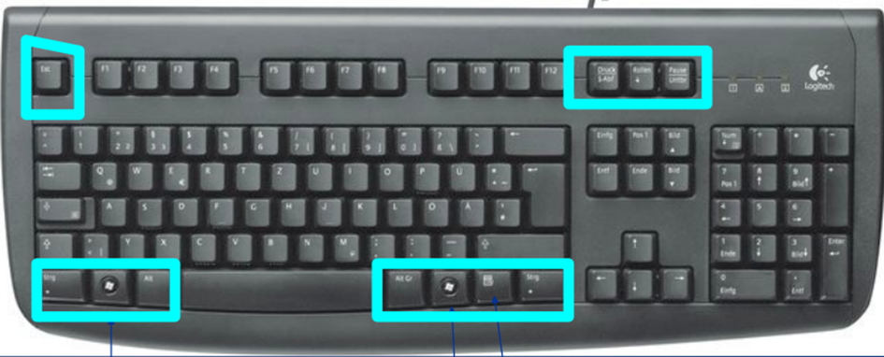
Special keys
Esc: Undo the last command or action (most commonly)
Ctrl i Alt: In combination with other keys, they expand their command capabilities
PrintScreen: Storing the entire image of the screen in the computer's memory (Clipboard)
Windows keys: Used only in the Windows operating system

Slide 24
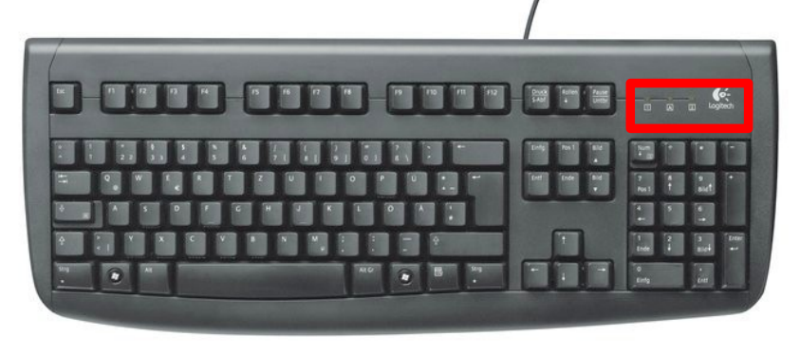
LED indicators
The illuminated LED diodes indicate the status of the toggle switches (whether any of them is turned on):
Caps Lock - uppercase letters
Num Lock - Numbers on the numeric keypad
Scroll Lock - Cursor switched to scroll mode

Slide 25
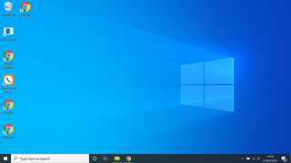
Launching programs, copying files, saving files
Programs can be launched in two ways:
1) From the Desktop

Slide 26
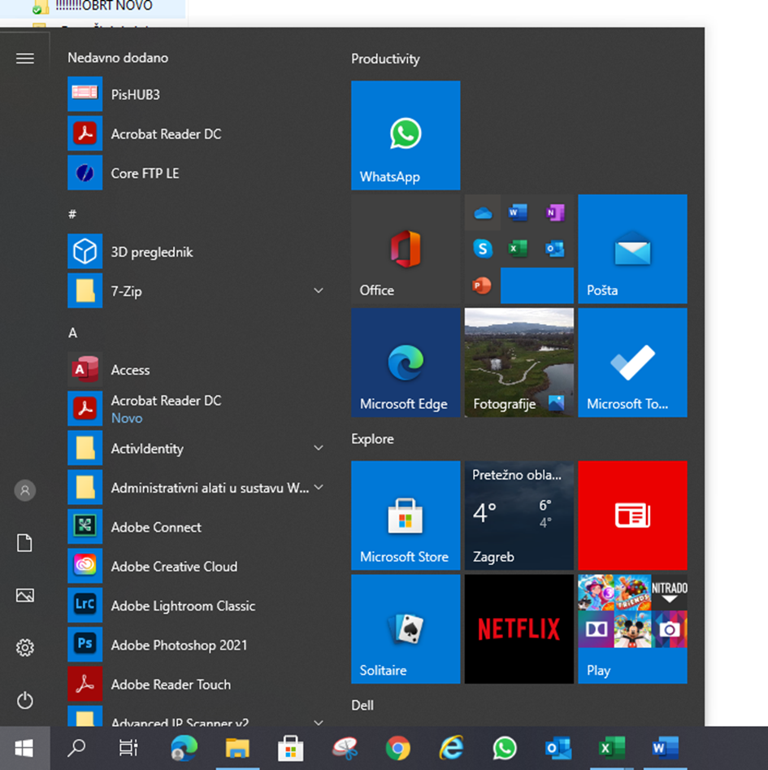
Launching programs, copying files, saving files
2) The second way is from the Start menu:

Slide 27
Parts of the START MENU
Programs pinned to the Start menu
User documents
Recently used programs
Computer management
All programs
Search area for files and programs
Shut down the computer, restart, and log into the user account

Slide 28

MOUSE
Left mouse click
1 CLICK - selection and command
2 CLICKS - command on the desktop and in Windows Explorer
Right click:
Context menu
Scroll wheel
Navigating through a document

Slide 29


Practice:
Participants, with the support of the mentor, demonstrate practical activities:
Turning devices on and off
Using the keyboard and mouse: basic functions, movements, clicks
Navigation through the operating system: desktop, opening and closing programs

Slide 30
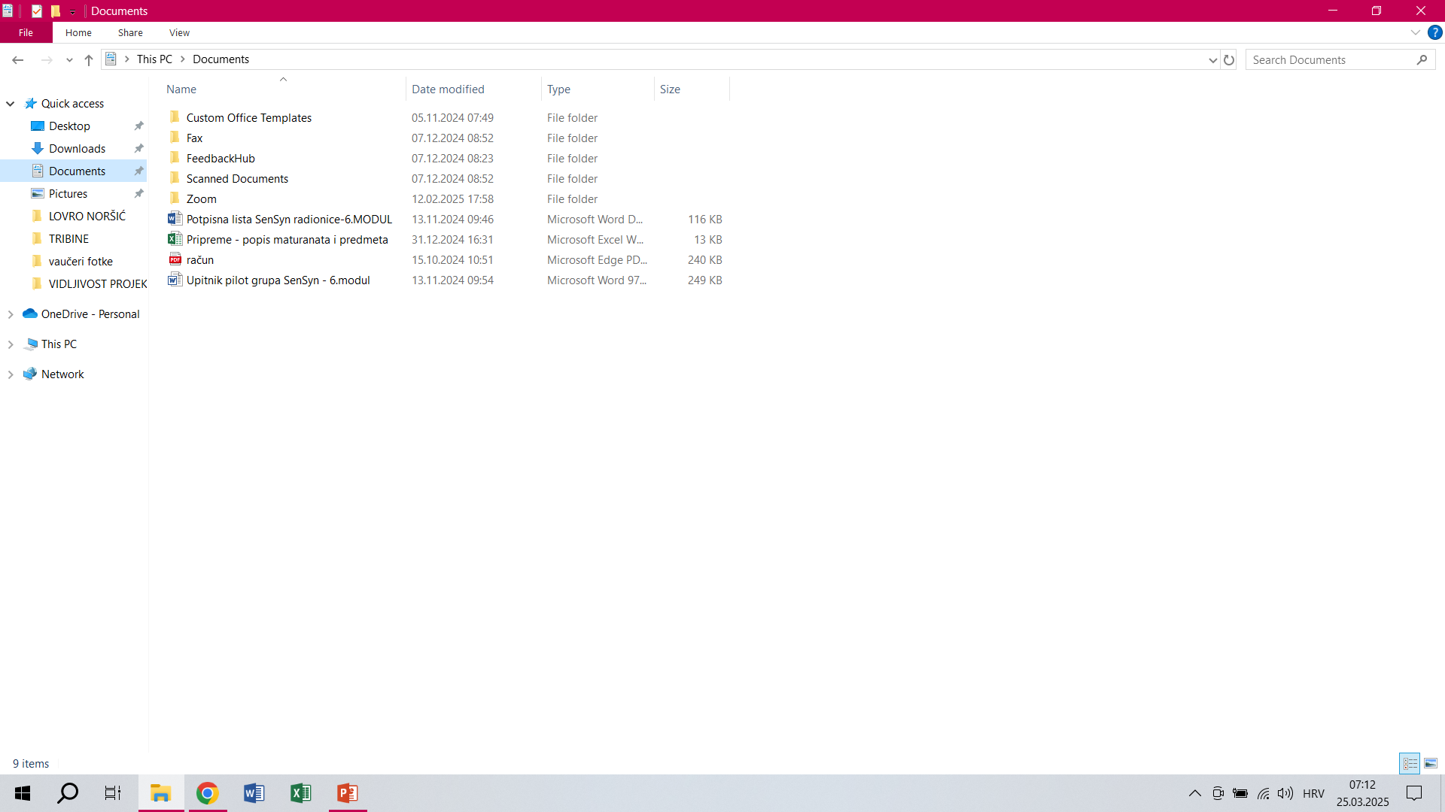
File and folder management in Windows (FILE) Explorer
The Parts of File Explorer

Slide 31


Practice
Each participant individually practices opening a folder on the desktop, renaming, and deleting a folder.
Partner practice for mutual support – participants are paired based on choosing Post-it notes of different colors (two of the same color form one pair).
In pairs, they repeat the same task.

Slide 32

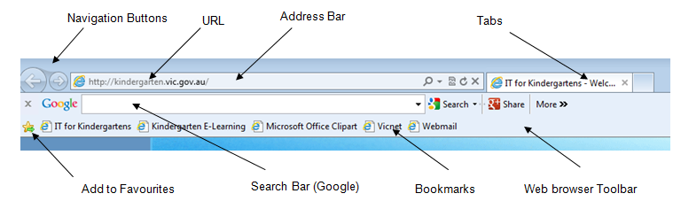
2. The Internet and using web browsers
  Chrome, Firefox, Safari... - web browsers used for browsing content:
Chrome web browser

Slide 33
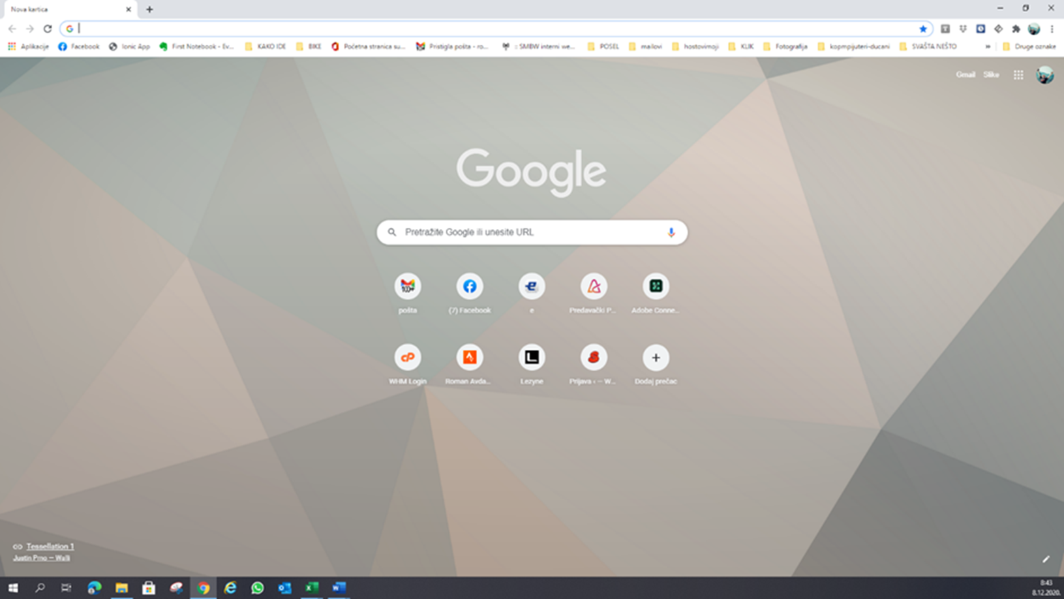
Tabs are used for viewing internet content separately - for example, in one tab we can browse the news, while in another we can check emails.
New tab

Slide 34
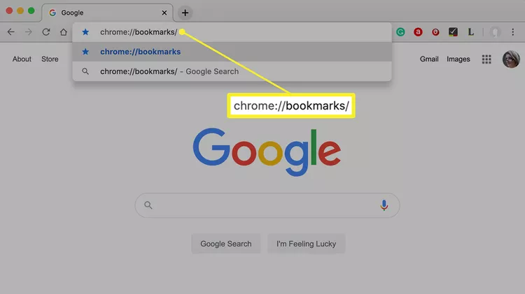
Bookmarks are created by grabbing the globe icon in front of the address of the open page with the mouse. That is, left-click the mouse, hold the click, drag it to the bookmarks bar, and release the left mouse button

Slide 35
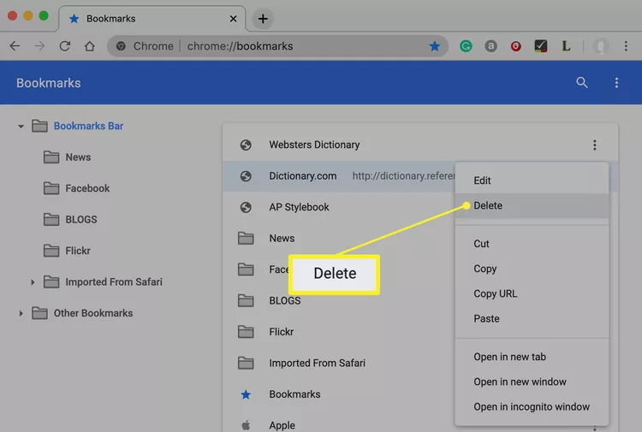
Deleting bookmarks is done by right-clicking on the bookmark to bring up the context menu:
And then we left-click on the delete command.

Slide 36

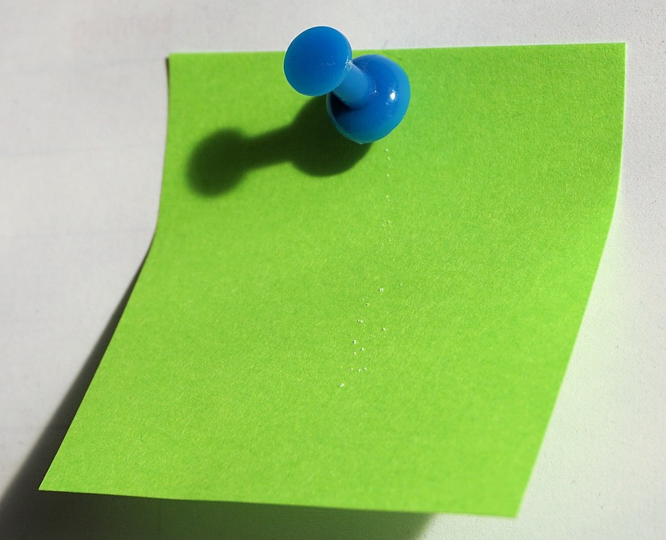
Practical part and evaluation
Participants practice a brief research on a chosen topic on the internet, recognizing key information and verifying sources.
Each participant writes on a Post-it note what they learned, what remains unclear, and what they would like to discuss in the next workshop.
The Post-it notes are used to enhance the preparation for the next workshop…

Slide 37


3. Using electronic mail (email)
Gmail:

Slide 38
Mail:
The easiest way to access this window is to type "Gmail" into the search bar, and when we get this window, we enter:
Your username:
For example: peter.parker, which is also the first part of your email, and here it is entered without @gmail.com.

Slide 39
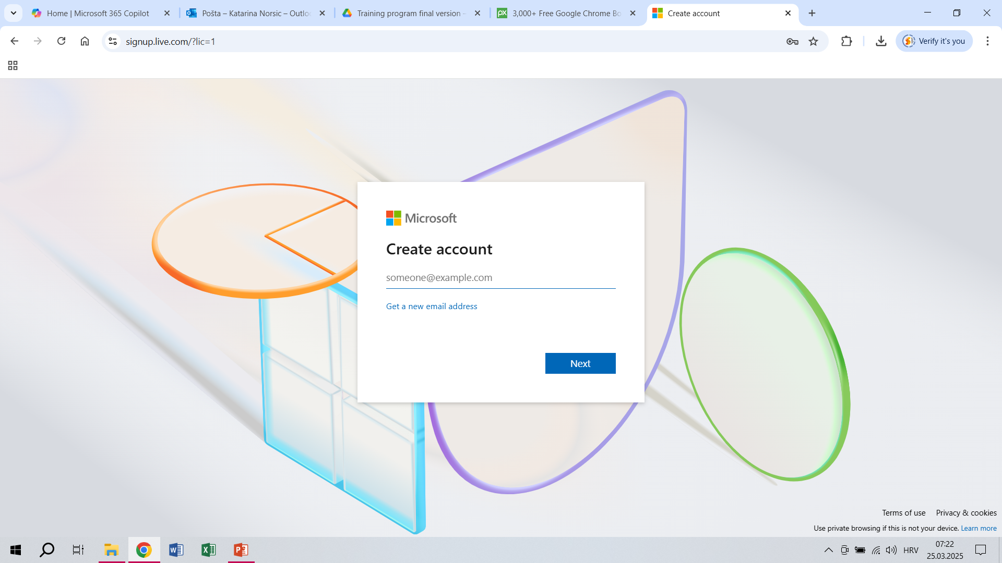
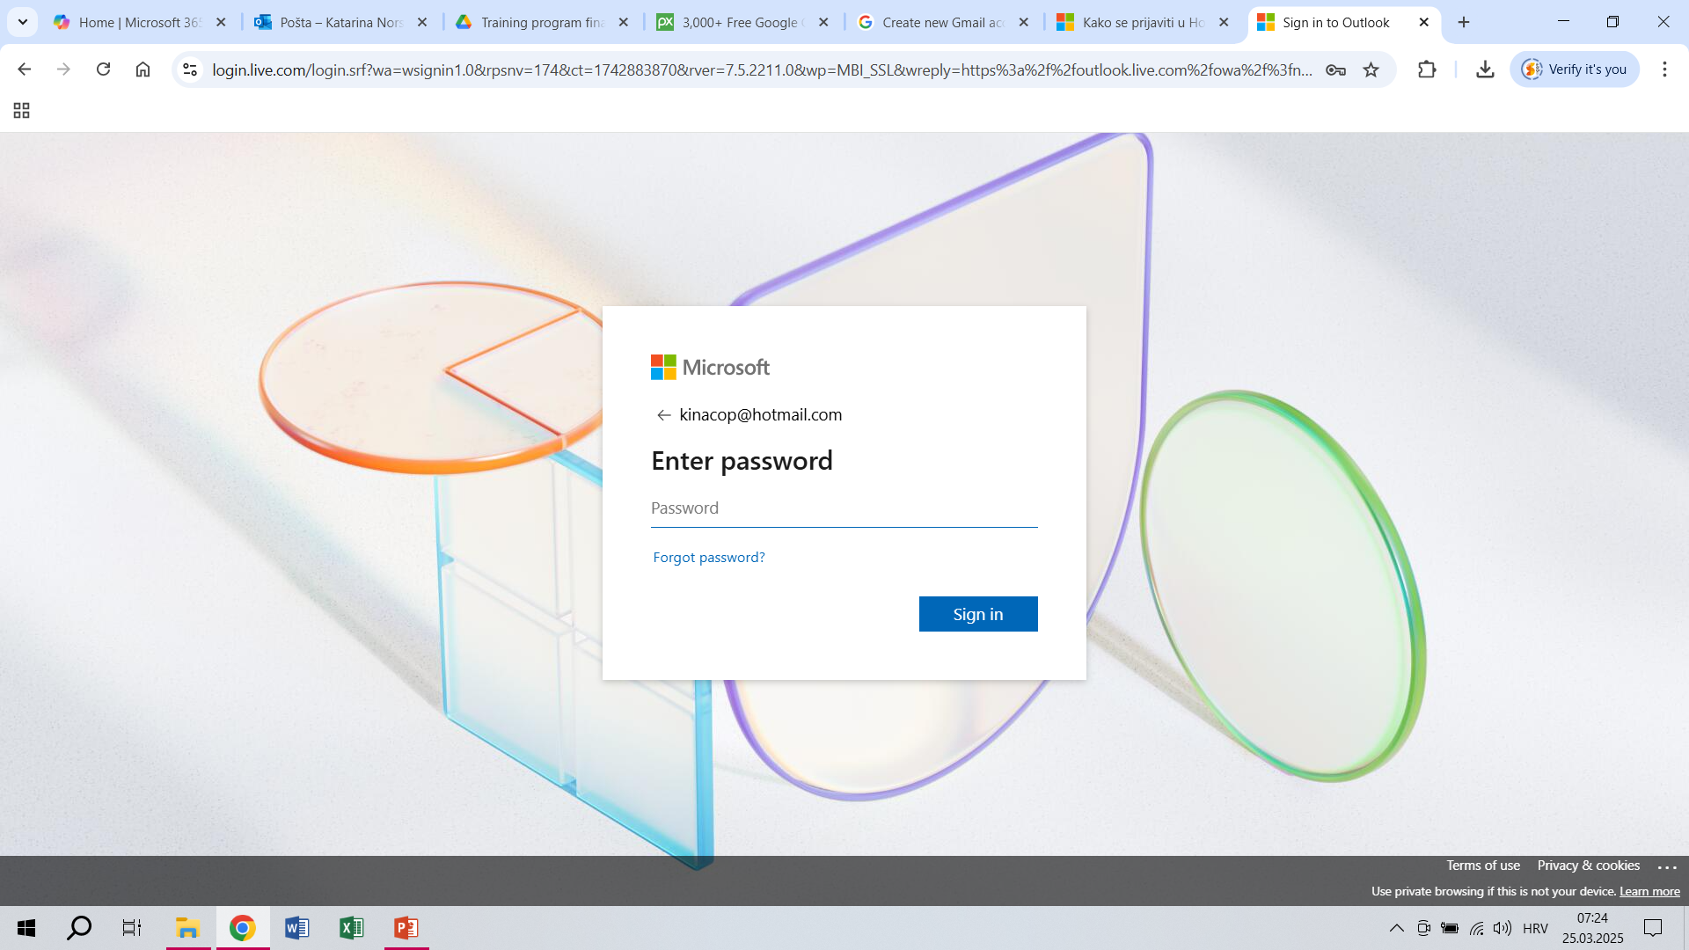
2. Pasword 🡪 the one you set when creating your Gmail account

Slide 40
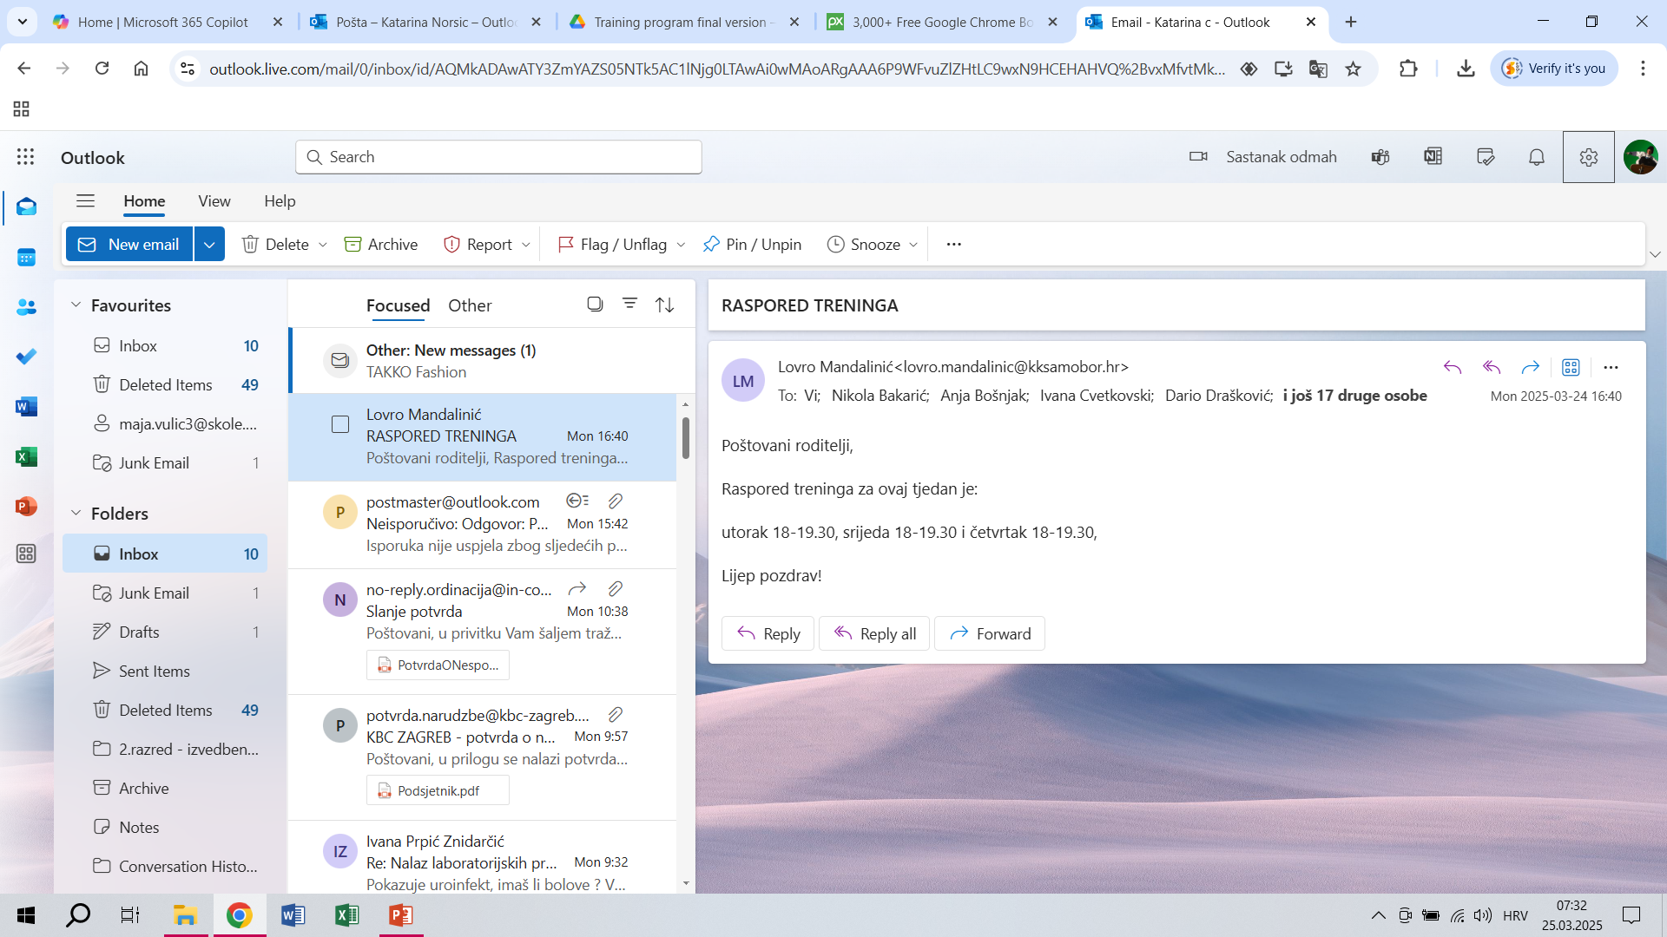
Using electronic mail (email):

Slide 41
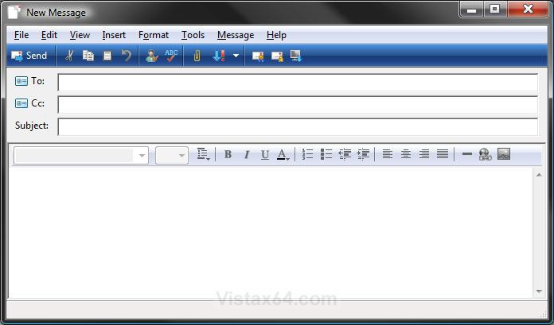
When we click on NEW MESSAGE, we get the following window:
Writing and sending a message:
Send button – click on it to send the message
Recipient field - the email address of the message recipient is entered in this field.
CC (Carbon Copy) is sent to a person for their information
BCC (Blind Carbon Copy) sends an email to recipients without revealing their addresses to others.
Field for adding a subject
Field for adding an attachment
Field for entering the message text

Slide 42

Practice
Through a brief internet search, participants learn about the most commonly used passwords on the internet over the past five years and what a strong password should contain.
With the mentor's support, they create an email account and practice sending and receiving messages independently and in pairs.
For practice, they send their research responses as an attachment via email to one of the participants.

Slide 43
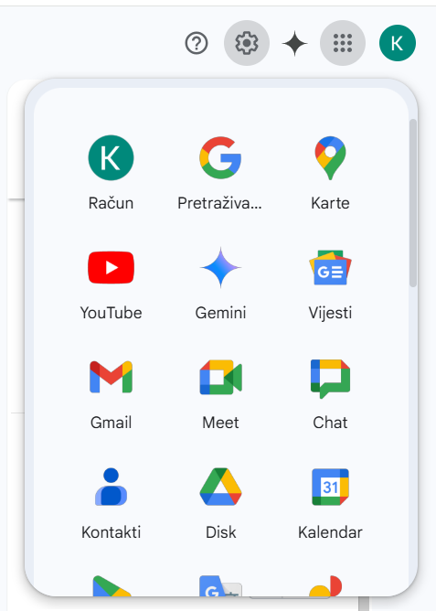
Calendar
As an additional service of Gmail, it helps us organize our time and set various reminders
Additional tools are opened here

Slide 44
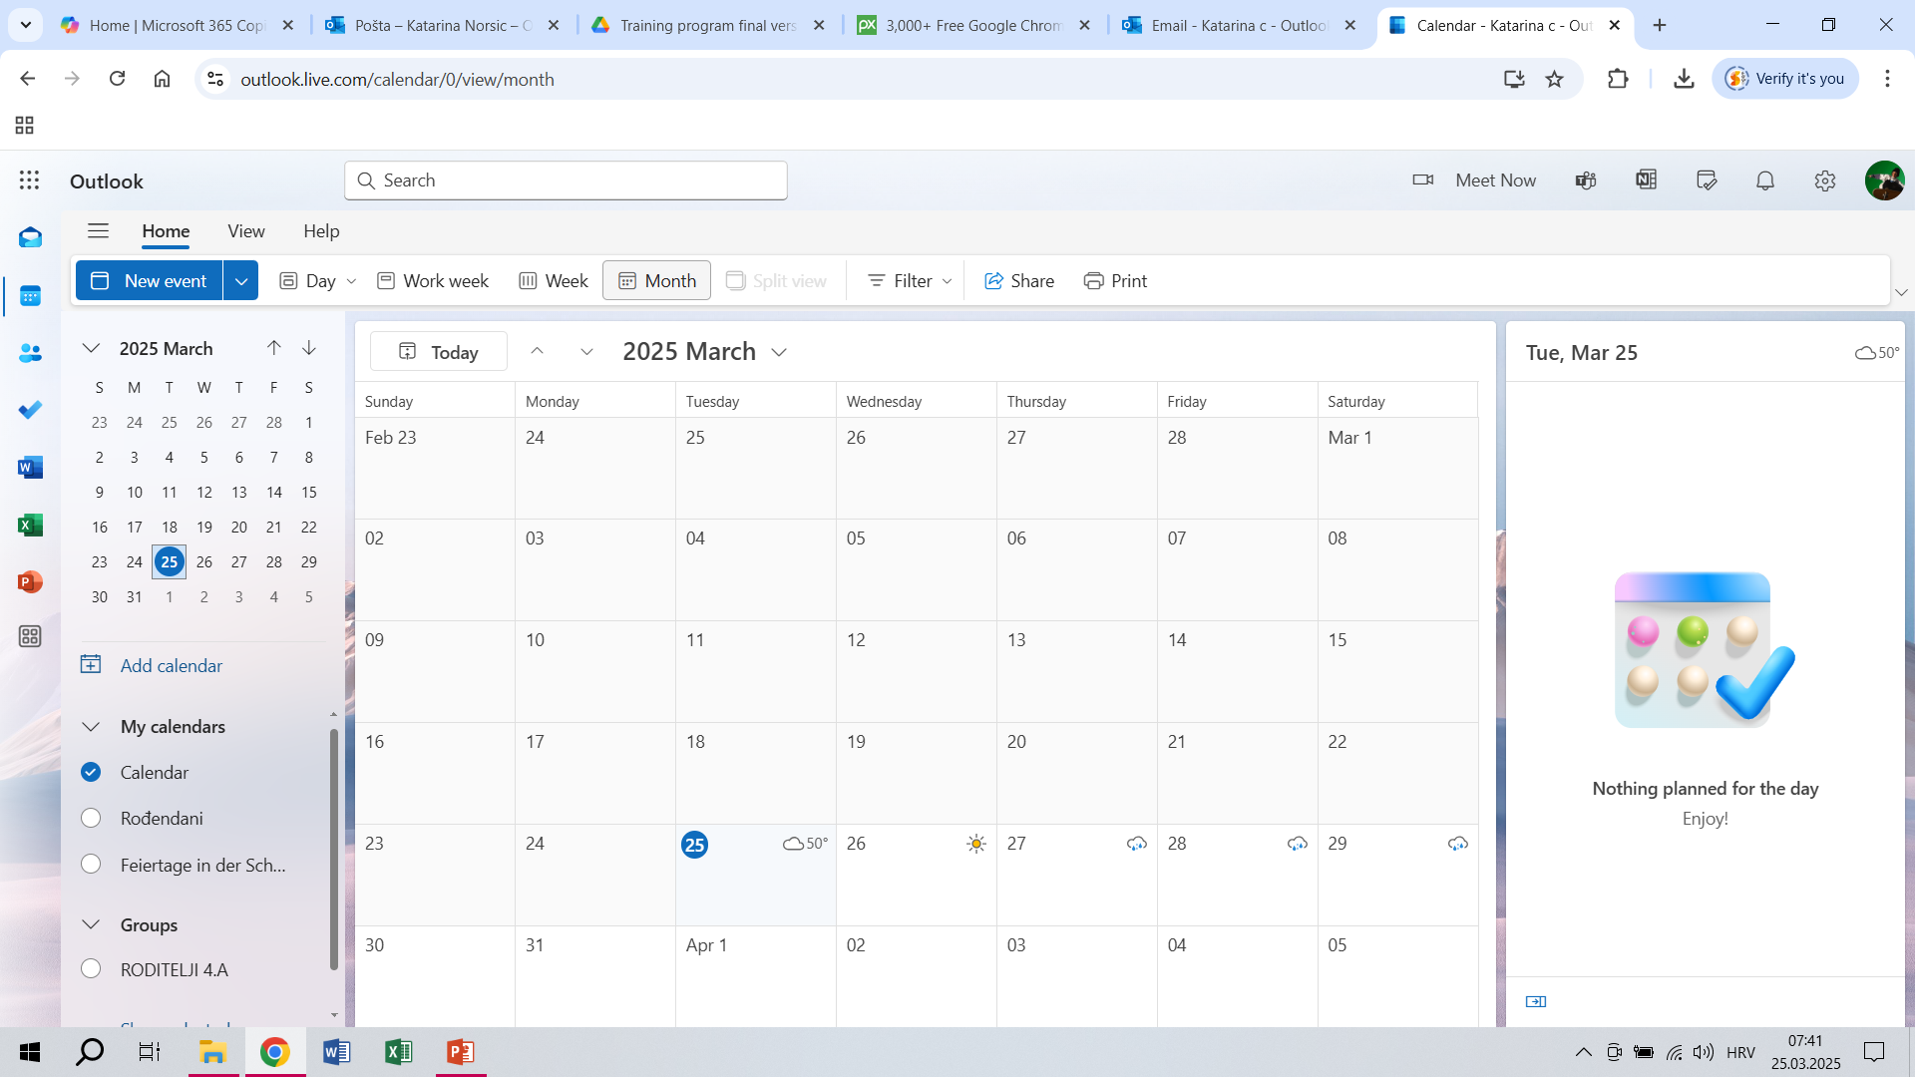

When we click on the Calendar button, we get the following window:

Slide 45

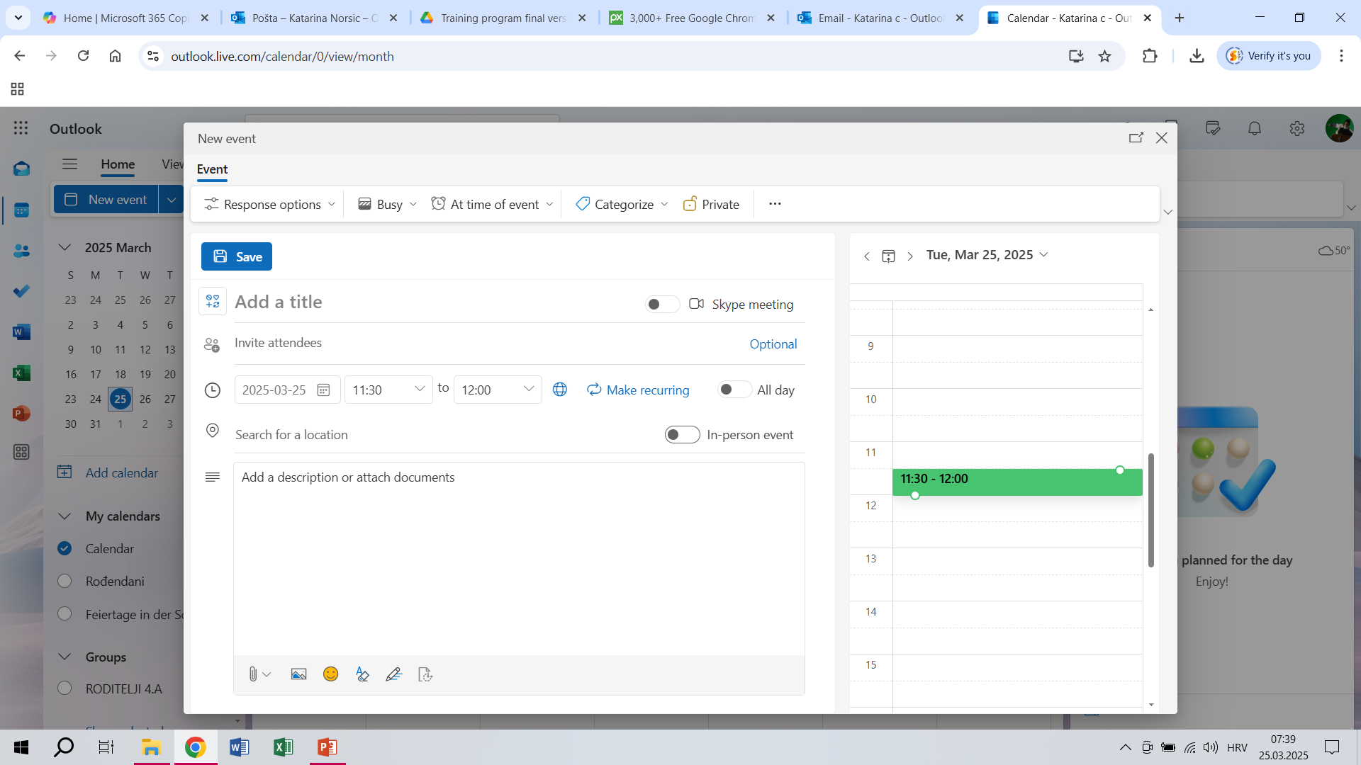

Exercise: with the Create Event button, the following window appears:
When you have created a new event, click Save!

Slide 46
CONTACTS
Open a new menu
contacts

Slide 47
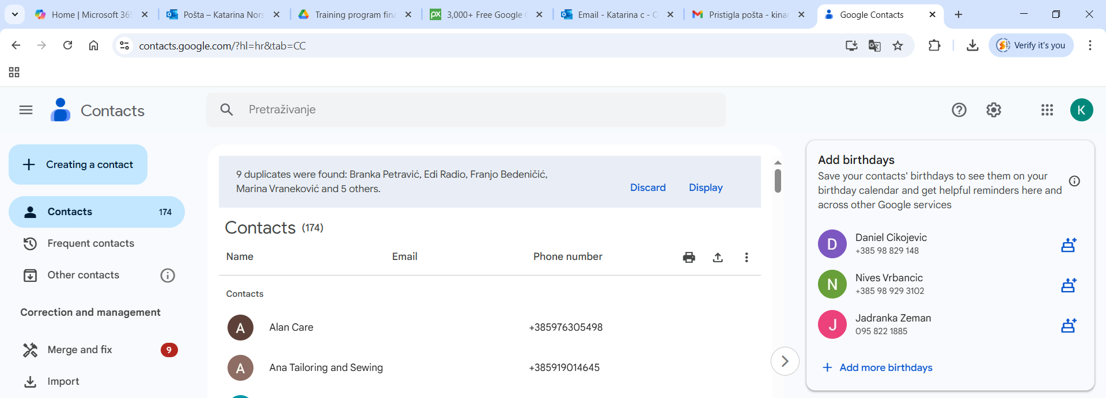
Creating a new contact

Slide 48
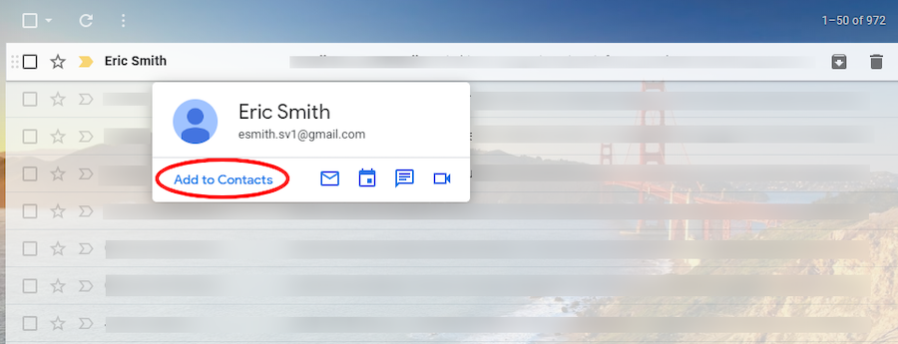
Adding a new contact

Slide 49
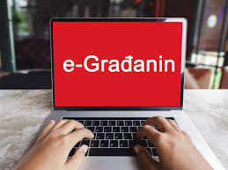
4. Accessing the e-Citizen profile and using online banking services
possibilities of digital health services
e-prescriptions
online consultations
online registration for a health examination.
method of accessing the e-Citizen profile.
What are the advantages of digital services?
E - citizen
Discussion

Slide 50
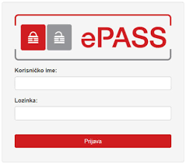

Practice
Simulation of access to health and other services that can be accessed through the e-Citizen profile
User name
password

Slide 51
Bill payment: going to the post office/bank or online banking?
Traditional methods: visiting the bank or post office
Modern Methods: Internet Banking, Mobile Banking (Apps)
Advantages 🡨🡪 Disadvantages

Slide 52
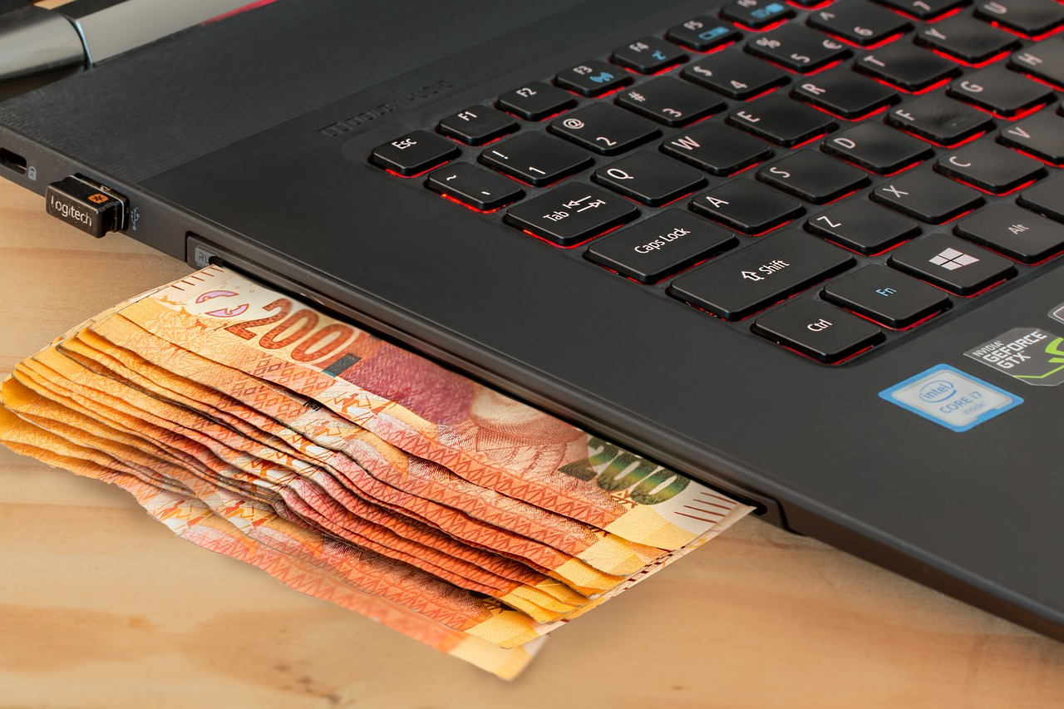
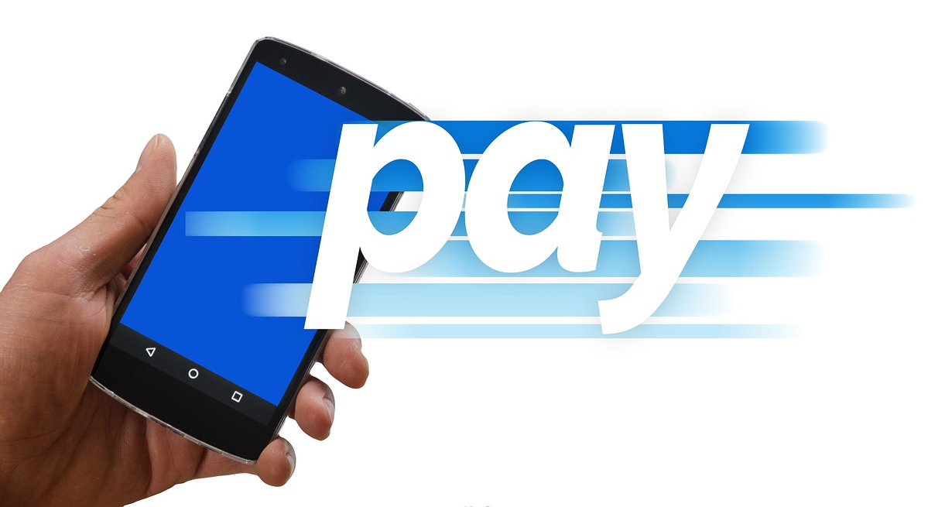
Practice
Simulation of using online banking for checking account balance, paying bills, and transferring money

Slide 53
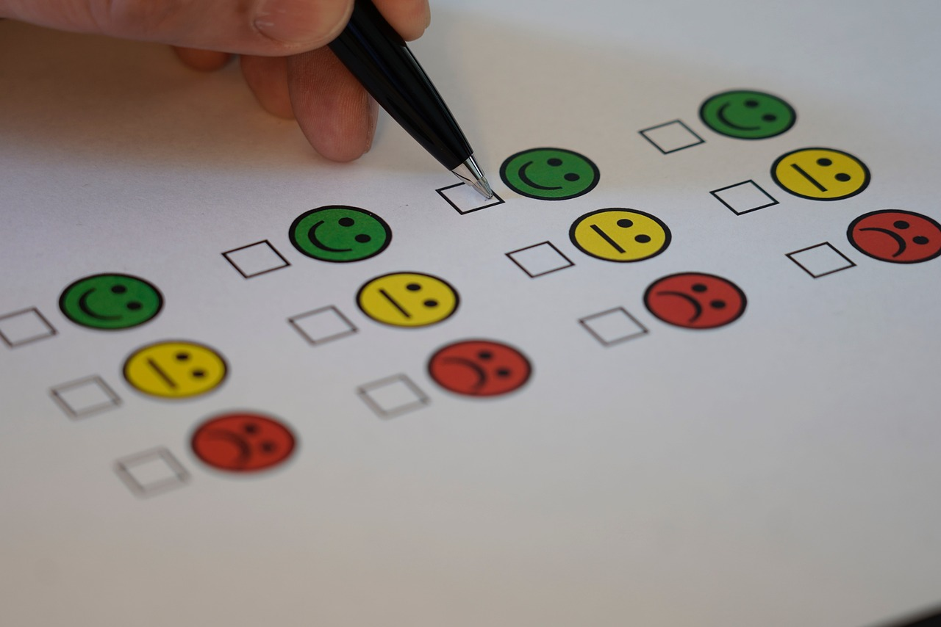
Conclusion and Evaluation:
• distribution of evaluation questionnaires
participants express their satisfaction with the workshop content and the teaching methods

Slide 54



Thank you for your attantion!

Slide 55
Sources and references
Digitalna uključenost, povezanost i pismenost starijih osoba: https://hrcak.srce.hr/file/464616
Programi digitalne i medijske pismenosti za osobe starije životne dobi u narodnim knjižnicama:
https://www.ekovjesnik.hr/clanak/6194/osnazivanje-starijih-osoba-i-ranjivih-skupina-za-digitalni-svijet
https://www.mirovina.hr/novosti/startao-e-umirovljenik-digitalna-pismenost-nije-rezervirana-samo-za-mlade/

