Slide 1
SenSyn - Senior Synergy: Empowering Lifelong Learning and Healthy living through Community Events

Slide 2
MODULE 3: HEALTHY FOOD AND COOKING
Learning as a way of life - Asking and Encouraging

Slide 3
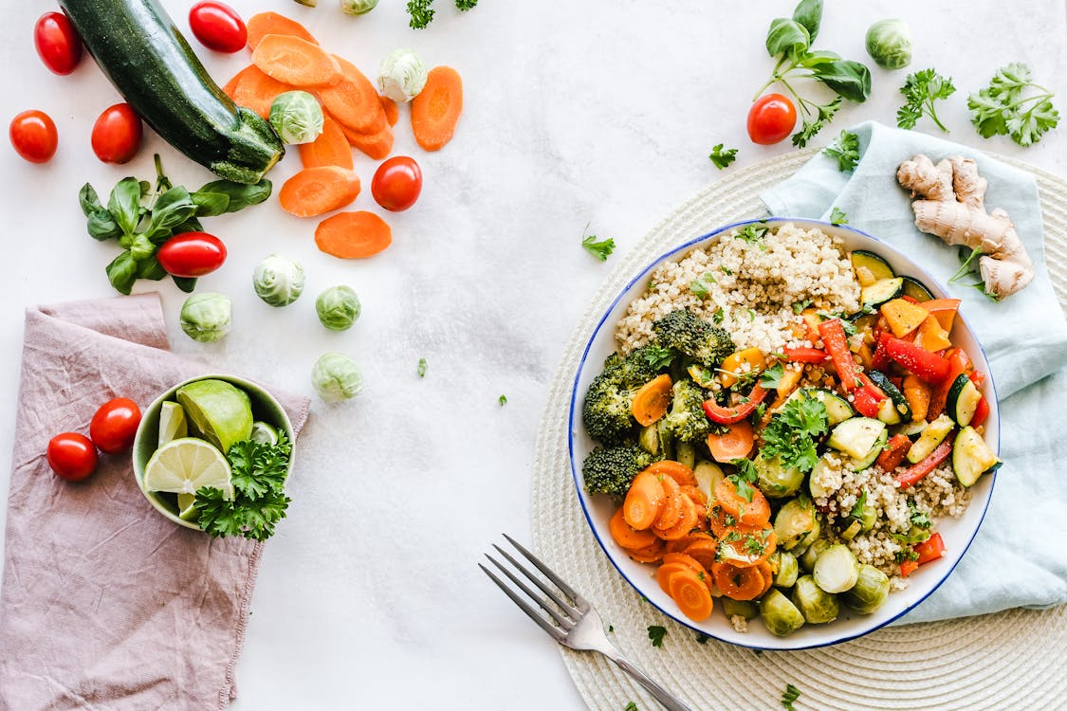
Healthy and Balanced Diet for Seniors

Slide 4
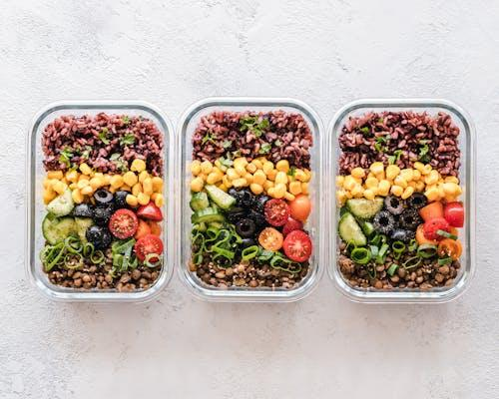
Healthy and Balanced Diet for Seniors
Why Diet Matters as We Age As we grow older, our bodies go through many changes. Metabolism slows down, muscle mass decreases, and the immune system weakens. A balanced diet can:
Boost energy levels
Improve cognitive function and memory
Strengthen the immune system
Reduce the risk of chronic diseases like diabetes, heart disease, and high cholesterol
Enhance longevity and overall quality of life

Slide 5
The Power of Small Changes
A healthy diet doesn’t have to mean a complete overhaul of current eating habits.
Small, gradual changes—like eating more vegetables or choosing whole grains—can greatly impact health.
Ta fotografija korisnika Nepoznat autor: licenca CC BY-SA-NC
Notes:
Encourage participants by saying, “It’s never too late to start improving your diet.
Engagement Prompt: Ask participants, “What does healthy eating mean to you?” This helps gauge their current knowledge and any concerns they may have.

Slide 6
The Goal
By the end of this session, you will have a clear understanding of:
The fundamentals of a balanced diet for seniors
Key nutrients important for your health
Practical tips for managing diabetes, cholesterol, and maintaining a healthy lifestyle
The benefits of Mediterranean cuisine
A simple, affordable 5-day menu you can try at home
This session is about making healthy eating affordable, accessible, and enjoyable.
Notes:
Encourage participants by saying, “It’s never too late to start improving your diet.
Engagement Prompt: Ask participants, “What does healthy eating mean to you?” This helps gauge their current knowledge and any concerns they may have.

Slide 7
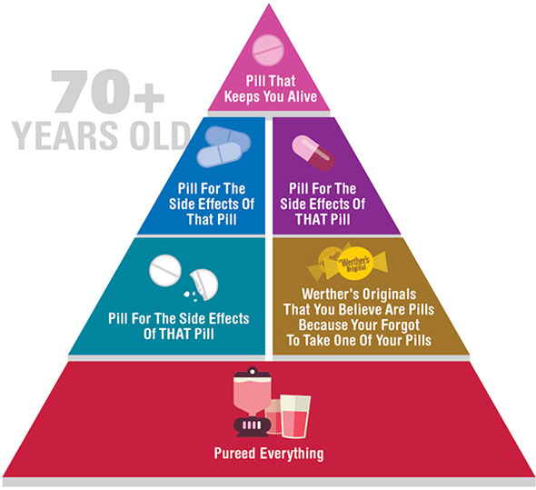
The Food Pyramid
Notes:
Note for the lecturer: The first illustration is meant as an icebreaker. Use it if you feel it's appropriate for a humor break. You can delete this slide if deemed inappropriate

Slide 8
The Senior-Friendly Food Pyramid
The food pyramid has been adapted for seniors to reflect changing nutritional needs. Key points include:
Bottom of the pyramid: Water—hydration is vital. Seniors should aim for about 6–8 glasses of water daily.
Next level: Fruits and vegetables—Aim for a variety of colors, which provide a mix of essential vitamins, minerals, and antioxidants.
Next level: Whole grains—Focus on whole grains such as oats, brown rice, and whole wheat bread, which help maintain energy and provide fiber for digestion.
Top levels: Protein and fats—Include lean sources of protein like chicken, fish, beans, and nuts. Healthy fats like olive oil are important, but moderation is key.

Slide 9
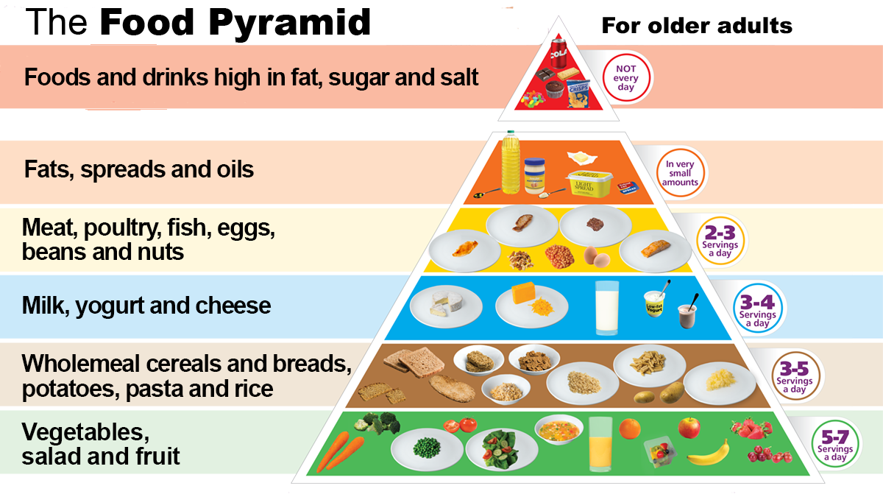
Notes:
Engagement Prompt: Does anyone here already follow a food pyramid or portioning system? Encourage a brief discussion on current meal routines and habits.

Slide 10
Why Hydration is Essential?
As we age, our sense of thirst diminishes, meaning seniors often drink less water without realizing it.
However, proper hydration is essential for:
Brain function: Staying hydrated helps maintain cognitive clarity and prevent confusion.
Energy levels: Dehydration can cause fatigue and weakness.
Digestion: Drinking water helps prevent constipation, a common issue in seniors.
Temperature regulation: Seniors are more prone to overheating and dehydration, especially in warm weather.

Slide 11
Signs of Dehydration
Symptoms to watch out for include:
Dry mouth or lips
Dizziness or confusion
Fatigue or weakness
Dark yellow urine
If any of these symptoms appear, it’s important to increase water intake right away.

Slide 12
Tips to drink more water
Drink water between meals, instead of with meals, as drinking water while eating can dilute stomach acids, potentially interfering with digestion.
Flavor it up: Add lemon slices, cucumber, or berries to make water more enjoyable.
Carry a water bottle: A simple habit like carrying a bottle ensures you’re never without water.
Herbal teas or broth: These can also contribute to your daily water intake if plain water isn’t appealing.
Notes:
Engagement Prompt: “How do you remind yourself to drink water? Do you notice a difference in your energy or health when you drink more?”

Slide 13
Affordable eating: Healthy doesn’t mean expensive
Common Misconception: Healthy Eating is Expensive
Many people believe that eating healthy requires purchasing expensive organic products or fancy superfoods. However, some of the most nutritious and affordable foods are simple, everyday items that can be found in any grocery store.
Whole grains: Oats, brown rice, barley—rich in fiber and affordable.
Legumes: Lentils, beans (dried or canned)—high in protein and fiber.
Vegetables: Carrots, cabbage, zucchini, spinach—especially when purchased seasonally.
Proteins: Eggs, canned tuna, beans, lentils, and lean chicken.

Slide 14
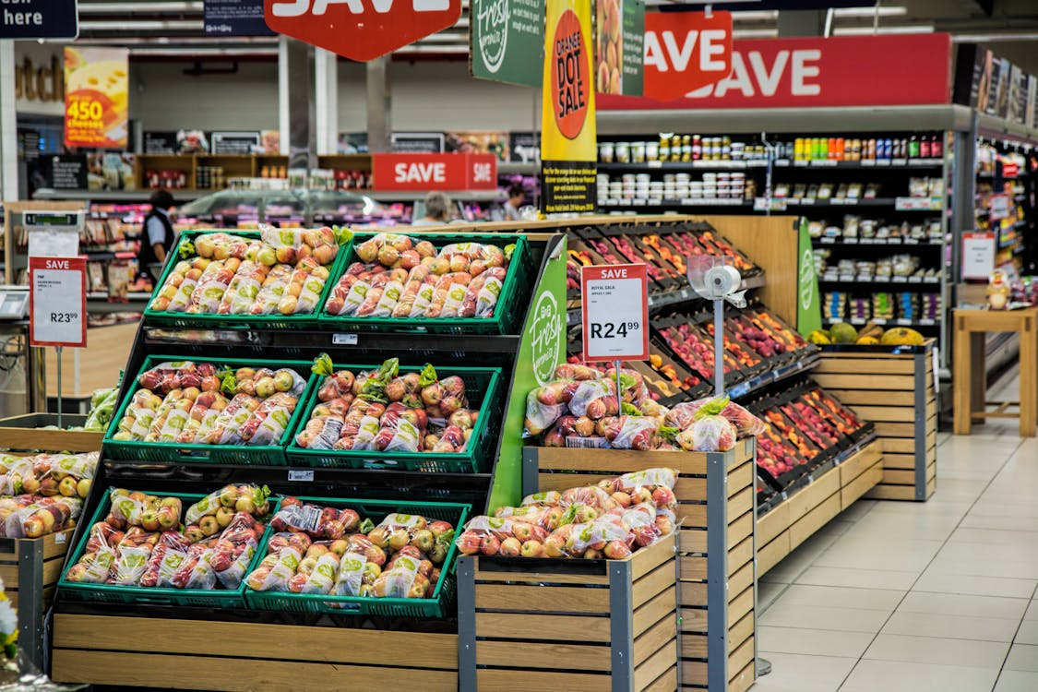
Smart Shopping Tips
Buy in season: Seasonal produce is often cheaper and fresher. Focus on what’s in season to save money.
Frozen vegetables: Just as nutritious as fresh vegetables and often more affordable. Plus, they don’t spoil quickly.
Bulk purchases: Items like rice, oats, beans, and lentils can be bought in bulk and stored for a long time.
Plan meals ahead: Creating a meal plan helps avoid impulse buys and ensures you use everything you purchase.
Notes:
Engagement Prompt: “Do you have any tips for saving money while shopping for groceries? What affordable meals do you make at home?”

Slide 15
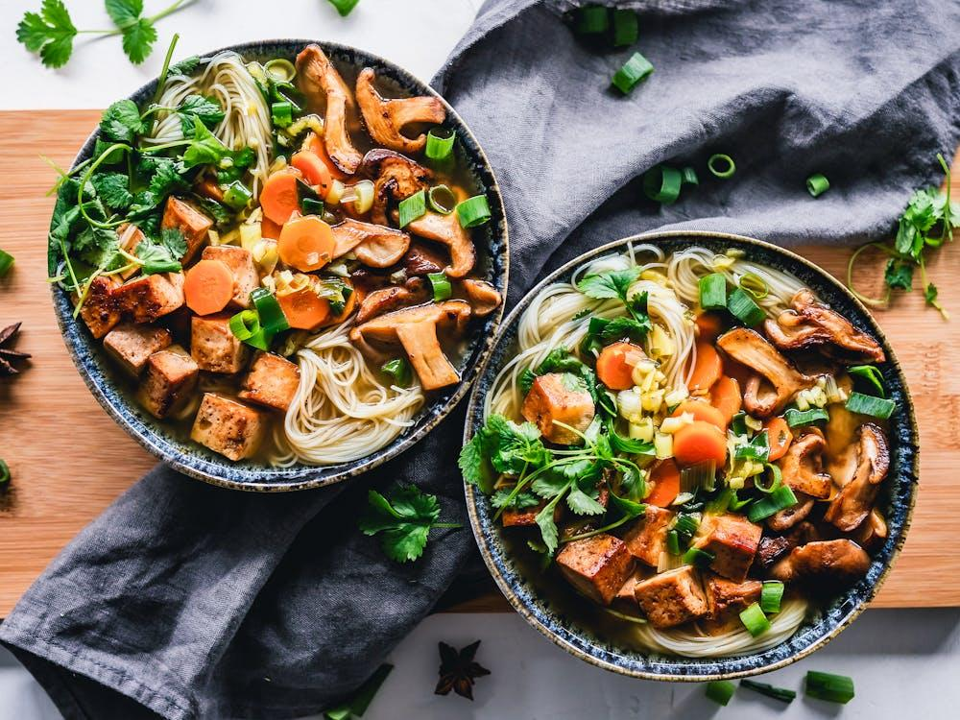
Simple, Affordable Meals
Oatmeal with fruits: A cheap, filling breakfast packed with fiber and nutrients.
Lentil soup: Easy to make, filling, and packed with protein and fiber. It’s a great option for managing diabetes and cholesterol.
Egg and vegetable stir-fry: Eggs are a cheap source of protein, and vegetables provide essential nutrients.

Slide 16
Foods for Managing Diabetes
Diabetes-Friendly Foods Managing blood sugar is essential for people with diabetes, and the right foods can help:
Low-Glycemic Index (GI) Foods: Foods that don’t spike blood sugar include whole grains (like oats and brown rice), legumes, and non-starchy vegetables (like broccoli, spinach, and peppers).
Healthy Fats: Foods like olive oil, avocados, nuts, and seeds can help control blood sugar and provide heart-healthy fats.
High-Fiber Foods: Fiber slows the absorption of sugar into the bloodstream, which helps maintain stable blood sugar levels. Foods like lentils, beans, and whole grains are great choices.

Slide 17
Cholesterol Management
High Cholesterol can lead to heart disease, but incorporating certain foods into your diet can help manage cholesterol levels:
Soluble Fiber: Found in oats, barley, beans, and fruits like apples and pears. Soluble fiber binds to cholesterol in the digestive system and helps remove it from the body.
Omega-3 Fatty Acids: Found in fatty fish (like salmon, sardines, and mackerel) and flaxseeds, omega-3s reduce the risk of heart disease and lower LDL cholesterol (the "bad" cholesterol).
Plant-Based Proteins: Beans, lentils, and tofu are excellent substitutes for red meat, which is high in saturated fats and can raise cholesterol.
Notes:
Engagement Prompt: “What foods do you currently eat to help manage your cholesterol? Have you noticed any positive changes?”

Slide 18
Portion control and meal timing
Portion sizes are crucial for managing both diabetes and cholesterol.
Eating smaller, more frequent meals can help maintain blood sugar levels and reduce cholesterol absorption.
Balanced Meals: Each meal should include a healthy balance of protein, whole grains, and vegetables.
For example, a lunch of grilled chicken, quinoa, and steamed broccoli is balanced, filling, and heart-healthy.
Notes:
Engagement Prompt: “What foods do you currently eat to help manage your cholesterol? Have you noticed any positive changes?”

Slide 19
Foods to limit or avoid
Refined sugars: Avoid sugary drinks, white bread, and pastries, which can spike blood sugar and contribute to high cholesterol.
Processed foods: Foods high in trans fats, like fried foods, snack cakes, and processed meats, can raise cholesterol levels and harm heart health.
Notes:
Engagement Prompt: “What foods do you currently eat to help manage your cholesterol? Have you noticed any positive changes?”

Slide 20
Food for Brain: Enhancing Cognitive Function
The Connection Between Diet and Brain Health Research has shown that what we eat can significantly affect our brain function, memory, and overall cognitive health. As we age, protecting brain health becomes even more crucial to maintain mental sharpness and reduce the risk of conditions like dementia and Alzheimer’s disease.
Notes:
Engagement Prompt: “What foods do you currently eat to help manage your cholesterol? Have you noticed any positive changes?”

Slide 21
Key Brain-Boosting Nutrients
Omega-3 Fatty Acids: Essential for maintaining the structure of brain cells and reducing inflammation, which is linked to cognitive decline.
Sources: Fatty fish (salmon, mackerel, sardines), flaxseeds, chia seeds, walnuts
Antioxidants: Help protect the brain from oxidative stress, which can damage brain cells
Sources: Berries (blueberries, strawberries), dark chocolate, spinach, kale
Vitamin E: Linked to better cognitive performance, this powerful antioxidant helps protect neurons.
Sources: Nuts (almonds, hazelnuts), sunflower seeds, avocado
B Vitamins (especially B6, B12, and Folate): Important for preventing brain shrinkage and supporting mental clarity and memory.
Sources: Leafy greens, eggs, fish, fortified cereals
Flavonoids: Found in certain plant foods, these compounds improve blood flow to the brain and may enhance memory.
Sources: Dark chocolate, citrus fruits, berries, tea (especially green tea)
Notes:
Engagement Prompt: “What foods do you currently eat to help manage your cholesterol? Have you noticed any positive changes?”

Slide 22
Foods to Support Memory and Learning
Leafy Greens: Spinach, kale, and broccoli are high in antioxidants and Vitamin K, which is linked to memory and cognitive health.
Berries: Blueberries and strawberries contain anthocyanins, which have been shown to improve memory and reduce cognitive decline.
Whole Grains: Brown rice, oats, and whole wheat bread provide a steady supply of energy to the brain, supporting concentration and focus.
Notes:
Engagement Prompt: “What foods do you currently eat to help manage your cholesterol? Have you noticed any positive changes?”

Slide 23
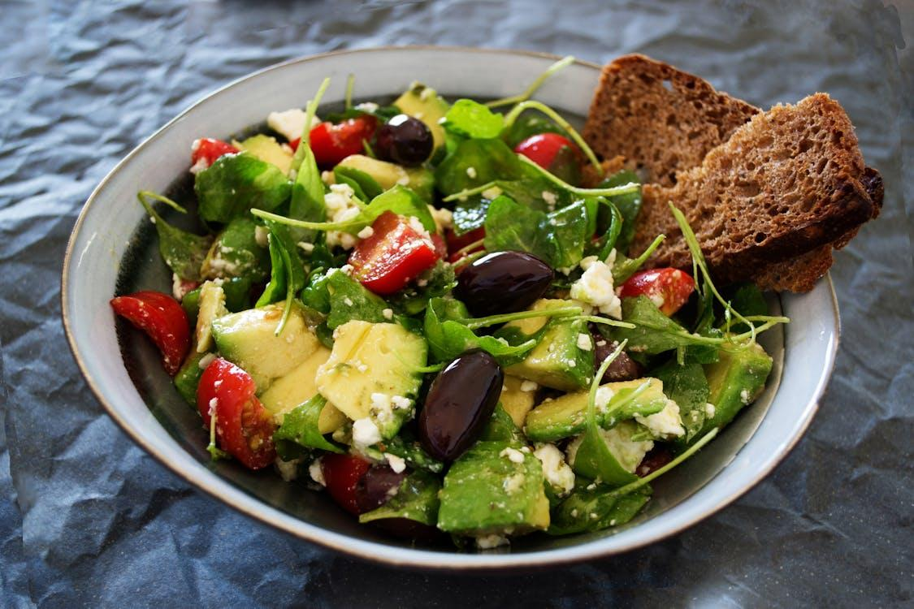
DASH and Mediterranean Diets for Cognitive Health
Both the DASH diet (Dietary Approaches to Stop Hypertension) and the Mediterranean diet are proven to support brain health
DASH diet: Low in salt, it helps reduce blood pressure and improve brain function.
Mediterranean diet: Rich in vegetables, fish, and healthy fats, this diet has been linked to slower cognitive decline and lower rates of Alzheimer’s disease.
What is the Mediterranean Diet?
The Mediterranean diet is based on the traditional eating habits of countries bordering the Mediterranean Sea, such as Croatia, Greece, Italy, and Spain.
This diet is celebrated for its health benefits, including its ability to improve heart health, support weight control, and promote longevity.
Notes:
Engagement Prompt: “What foods do you notice help you stay sharp and focused? Do you feel a difference in your mental clarity when you eat certain foods?”

Slide 24
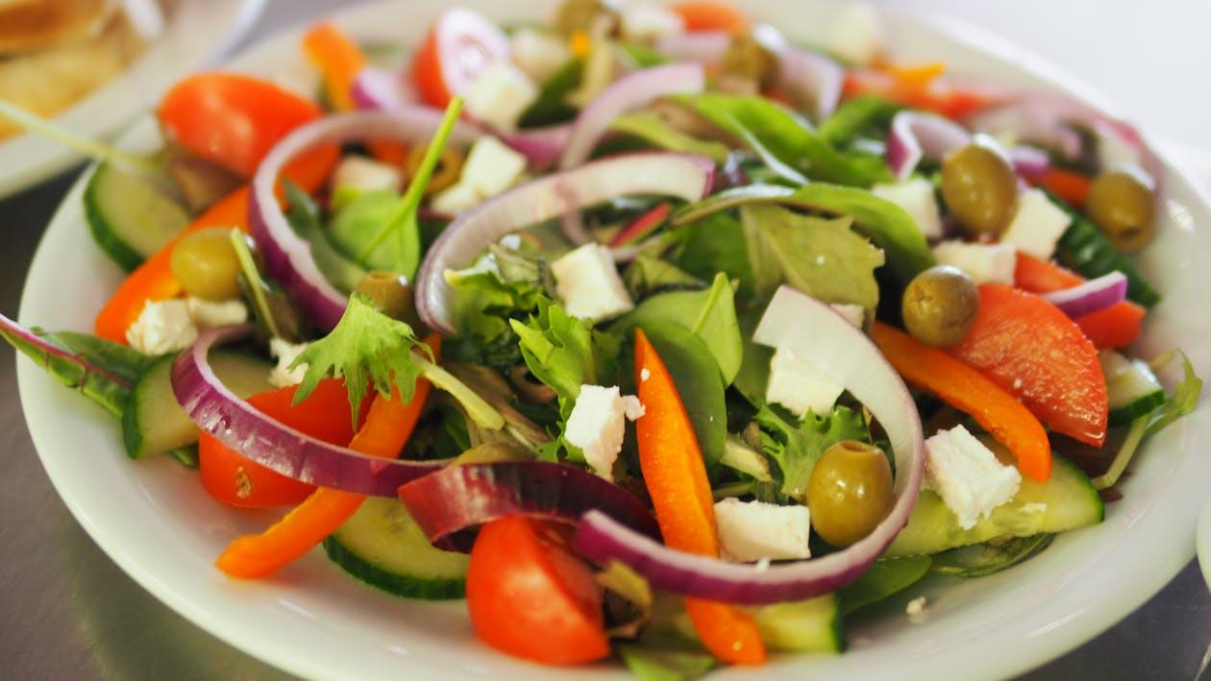
The Mediterranean Diet Core Elements:
Fruits and Vegetables: High intake of colorful vegetables and fruits.
Whole Grains: Whole wheat, oats, barley, and other grains.
Healthy Fats: Olive oil is the primary source of fat, rich in heart-healthy monounsaturated fats.
Lean Protein: Focus on fish, poultry, and plant-based proteins like beans and lentils. Limited red meat.
Nuts and Seeds: A handful of unsalted nuts daily provides healthy fats and fiber.
Moderate Dairy: Include small amounts of yogurt and cheese.
Herbs and Spices: Instead of salt, flavor food with garlic, oregano, basil, and rosemary.

Slide 25
Why the Mediterranean Diet is Ideal for Seniors?
Heart Health: The diet is low in saturated fat and rich in antioxidants, which help reduce bad cholesterol (LDL) and lower the risk of heart disease.
Cognitive Health: The Mediterranean diet is associated with slower cognitive decline and a lower risk of Alzheimer’s and dementia.
Longevity: Studies have shown that populations following the Mediterranean diet have longer life expectancies.
Diabetes and Cholesterol: The focus on whole grains, fiber, and healthy fats helps regulate blood sugar and cholesterol levels, making it ideal for managing diabetes and heart health.
Weight Management: The diet's emphasis on whole foods and healthy fats can help with weight control.
Notes:
Engagement Prompt: “What Mediterranean-inspired foods do you already enjoy? Have you noticed any health benefits from including more vegetables, fish, or olive oil in your meals?”

Slide 26
Data on Longevity and Health
A study from Harvard shows that the Mediterranean diet can reduce the risk of heart disease by up to 30%.
Populations in Mediterranean regions, such as the Greek island of Ikaria, often live longer and experience fewer chronic illnesses.
The diet also reduces the risk of stroke, cancer, and type 2 diabetes.
Fun Fact: In Ikaria, it’s common for people to live well into their 90s, and many remain active into their later years, thanks to their lifestyle and diet.
Notes:
Engagement Prompt: “What Mediterranean-inspired foods do you already enjoy? Have you noticed any health benefits from including more vegetables, fish, or olive oil in your meals?”

Slide 27
Fun Quiz or Trivia
Question: "Which type of oil is the most commonly used in the Mediterranean diet?"
Answer: Olive oil!
Question: "Which country is known for originating the Mediterranean diet?"
Answer: Greece!
Question: "Name a heart-healthy food from the Mediterranean diet."
Answer: Fish, like salmon or sardines.
Notes:
Engagement Prompt: “What Mediterranean-inspired foods do you already enjoy? Have you noticed any health benefits from including more vegetables, fish, or olive oil in your meals?”

Slide 28
5-Day Mediterranean Menu
Day 1:
Breakfast: Oatmeal with a handful of berries and walnuts Why? Oatmeal is high in fiber, which helps with digestion and blood sugar control. Berries are rich in antioxidants, and walnuts provide brain-boosting omega-3s.
Lunch: Lentil soup with a slice of whole-grain bread Why? Lentils are high in protein and fiber, which are great for heart health and controlling blood sugar. Whole grains add more fiber and slow down digestion.
Dinner: Grilled chicken with steamed broccoli and a quinoa side Why? Chicken is a lean protein, broccoli is packed with vitamins and fiber, and quinoa is a whole grain rich in nutrients and low on the glycemic index.
Snack: Apple slices with a tablespoon of peanut butter Why? Apples are high in fiber, while peanut butter offers healthy fats and protein.

Slide 29
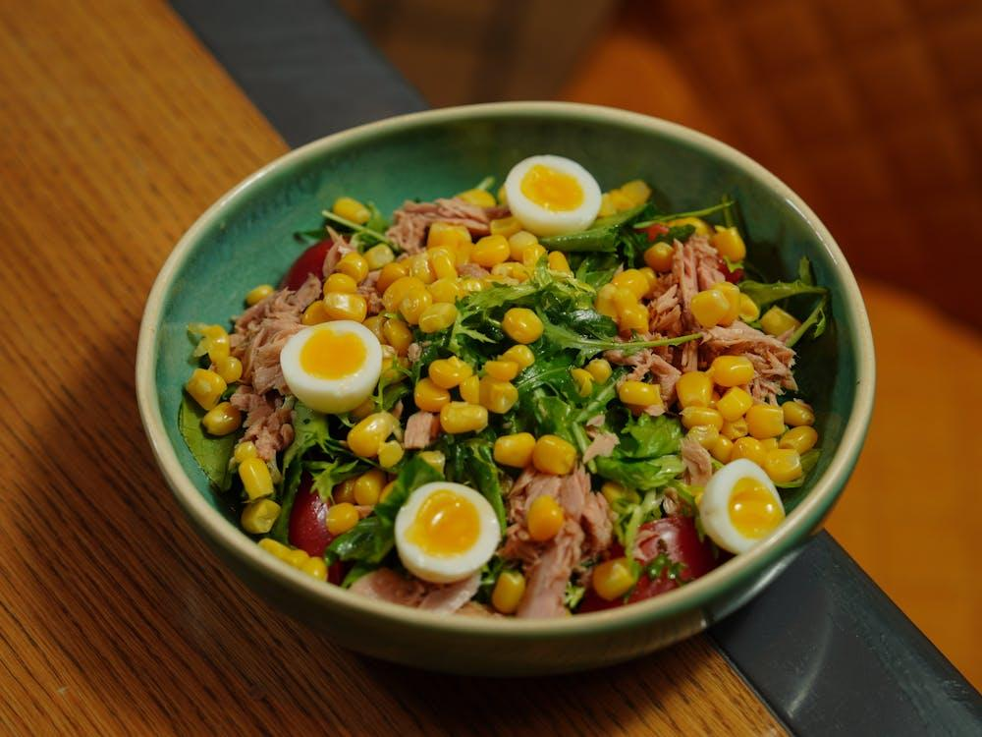
5-Day Mediterranean Menu
Day 2:
Breakfast: Greek yogurt with chia seeds and a drizzle of honey Why? Greek yogurt is a great source of protein and probiotics for digestive health. Chia seeds add omega-3s and fiber, while honey can be enjoyed in moderation.
Lunch: Tuna salad (canned tuna, olive oil, cucumber, tomatoes) with whole-grain toast Why? Tuna is rich in omega-3s and protein, while olive oil provides heart-healthy fats.
Dinner: Baked salmon with roasted vegetables (carrots, zucchini, onions) Why? Salmon is a great source of omega-3s, while roasted veggies offer fiber, vitamins, and minerals.
Snack: A handful of unsalted almonds Why? Almonds are an excellent source of healthy fats, fiber, and Vitamin E.

Slide 30
5-Day Mediterranean Menu
Day 3:
Breakfast: Scrambled eggs with spinach and whole-grain toast Why? Eggs provide high-quality protein, and spinach is rich in vitamins and minerals.
Lunch: Chickpea salad with cucumbers, tomatoes, olive oil, and lemon juice Why? Chickpeas are a fantastic source of plant-based protein and fiber. Olive oil and lemon juice add healthy fats and flavor.
Dinner: Stir-fried tofu with brown rice and mixed vegetables Why? Tofu provides plant-based protein, and brown rice is a low-glycemic option. Vegetables provide fiber and nutrients.
Snack: A small pear or seasonal fruit Why? Fruit adds natural sweetness and fiber.

Slide 31
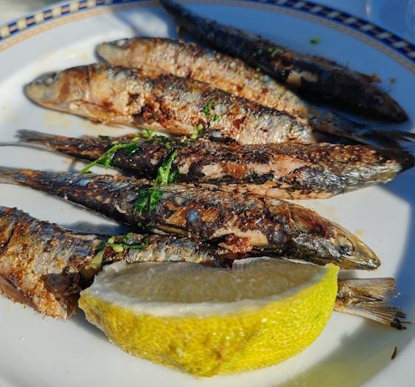
5-Day Mediterranean Menu
Day 4:
Breakfast: Whole-grain toast with mashed avocado and a boiled egg Why? Avocados are full of healthy fats, and eggs provide protein, making this a heart-healthy and satisfying breakfast.
Lunch: Barley salad with tomatoes, cucumbers, olive oil, and a slice of feta Why? Barley is rich in fiber and helps with cholesterol management. Feta adds flavor and a little calcium.
Dinner: Grilled sardines with sautéed spinach and sweet potato mash Why? Sardines are high in omega-3s, spinach is nutrient-dense, and sweet potatoes provide fiber and vitamins.
Snack: A few olives or dried fruit Why? Olives offer healthy fats, while dried fruit adds natural sweetness.

Slide 32
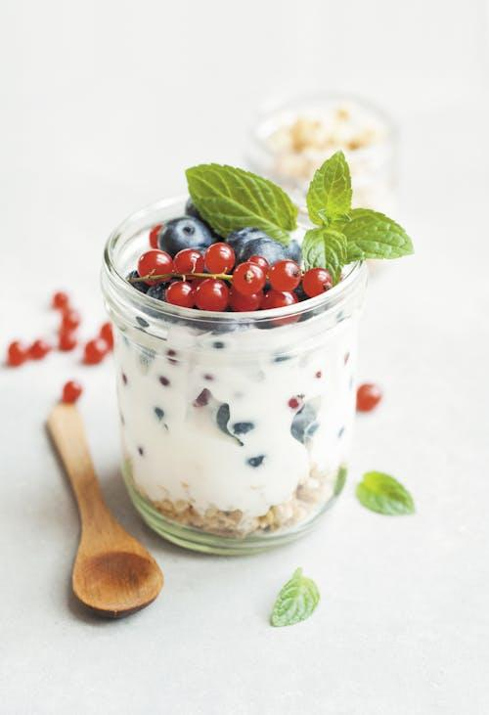
5-Day Mediterranean Menu
Day 5:
Breakfast: Porridge made with milk, topped with flaxseeds and a sliced apple Why? Porridge provides slow-releasing energy, while flaxseeds are full of fiber and omega-3s.
Lunch: Mediterranean-style bean soup (white beans, carrots, celery, olive oil) Why? Beans are high in protein and fiber, while olive oil helps with heart health.
Dinner: Roasted chicken thighs with a side of bulgur and steamed green beans Why? Chicken thighs are flavorful and high in protein, while bulgur is a whole grain that’s good for blood sugar control.
Snack: A small bowl of plain yogurt with a teaspoon of honey Why? Yogurt provides probiotics for gut health, and honey can be enjoyed in moderation.

Slide 33
Quick test
3: What nutrient is especially important for brain health and can be found in fish like salmon and sardines?
Calcium
Omega-3 fatty acids
Vitamin C
4: Which of the following is a great affordable source of protein?
Lentils
Soda
Pastries
1: What is the primary source of healthy fats in the Mediterranean diet?
a) Butter
b) Olive oil
c) Coconut oil
2: Which type of foods should seniors include more to help with digestion and lower cholesterol?
Refined grains
Processed meats
Fiber-rich foods like whole grains and vegetables

Slide 34
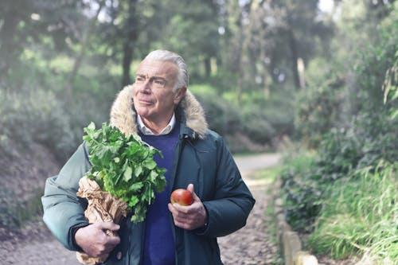
Developing Healthy Habits
Small Changes, Big Impact Healthy habits can be built over time through simple, consistent changes. Focus on sustainable actions like:
Starting Slow: Add one or two new habits at a time, such as including more vegetables or drinking more water.
Consistent Routine: Regular meals help maintain stable blood sugar levels and energy throughout the day.
Balance, Not Deprivation: It’s okay to indulge occasionally, as long as most meals are balanced and nutritious.
Notes:
Engagement Prompt: “What small habits have you started to make your diet healthier?”

Slide 35
Conclusion and Q&A
Recap of Key Takeaways
Eating healthy doesn’t have to be expensive or complicated.
Small, manageable changes can make a big difference in both physical and mental health.
Notes:
Final Engagement Open the floor to any remaining questions or comments. Encourage participants to share any challenges they face and offer further support or solutions. Print the menu for participants and give them to take home.

Slide 36
Resources
New dietary strategies for healthy ageing in Europe (NU-AGE)
European Food Information Council (EUFIC)
What is a plant-based diet and does it have any benefits?
Mediterranean Diet
Cookbooks:
"Mediterranean Cookbook" by Marie-Pierre Moine
"The Complete Mediterranean Cookbook" by America's Test Kitchen
„Pravilna prehrana osoba starije dobi”
Notes:
Final Engagement Open the floor to any remaining questions or comments. Encourage participants to share any challenges they face and offer further support or solutions. Print the menu for participants and give them to take home.

Slide 37
Thank you for you time www.sensyn.si
Ageless Minds Healthy Strides
SenSyn
Senior Synergy: Empowering Lifelong Learning and Healthy living with Community Events
Notes:
Final Engagement Open the floor to any remaining questions or comments. Encourage participants to share any challenges they face and offer further support or solutions.

