Slide 1
SenSyn - Senior Synergy: Empowering Lifelong Learning and Healthy living through Community Events

Slide 2
MODULE 4: MAINTAINING MENTAL AND PHYSICAL VITALITY

Slide 3
MENTAL VITALITY:
Mental vitality refers to the ability of the brain to function at its best, supporting cognitive health, emotional well-being, and resilience
It involves maintaining clarity of thought, sharpness, focus, creativity, and the ability to learn, adapt, and solve problems

Slide 4
MENTAL VITALITY:
It is also closely linked to emotional health, including positive mood, a sense of purpose, and the ability to cope with stress and challenges
It is fostered through activities that stimulate the brain, such as reading, puzzles, learning new skills, and engaging in social interactions.

Slide 5
KEY ASPECTS OF MENTAL VITALITY INCLUDE:
COGNITIVE FUNCTION: memory, attention, reasoning, and problem-solving abilities.
EMOTIONAL WELL-BEING: mental resilience, stress management, and emotional regulation.
SOCIAL ENGAGEMENT: active participation in social, cultural, or community activities that keep the mind engaged.

Slide 6
THE BENEFITS OF GOOD MENTAL VITALITY
ENHANCED EMOTIONAL WELL-BEING:
Strong mental vitality can help seniors manage stress, reduce feelings of anxiety, and alleviate symptoms of depression.
Engaging in social activities, learning new things, and having a sense of purpose can enhance mood
REDUCED RISK OF COGNITIVE DECLINE:
Engaging in mentally stimulating can help protect against cognitive decline and reduce the risk of conditions like dementia and Alzheimer’s disease

Slide 7
THE BENEFITS OF GOOD MENTAL VITALITY
IMPROVED SOCIAL INTERACTION :
Mental vitality encourages social engagement, which is crucial for combating loneliness and social isolation
BETTER PROBLEM-SOLVING AND DECISION-MAKING:
Keeping the brain active helps seniors remain mentally flexible and manage financial, health, and household decisions, contributing to independence.

Slide 8
THE BENEFITS OF GOOD MENTAL VITALITY
PROTECTION AGAINST MENTAL HEALTH DISORDERS:
Regular mental stimulation helps reduce the risk of depression and anxiety.
Studies show that seniors who stay mentally active tend to have a more positive outlook on life, which can be crucial for aging with dignity and resilience
INCREASED SENSE OF PURPOSE:
Mental vitality helps seniors find meaning in their lives
Having a sense of purpose is linked to longer life expectancy and improved emotional health.

Slide 9
OPPORTUNITIES FOR MAINTAINING MENTAL VITALITY:
CREATIVE BRAIN EXERCISES
Engage in mentally stimulating activities like puzzles, crosswords, or brain games.
Creative exercises, such as drawing or crafting, also stimulate the brain and encourage problem-solving and critical thinking skills, improving cognitive function.

Slide 10
OPPORTUNITIES FOR MAINTAINING MENTAL VITALITY:
JOURNALING
Regular journaling helps clarify thoughts, improve emotional regulation, and stimulate self-reflection.
Writing about your experiences or setting goals can also provide mental clarity and reduce mental clutter.

Slide 11
OPPORTUNITIES FOR MAINTAINING MENTAL VITALITY:
LIFELONG LEARNING
Whether it’s taking an online course, reading books, or learning a new language, lifelong learning keeps the mind engaged and sharp.
It fosters neuroplasticity, the brain’s ability to form new neural connections.

Slide 12
OPPORTUNITIES FOR MAINTAINING MENTAL VITALITY:
SOCIAL CONNECTION
Regular social engagement - through conversations, group activities, or community events - helps maintain mental vitality by providing cognitive stimulation, emotional support, and a sense of belonging.

Slide 13
OPPORTUNITIES FOR MAINTAINING MENTAL VITALITY:
MINDFUL WALKING
Combine physical activity with mental focus by practicing mindful walking.
This involves walking at a steady pace while paying attention to the sensations of movement, your breathing, and the environment around you.
It helps reduce stress, improves focus, and boosts mood.

Slide 14
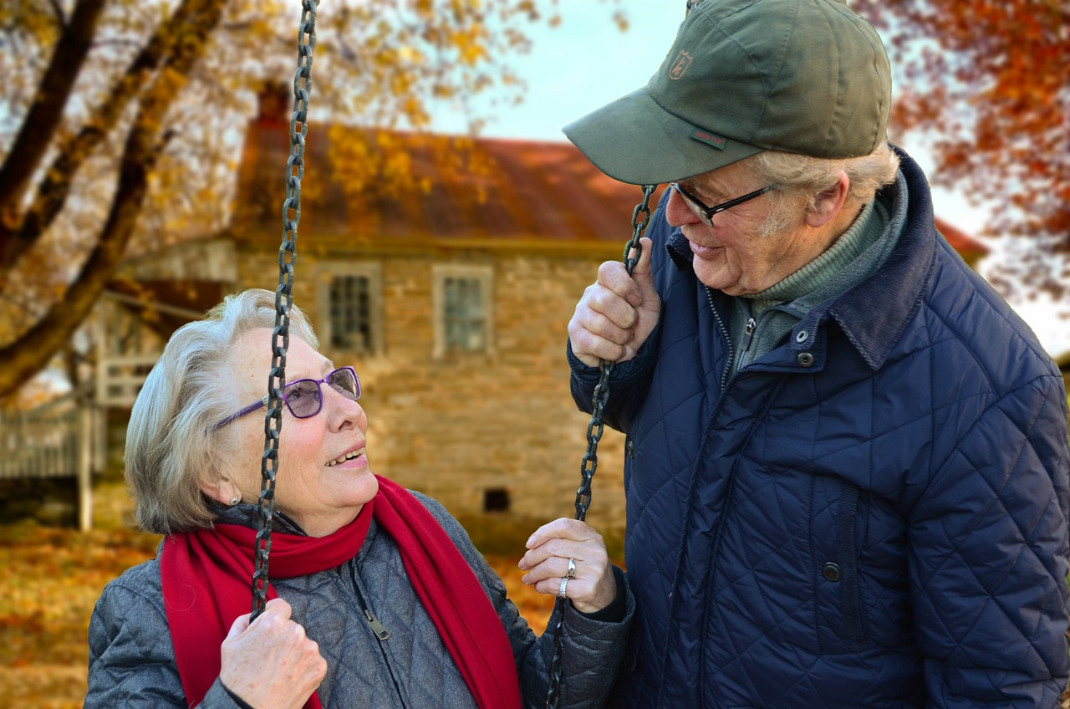
What do you do to stimulate your brain?
Which new skill would you like to learn?

Slide 15
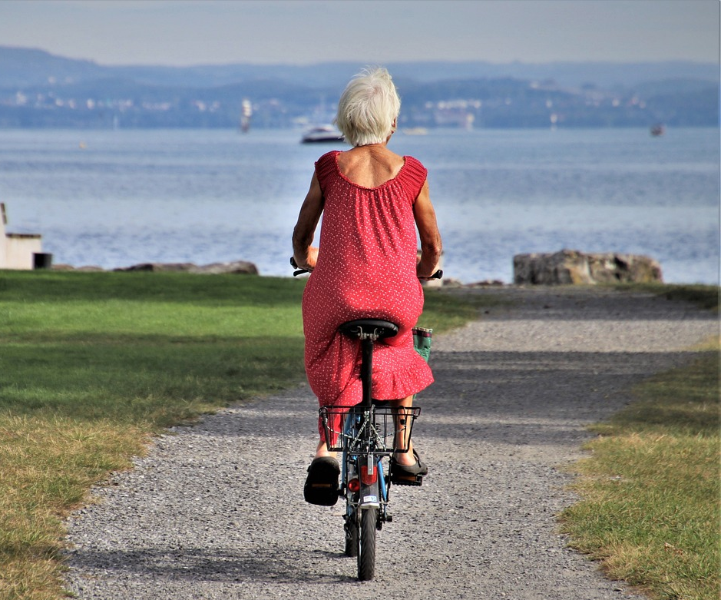
PHYSICAL VITALITY:
Refers to the overall state of physical health and energy, including the strength, endurance, flexibility, and resilience of the body
It is the capacity to perform daily physical activities with ease and to recover from exertion or illness quickly.
It is closely associated with maintaining physical fitness, a healthy body weight, proper nutrition, good cardiovascular health, and muscle strength.

Slide 16
KEY ASPECTS OF PHYSICAL VITALITY INCLUDE:
PHYSICAL FITNESS: cardiovascular endurance, strength, flexibility, and balance.
ENERGY LEVELS: the ability to perform daily tasks without excessive fatigue.
HEALTH: the absence of chronic diseases, good immune function, and recovery ability.

Slide 17
THE BENEFITS OF GOOD PHYSICAL VITALITY
IMPROVED MOBILITY AND INDEPENDENCE:
Regular physical activity helps seniors maintain muscle strength, balance, and flexibility, reducing the risk of falls and injuries.
Staying physically active enables seniors to remain independent.
REDUCED RISK OF CHRONIC DISEASES:
Physical activity can reduce the risk of chronic conditions common in older adults,
Regular exercise also improves circulation and helps manage weight, lowering the risk of complications and contributing to overall health.

Slide 18
THE BENEFITS OF GOOD PHYSICAL VITALITY
ENHANCED BONE HEALTH AND MUSCLE STRENGTH:
Physical activity helps strengthen bones, preventing conditions like osteoporosis.
Strong muscles also support joint health, reduce the risk of falls, and help seniors remain active and mobile.
INCREASED ENERGY AND STAMINA:
Regular exercise helps seniors build stamina and reduce feelings of fatigue. They feel more energetic and capable of engaging in daily activities and social events.

Slide 19
THE BENEFITS OF GOOD PHYSICAL VITALITY
BOOSTED IMMUNE SYSTEM:
Moderate physical activity has been shown to boost the immune system
Regular exercise can help seniors recover more quickly from illness and avoid common age-related infections.
BETTER SLEEP QUALITY:
Regular physical activity promotes better sleep patterns and quality.

Slide 20
OPPORTUNITIES FOR MAINTAINING PHYSICAL VITALITY:
WALKING
Benefits: Walking is one of the most accessible and effective low-impact exercises for seniors. It improves cardiovascular health, helps maintain bone density, boosts mood, and improves balance.
Tips: Start with short walks (10-15 minutes) and gradually increase the duration.

Slide 21
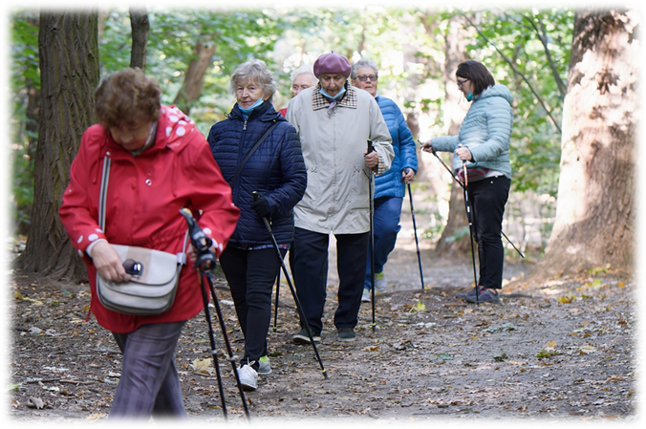
OPPORTUNITIES FOR MAINTAINING PHYSICAL VITALITY:
NORDIC WALKING
It is a full-body exercise that involves walking with specially designed poles that engage the upper body, including the arms, shoulders, chest, and back, in addition to the legs.
The poles help propel the walker forward, providing more stability and support, which is especially beneficial for seniors with balance concerns.

Slide 22
OPPORTUNITIES FOR MAINTAINING PHYSICAL VITALITY:
MEDICAL EXERCISES FOR SENIORS
Exercises are led by qualified physiotherapists or instructors who specialize in working with seniors, and their goal is to reduce the risk of injury, improve mobility, and alleviate pain or symptoms from conditions such as arthritis, osteoporosis, spinal issues, and similar concerns.

Slide 23
OPPORTUNITIES FOR MAINTAINING PHYSICAL VITALITY:
CHAIR YOGA
Benefits: Chair yoga is a modified version of traditional yoga that can be done while seated or with support from a chair. It helps improve flexibility, balance, and strength without putting strain on the joints.
Tips: Focus on deep breathing, gentle stretching, and slow movements.

Slide 24
OPPORTUNITIES FOR MAINTAINING PHYSICAL VITALITY:
TAI CHI
Benefits: Tai Chi is a form of mind-body exercise that combines slow, deliberate movements with breathing techniques. It’s great for improving balance, reducing stress, and enhancing coordination.
Tips: Tai Chi can be done in a group class or independently. It’s gentle on the joints and perfect for seniors with limited mobility.

Slide 25
POTENTIAL BARRIERS TO MAINTAINING PHYSICAL VITALITY
Health issues:
Economic Barriers
Others:
lack of motivation
lack of time or routine
fear of injury
low self-asteem
joint pain
fatigue
balance problems
reduced mobility
chronic conditions
low income and high costs of exercise facilities
no access to transportation to exercise facilities
What barriers affect your physical activity the most?
How can you overcome them?

Slide 26
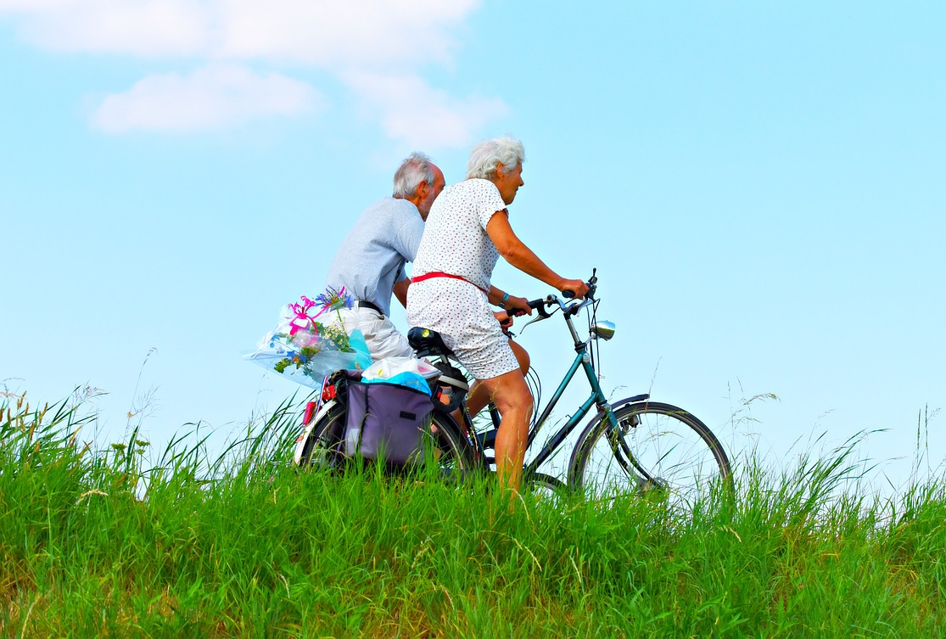
OVERCOMING BARRIERS – TIPS:
Start slowly and set realistic goals
Exercise with a friend, family member, or in a group setting.
Create a routine and make exercise a habit
A routine helps form a habit and ensures long-term commitment to staying active, even on days when motivation is low.

Slide 27
COMBINING PHYSICAL AND MENTAL ACTIVITY
Example of good practice:
Reminiscence /
Reminiscence promenade

Slide 28
REMINISCENCE
Reminiscence is a highly productive and simple technique * that originates from gerontology, aimed at strengthening the identity and empowering older adults, which also means enhancing relationships and improving their overall well-being.
*Burnside, I.M. (1984.) Working With the Elderly: Group Process and Techniques

Slide 29
The reminiscence technique has been applied globally for many years, and numerous studies have demonstrated its benefits:
Improvement of cognitive functions
Emotional well-being: reminiscence can help reduce feelings of depression and anxiety
Strengthening identity and self-esteem
Social connection: group reminiscence can encourage social interaction and bonding with others
Physical benefit: walking promotes circulation, strengthens fitness, contributes to a sense of calm, and improves mood.

Slide 30
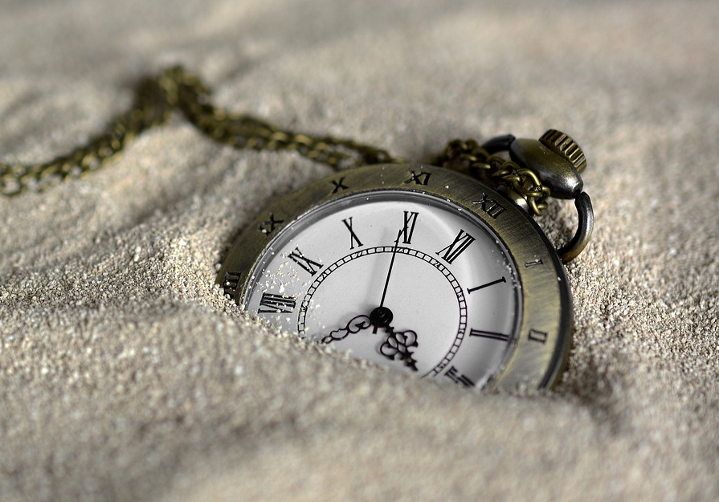
Reminiscence session
Through sensory stimulation and questions, the moderator evokes emotional memories and encourages personal reminiscence
The participants respond by recalling events, experiences, and people from their past.
They share their memories with the group, creating a collective narrative about past events.
The moderator encourages participants to connect their memories with each other, identifying similarities and differences.

Slide 31
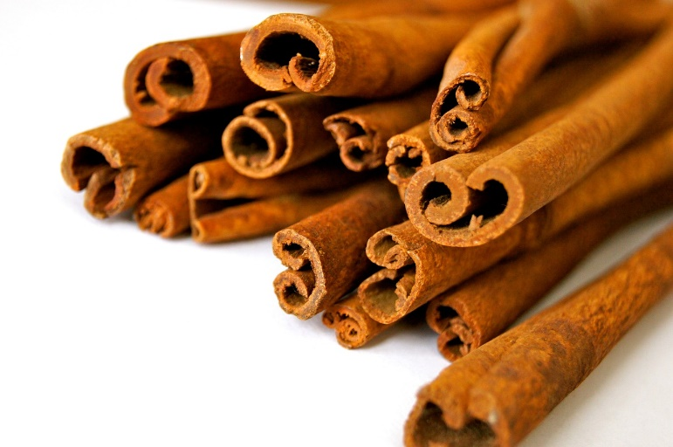
Reminiscence session – Example:
the moderator provides various spices and fruits in bowls
The reminiscence starts with questions:
What was your favorite cake during childhood or youth?
Who made this cake?
On what occasions was it eaten?

Slide 32
Reminiscence session - possible topics include:
Childhood and Youth:
Family Life: What did the family home look like? Who cooked? How did they spend holidays?
Games and Activities: What games did they play as children? What were their favorite play areas?
Education and Career:
School: What was the first day of school like? Who were their friends? Favorite subjects, teachers, and school activities.
First Job: How did they get their first job? What did they do and how did it feel?
Professional Achievements: What are their proudest moments in their career?

Slide 33
Reminiscence session - possible topics include:
Family Life:
Marriage and Partnership: How did they meet their partner? Memories of the wedding.
Parenting: Memories of the birth of children, their upbringing, and shared activities.
Family Rituals and Traditions: Holidays, birthdays, and other family celebrations.
Travel and Holidays:
Holidays and Leisure: How did they spend summer and winter vacations? What activities were most enjoyable?
Travel: Where did they travel? What are their fondest memories from these travels?
Favorite Destinations: Places that had special significance or were frequently visited.

Slide 34
Reminiscence session - possible topics include:
Daily Life:
Fashion and Style: What was the fashion like in their time? How did they dress for special occasions?
Food and Cuisine: Favorite recipes, traditional dishes, and family meals.
Social Interactions: How did they socialize with friends and family? Where did they gather?
Pets and Nature:
Pets: Memories of pets and their impact on life.
Nature: Favorite natural spots, gardening, and memories of being in nature.

Slide 35
Reminiscence session - possible topics include:
Culture and Entertainment:
Favorite movies, music, books, or events like concerts and theater performances.
Local History: Interesting events and changes in the city or community over their lifetime.
Historical Events: Where were they and what did they do during significant historical events (e.g., end of a war, political changes)?

Slide 36
Reminiscence session – tips:
Painful subjects such as the loss of loved ones, war experiences, or natural disasters can evoke strong emotional reactions and may be challenging for some participants. Therefore, such topics are generally avoided
Participants should always be aware that they can choose not to take part in any discussion that may be too distressing for them.

Slide 37
Reminiscence Walk

Slide 38
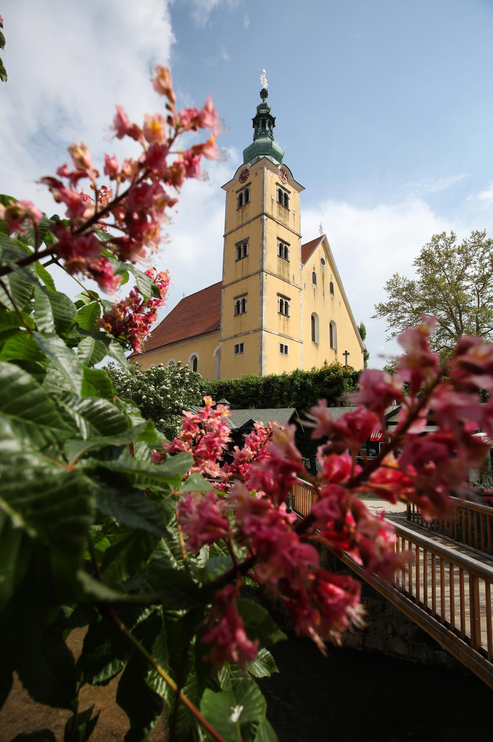
Reminiscence Walk
The moderator introduces the activity, providing a brief reminder of the purpose of the walk and the role of the guide in evoking memories related to historical and cultural landmarks
Participants share their memories related to specific places / events, while the guide offers additional significance of the landmarks/events

Slide 39
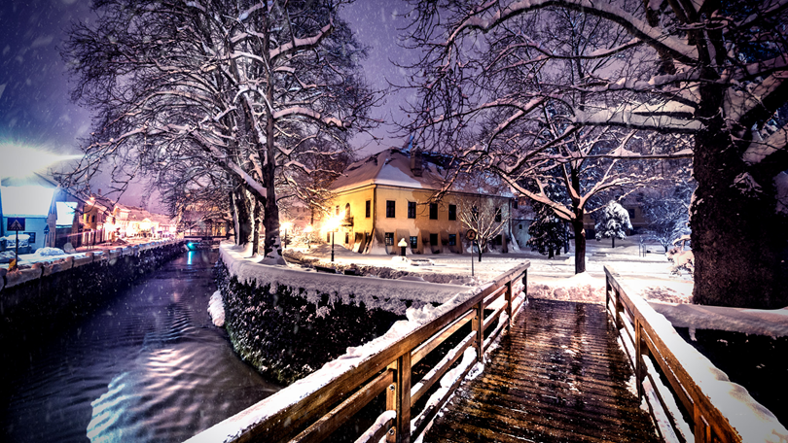
Reminiscence Walk
How has this place changed since you first visited it?"
Personal photographs or postcards from participants can also stimulate memories. The moderator may ask questions to prompt deeper reflection, such as:

Slide 40
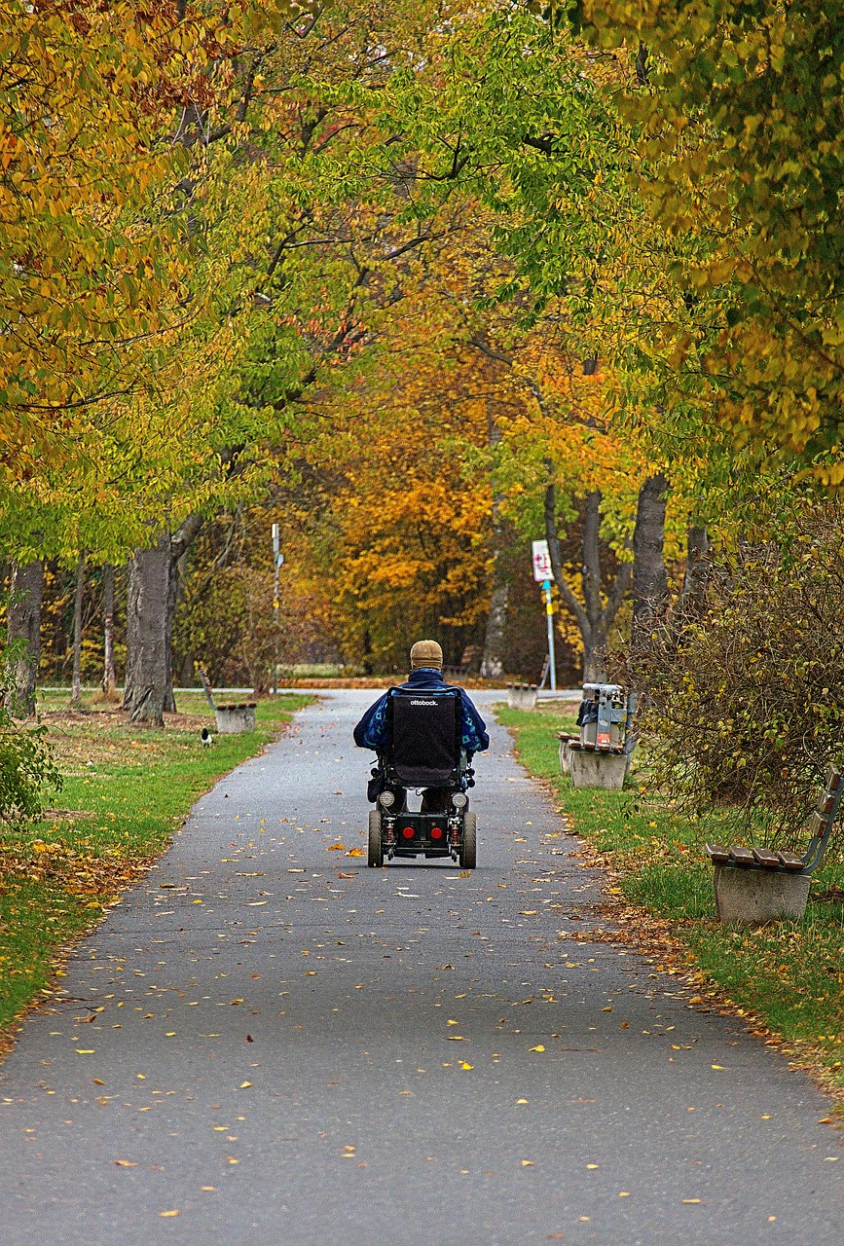
Reminiscence Walk – tips:
Break at a key location: it is important to include a short break where participants can relax and discuss their impressions from the walk.
Participants can share their observations on the links between personal and city history.
During the walk, participants can also identify potential obstacles for older adults/people with disabilities and provide suggestions for removing these barriers

Slide 41
Summary and Evaluation:
Briefly summarize the entire workshop, emphasizing the importance of preserving memories and connecting with the city.
Encourage participants to continue reminiscing and exploring the city's history on their own initiative.
Collect feedback from participants to improve future workshops.

Slide 42
Thank you for your attantion!

Slide 43
Sources and references:
1. Burnside, I.M. (1984.) Working With the Elderly: Group Process and Techniques
2. Ajduković, M. (1994.) Model individualnog i grupnog rada sa starijim prognanicima. Ljetopis Studijskog centra socijalnog rada 1, 33-42.
3. Ajduković, M. (1995.a) Društvena skrb o starijim osobama: izazov 21. stoljeća. Starost i starenje - izazov današnjice. Zbornik radova. Zagreb: Ministarstvo rada i socijalne skrbi, 97-102.
4. Ajduković, M. (1995.b) Učenje tehnike dosjećanja - potrebe i iskustva u izobrazbi djelatnika ustanova za starije osobe. Starost i starenje - izazov današnjice. Zbornik radova. Zagreb: Ministarstvo rada i socijalne skrbi, 91-95.
https://sesvete.senecura.hr/vijesti/radionica-dosjecanjem-ili-reminiscencijom-u-senecura-domu-za-starije-sesvete/
https://www.goldencarers.com/how-to-structure-reminiscing-sessions-for-seniors/3184/
https://alzheimer.ca/bc/sites/bc/files/documents/Conversation-starters_Handout_Dec2020_0.pdf

