Slide 1



SenSyn - Senior Synergy: Empowering Lifelong Learning and Healthy living through Community Events

Slide 2

MODULE 5:
PHYSICAL ACTIVITY AND EXERCISE

Slide 3


PHYSICAL ACTIVITY AND EXERCISE

Slide 4
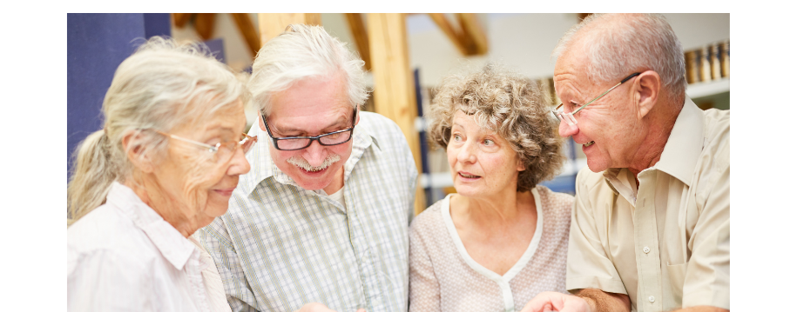

PHYSICAL ACTIVITY AND EXERCISE
Physical activity and exercise are essential components of a healthy lifestyle. They enhance physical well-being, improve mobility, and reduce the risk of chronic diseases, while also boosting mental health by reducing anxiety and depression. Engaging in regular exercise fosters social interaction and creates a sense of community.

Slide 5

WHAT IS PHYSICAL ACTIVITY?
Physical activity is defined as any bodily movement produced by skeletal muscles that results in energy expenditure. The energy expenditure can be measured in kilocalories. Physical activity in daily life can be categorized into occupational, sports, conditioning, household, or other activities.
Carl J. Caspersen, Kenneth E. Powell and Gregory M. Christenson, 1985.
World Health Organization (WHO) refers to physical activity as all movement, made including during leisure time, for transport to get to and from places, or as part of a person’s work or domestic activities. Both moderate- and vigorous-intensity physical activity improve health. Popular ways to be active include walking, cycling, wheeling, sports, active recreation and play, and can be done at any level of skill and for enjoyment by everybody.
Notes:
Caspersen, C. J., Powell, K. E., & Christenson, G. M. (1985). Physical Activity, Exercise, and Physical Fitness: Definitions and Distinctions for Health-Related Research. Public Health Reports (1974-), 100(2), 126–131. http://www.jstor.org/stable/20056429

Slide 6
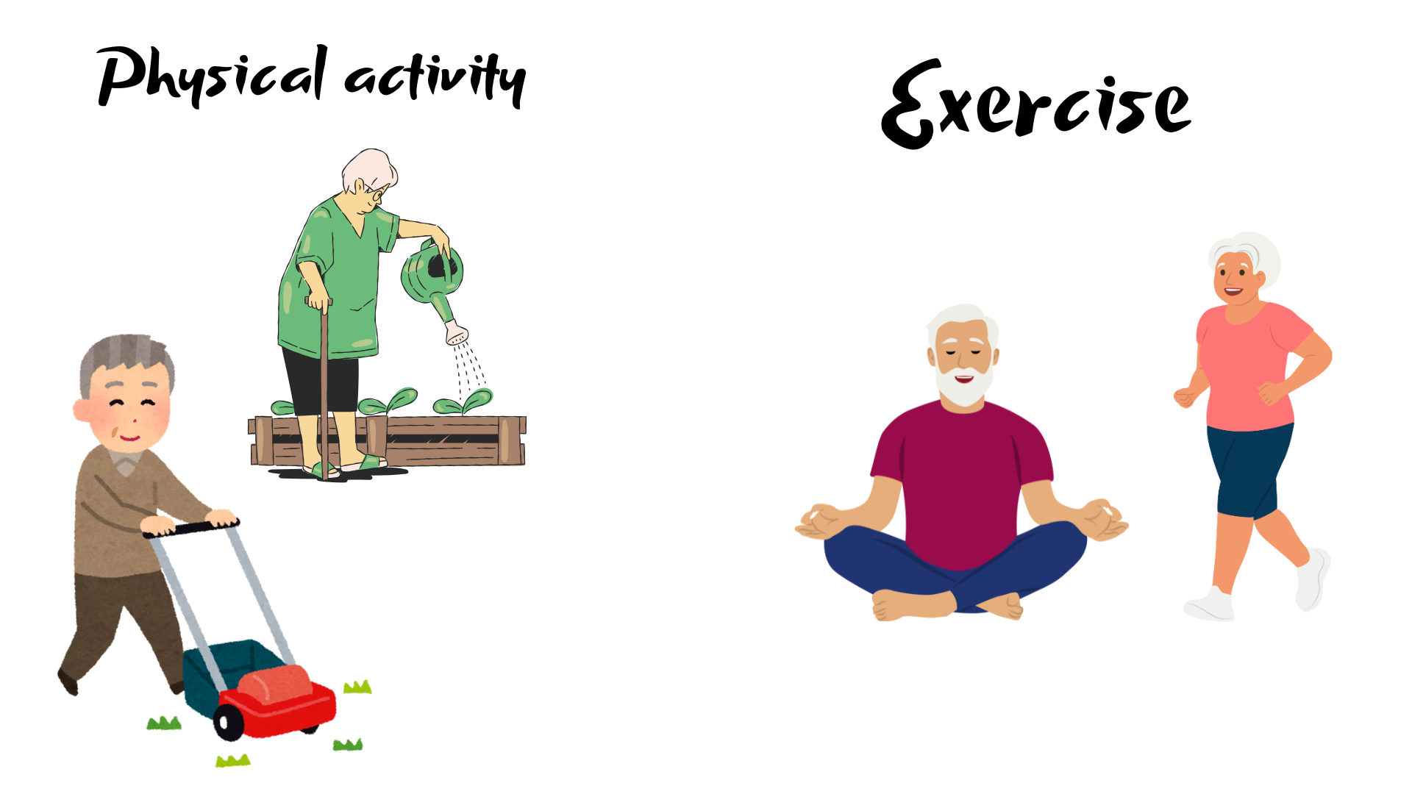
WHAT IS EXERCISE?
The term exercise has been used interchangeably with physical activity because both have common elements. Physical activity and exercise involve any bodily movement produced by skeletal muscles that expends energy, are measured by kilocalories ranging continuously from low to high, and are positively correlated with physical fitness as the intensity, duration, and frequency of movements increase.
Exercise, however, is not synonymous with physical activity: it is a subcategory of physical activity.
Notes:
Carl J. Caspersen, Kenneth E. Powell and Gregory M. Christenson (1985), page 128

Slide 7
Elements of physical activity and exercise
Physical activity | Exercise
Bodily movement via skeletal muscles | Bodily movement via skeletal muscles
Results in energy expenditure | Results in energy expenditure
Energy expenditure (kilocalories) varies continuously from low to high | Energy expenditure (kilocalories) varies continuously from low to high
Positively correlaterd with physical fitness | Very positively correlated with physical fitness
 | Planned, structured, and repetitive bodily movement
 | An objective is to improve or maintain physical fitness component(s)
Notes:
Page: 127

Slide 8
Types of Physical activities and Exercises
Physical activity | Exercise
Walking to work. | Running on a treadmill.
Gardening. | Weightlifting
Cleaning the house. | Yoga.
Playing with children. | Swimming laps.
Hanging clothes. | Cycling.

Slide 9
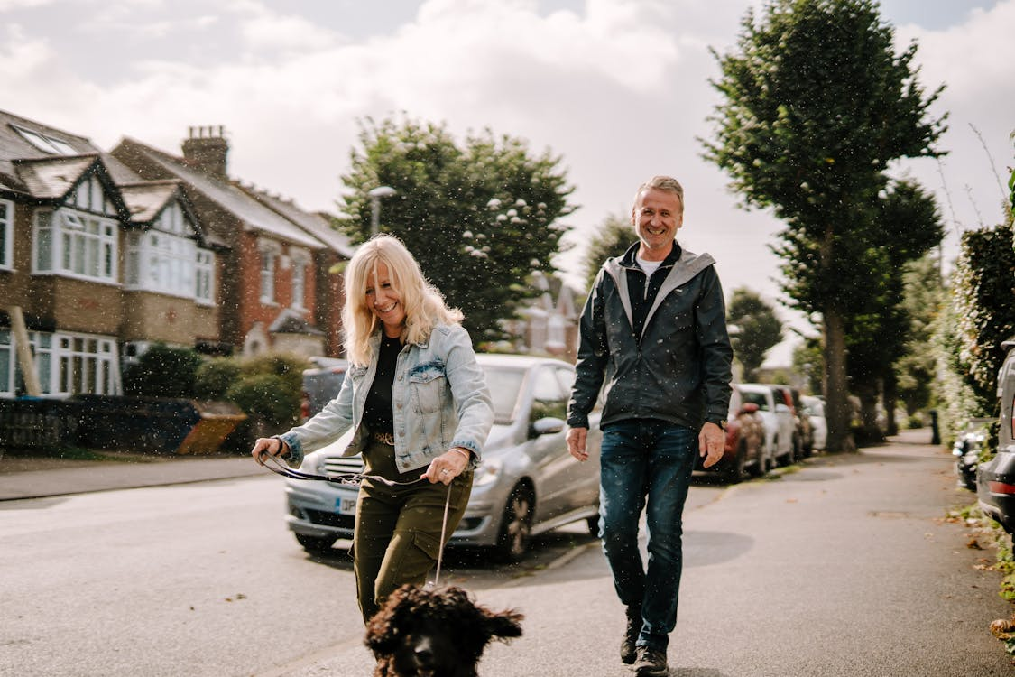
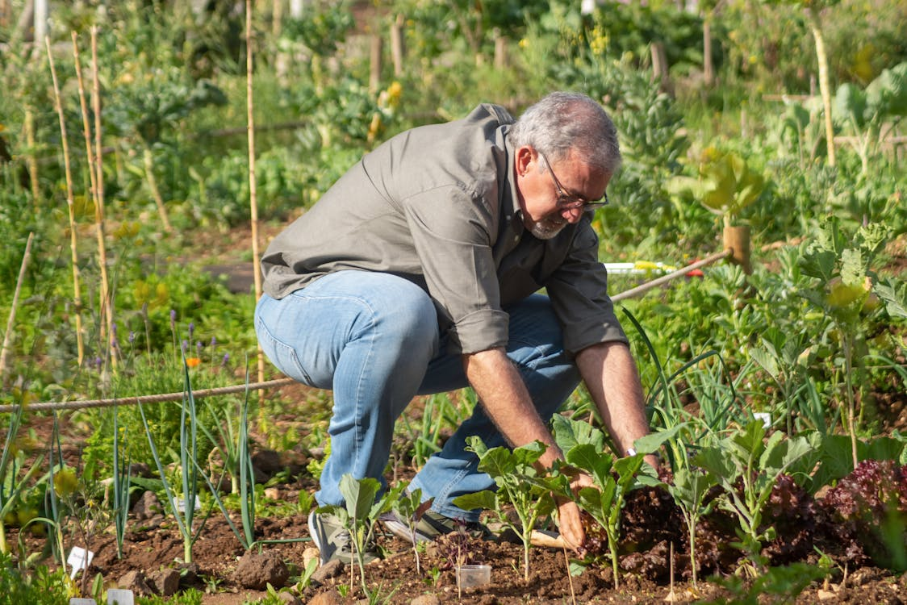
Benefits of Physical activities for seniors
Physical activities are not planned or structured for fitness improvement, but still bring significant health benefits.
Improve functional ability
Supports daily tasks: Activities like gardening, walking around the house, or doing light chores help maintain mobility and independence for everyday activities.
Maintains joint flexibility: Regular movement keeps joints from getting stiff, making daily motions like reaching, bending, and walking easier.

Slide 10
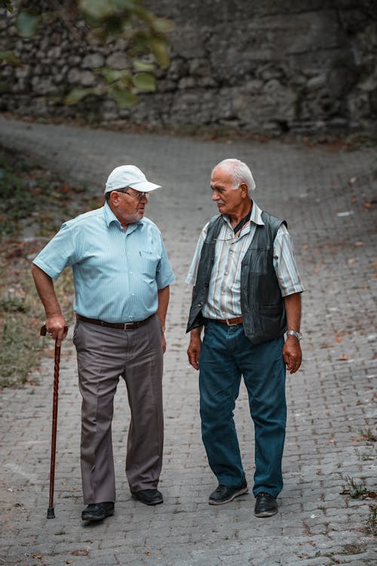
Benefits of physical activities for seniors
Enhances mental and emotional well-being
Reduces feelings of isolation: Simple physical activities such as walking with friends or playing with grandchildren provide social interaction and can lift mood.
Increases energy levels: Gentle movements throughout the day help maintain energy and reduce fatigue.

Slide 11
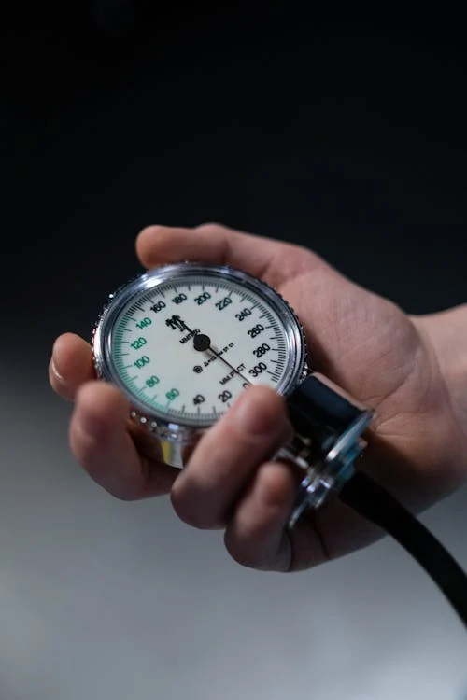
Benefits of physical activities for seniors
Supports cardiovascular health in a low-intensity way
Promotes circulation: Light activities, like casual walking or gardening, encourage blood flow without putting too much strain on the heart.
Helps manage blood pressure: Regular low-intensity activities can contribute to heart health and lower blood pressure over time.

Slide 12
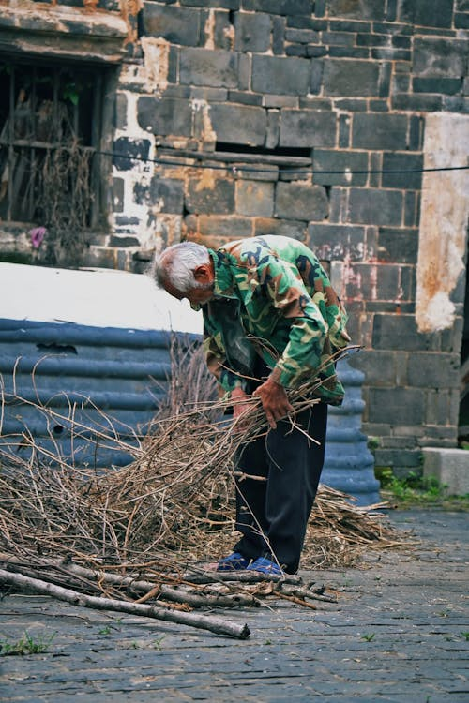
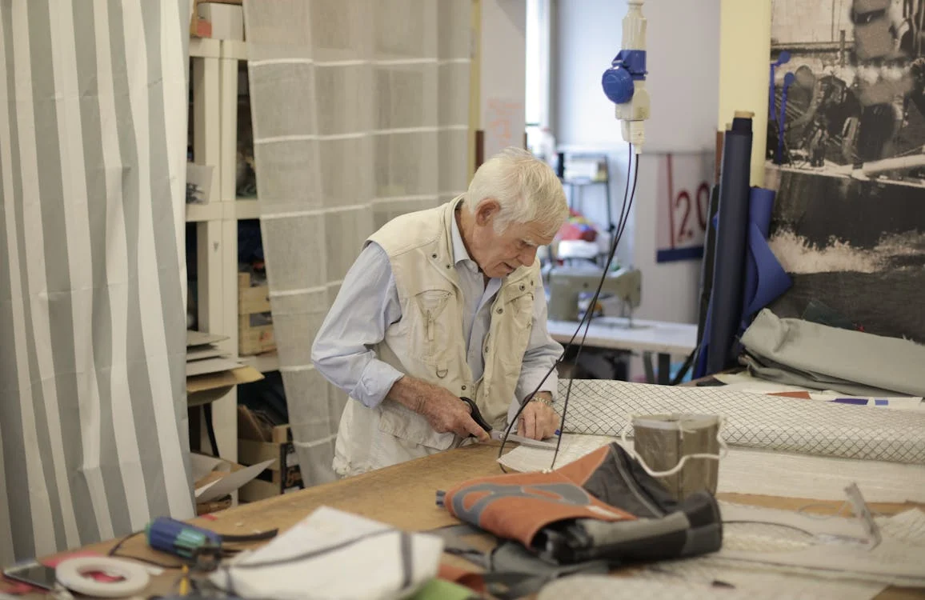
Benefits of physical activities for seniors
Reduces risk of falls through functional movements
Improves balance naturally: Activities that involve standing, bending, and reaching help seniors maintain balance and coordination without structured balance training.

Slide 13
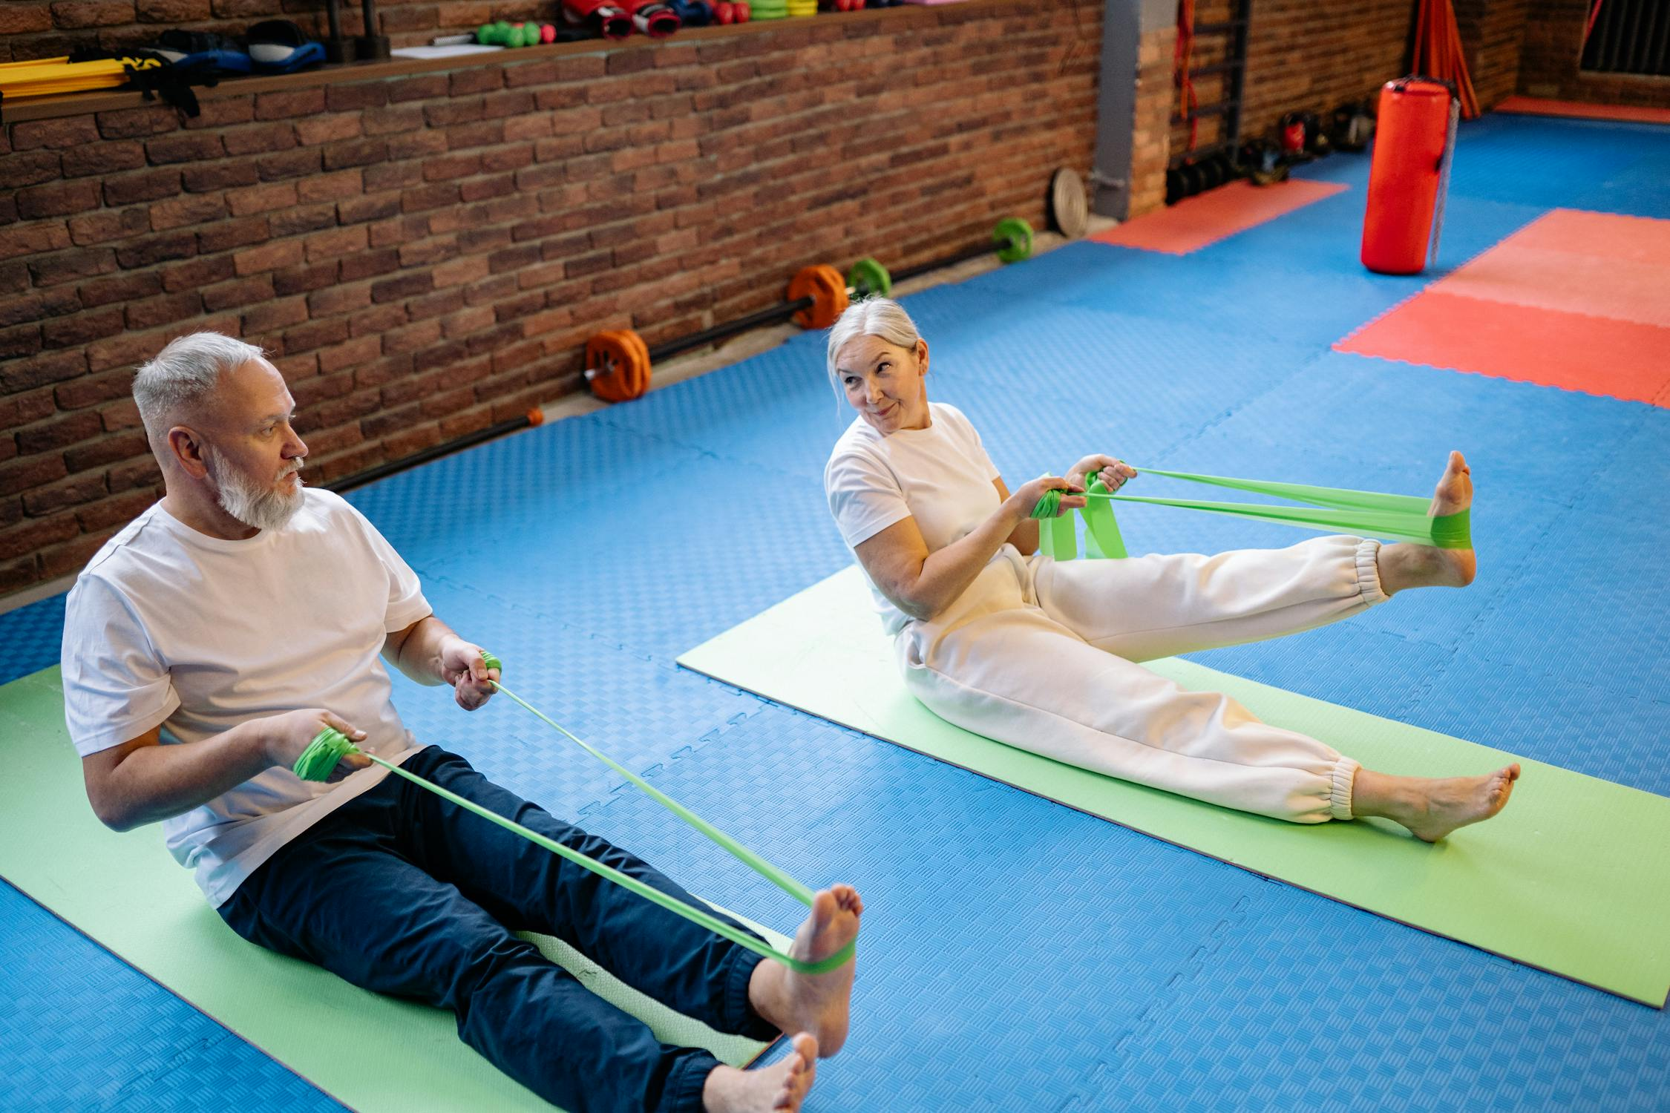
Benefits of exercise for seniors
Increases strength and muscle mass
Builds muscle strength: Resistance exercises like weightlifting or using resistance bands help maintain muscle mass, which tends to decline with age.
Strengthens bones: Weight-bearing exercises, such as strength training, help improve bone density and reduce the risk of osteoporosis.

Slide 14
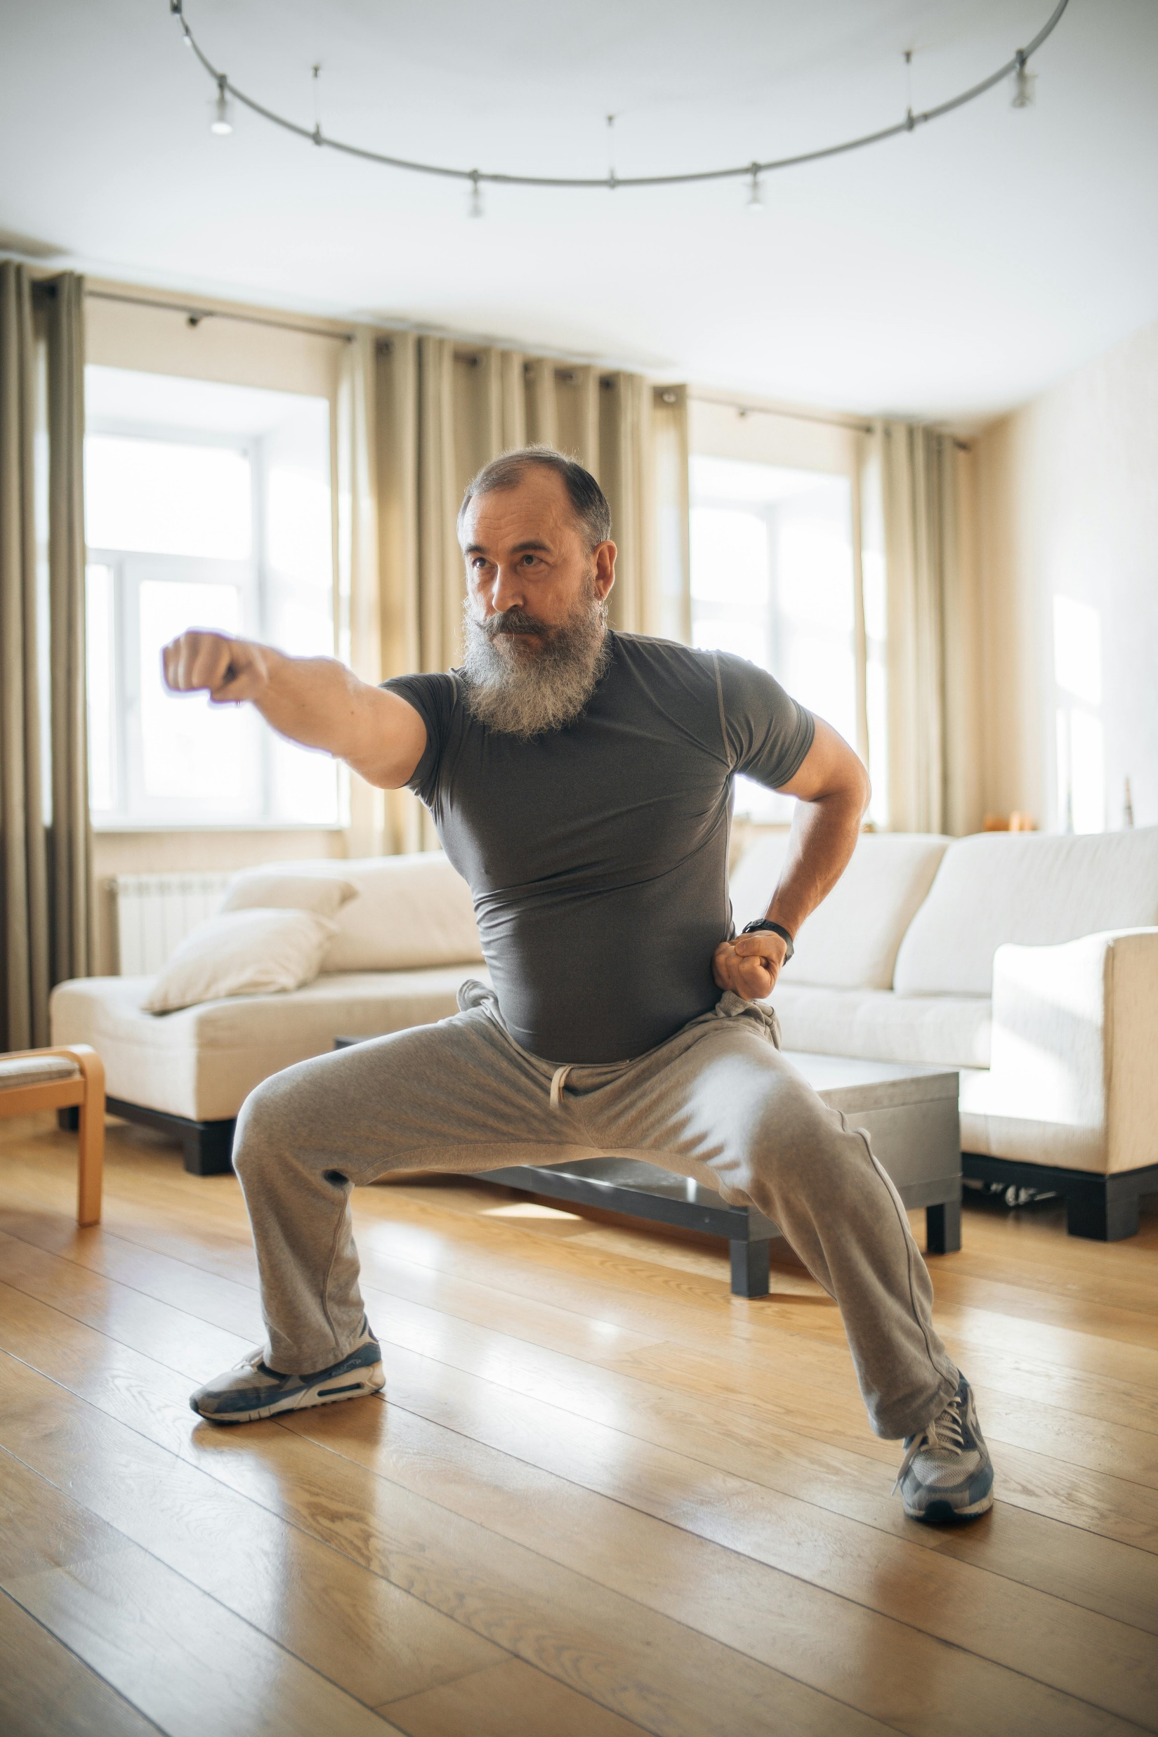
Benefits of exercise for seniors
Enhances cardiovascular endurance
Improves heart health: Regular aerobic exercises like cycling, swimming, or treadmill walking can strengthen the heart and increase cardiovascular endurance.
Lowers cholesterol and blood sugar levels: Exercise is effective in managing conditions like high cholesterol and type 2 diabetes.

Slide 15
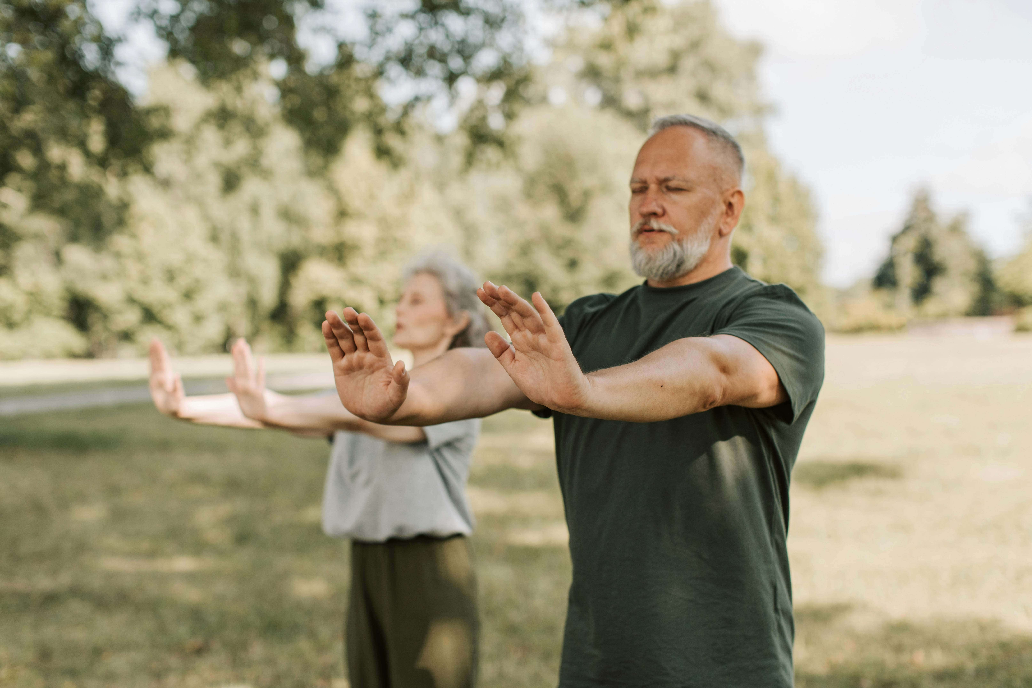
Benefits of exercise for seniors
Improves balance and coordination through targeted training
Balance exercises: Structured balance training, like Tai Chi or specific balance exercises, can reduce the risk of falls more effectively than general physical activities.
Core strengthening: Exercises focused on the core (e.g., Pilates) help improve stability and body control.

Slide 16
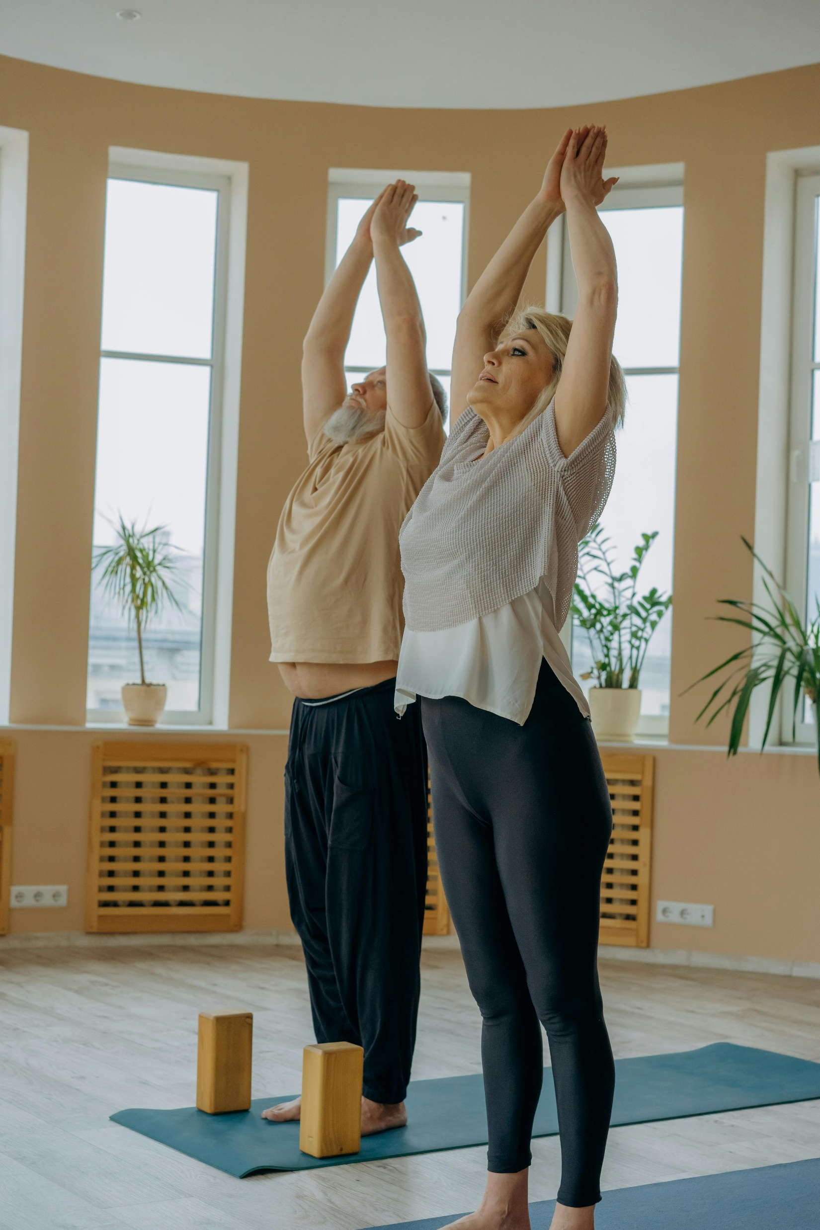
Benefits of exercise for seniors
Promotes flexibility and joint health
Increases range of motion: Exercises like yoga or stretching routines enhance flexibility and keep joints healthy.
Reduces pain in conditions like arthritis: Targeted exercises can help alleviate joint pain and improve joint function.

Slide 17
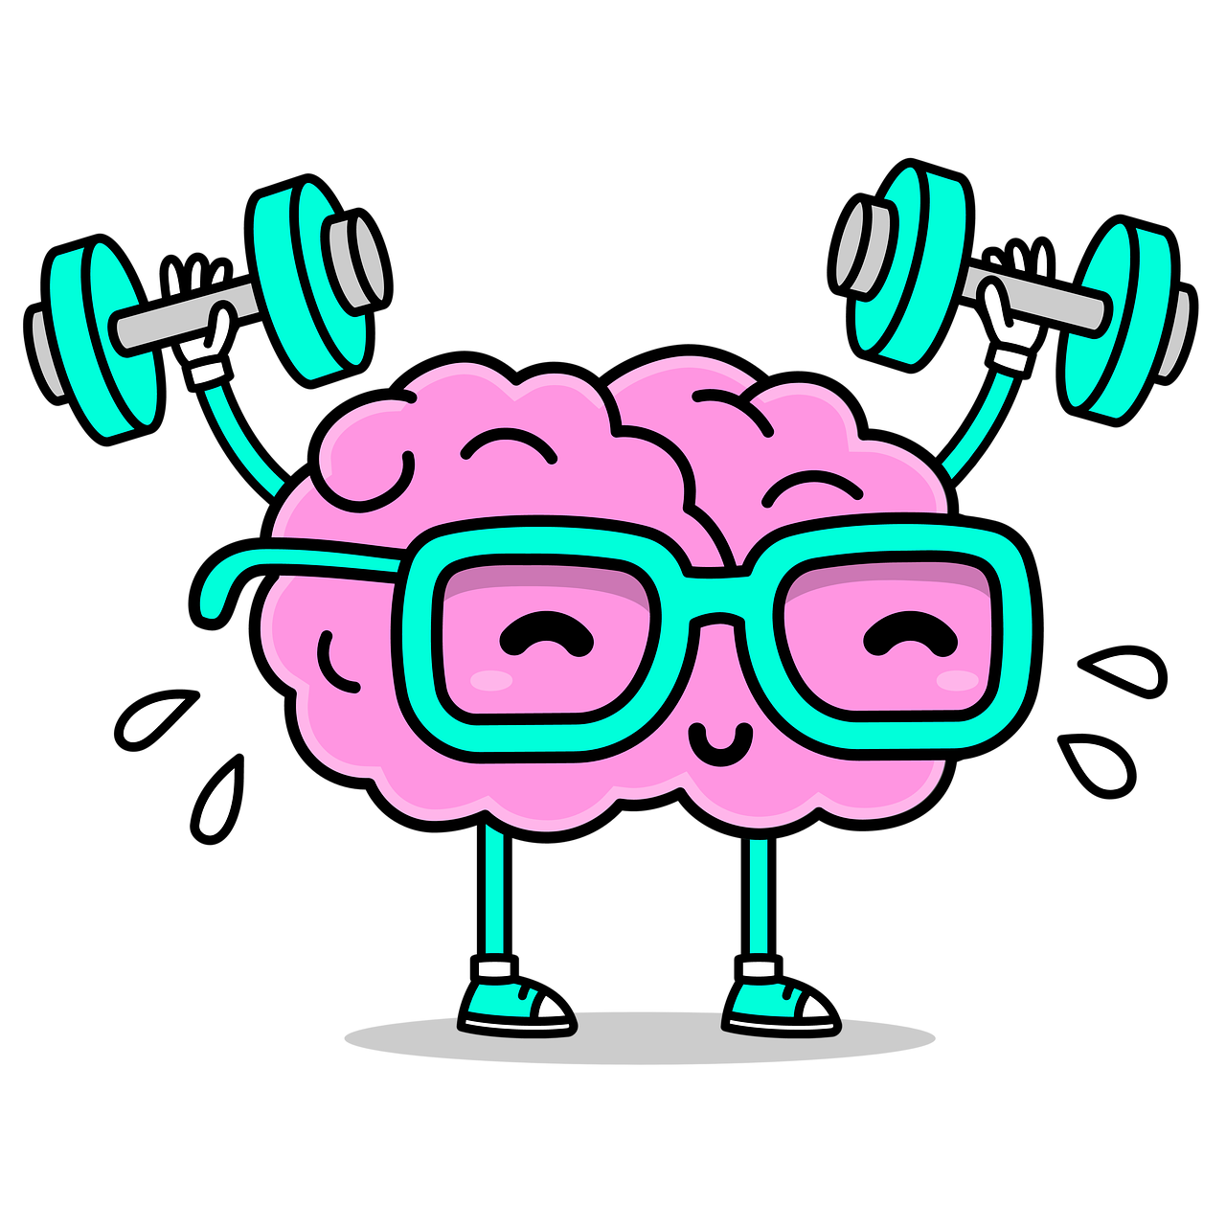
Benefits of exercise for seniors
Enhances cognitive function and mental health more effectively
Boosts brain health: Exercise has been linked to improved cognitive function and a lower risk of cognitive decline.
Reduces symptoms of depression and anxiety: Structured exercise releases more endorphins and is particularly beneficial for mental health.

Slide 18

Levels of physical inactivity globally
Study published in 2024 shown that 1/3 of world‘s adult population is physically inactive. That is 1.8 billion adults, who do not meet the global recommendations of at least 150 minutes of moderate-intensity physical activity per week.
After 60 years of age physical inactivity levels increase in both men and women.
Notes:
Soruce: https://www.who.int/news-room/fact-sheets/detail/physical-activity

Slide 19
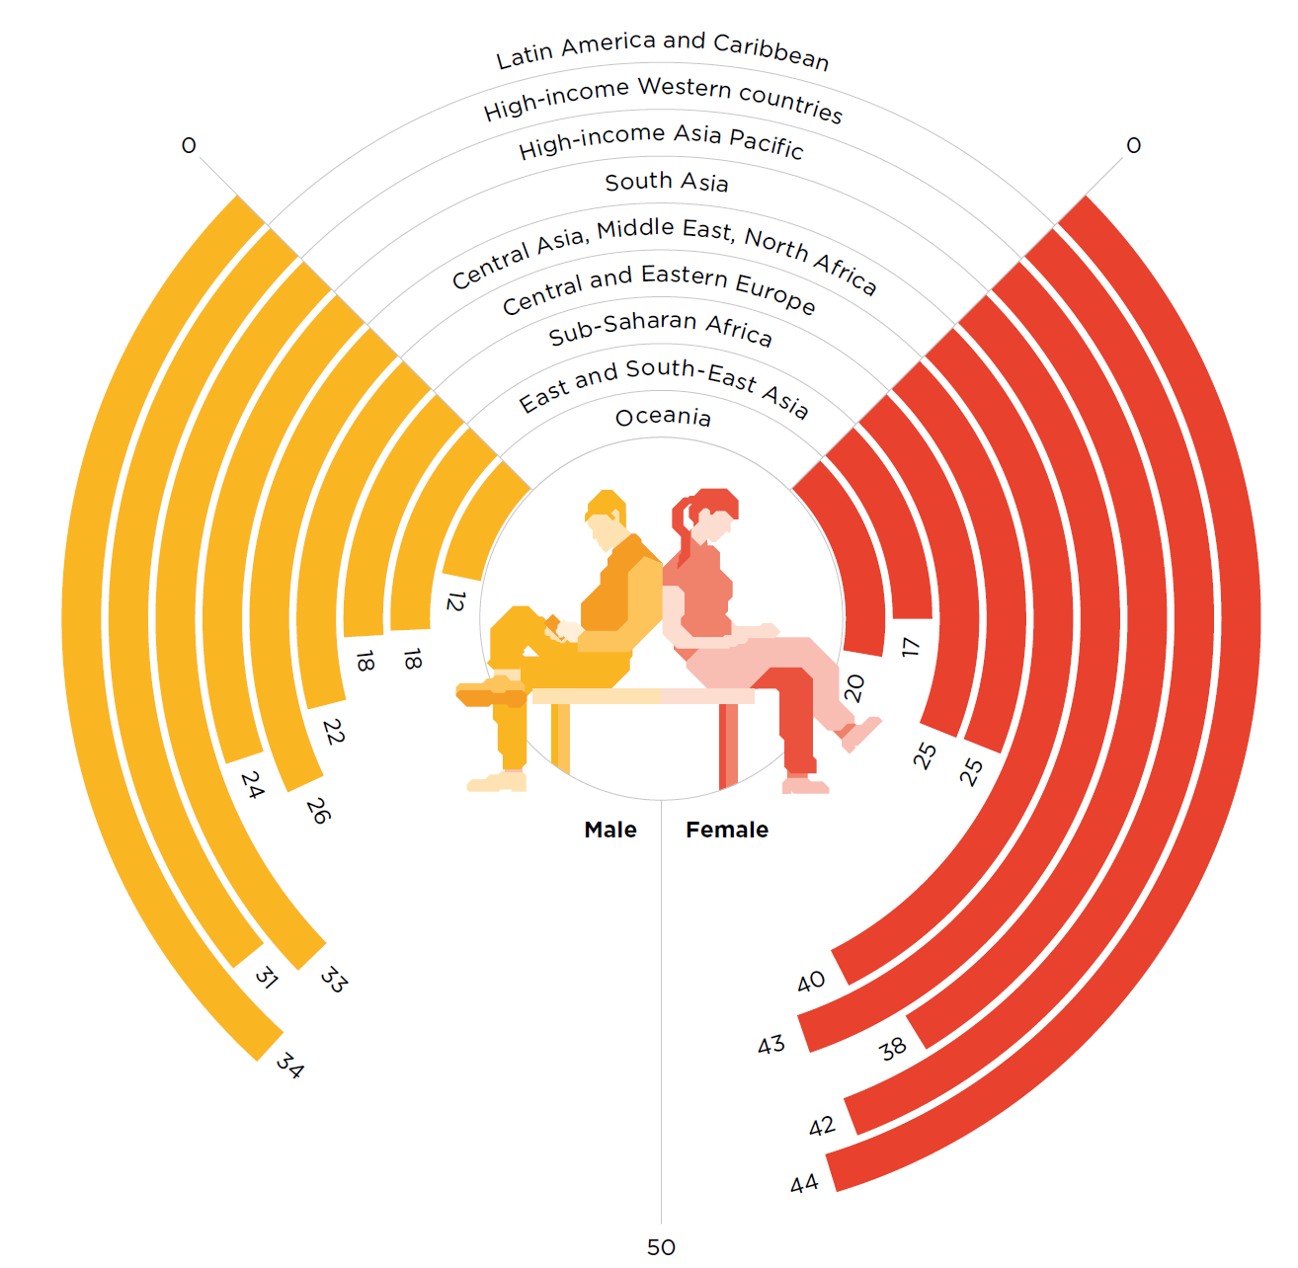
Levels of physical inactivity in 2016 by sex and subregions
Notes:
ACTIVE: a technical package for increasing physical activity. Geneva: World Health Organization; 2018. Licence: CC BY-NC-SA 3.0 IGO.
URL: https://www.who.int/publications/i/item/9789241514804

Slide 20
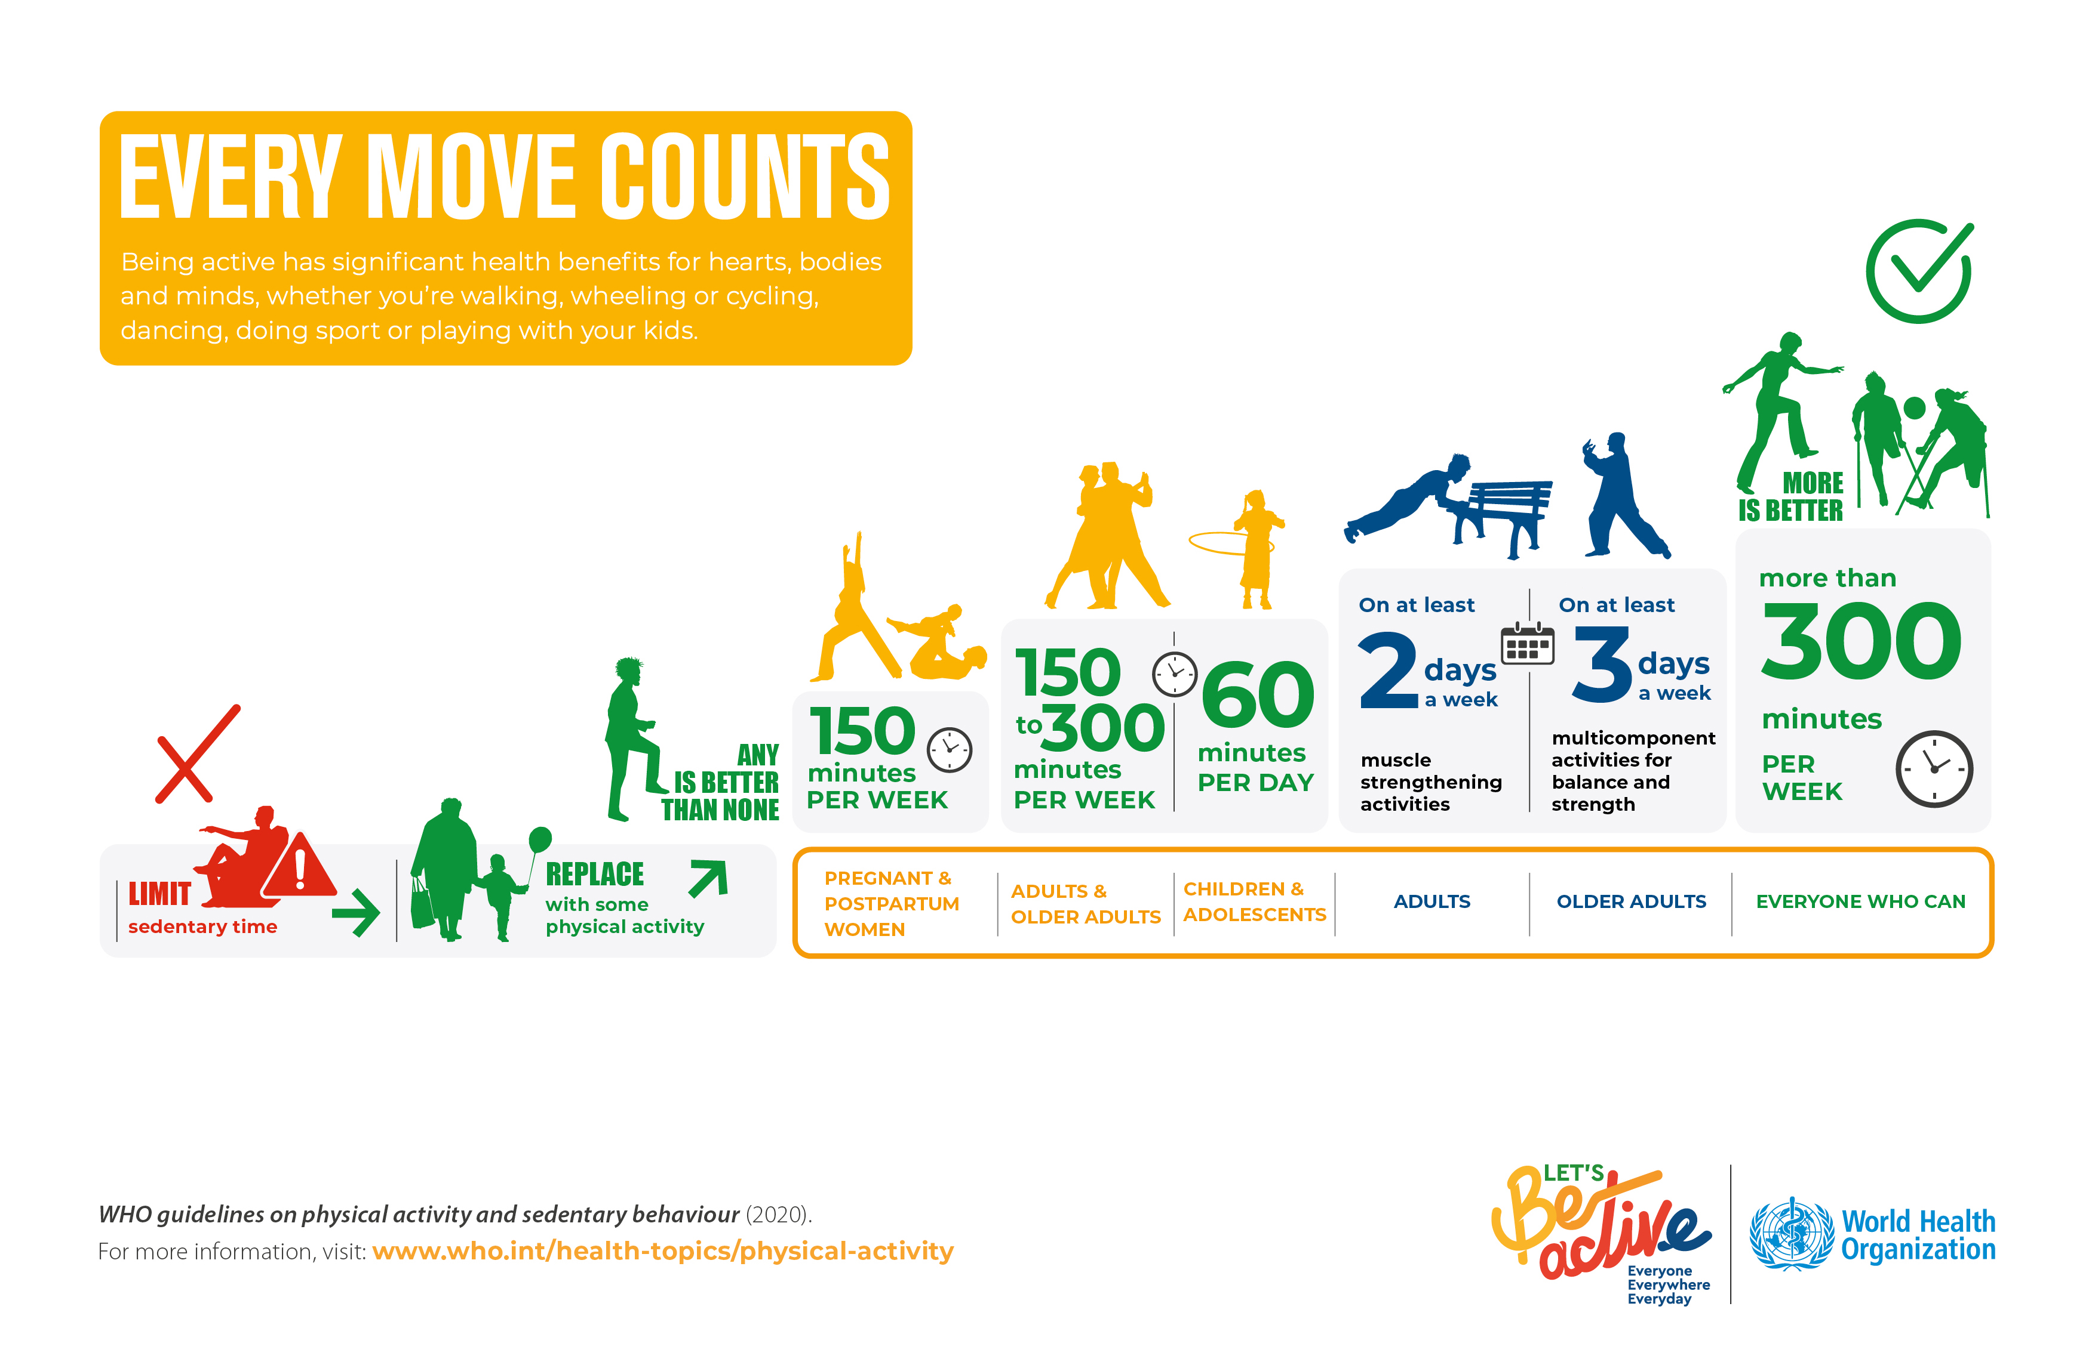
WHO – Every move counts
Notes:
Source: https://www.who.int/multi-media/details/who-guidelines-on-physical-activity-and-sedentary-behaviour, 7. 6. 2021

Slide 21
Common training methods for a healthy workout routine
Flexibility Exercise
Flexibility = ability of a joint, or series of joints, to move through a full range of motion without injury. A deficiency in muscle strength combined with inadequate flexibility frequently leads to musculoskeletal injuries, lower back pain, and a reduction in functional independence, particularly among older and inactive individuals (Herda et al., 2011).
Source: (Ketelhut and Ketelhut, 2020)
Factors affecting flexibility
Age | Level of physical activity
Sex | Stretch tolerance
Joint structure | Time of day
Muscle and connective tissue | Temperature
Notes:
Source: Herda TJ, Costa PB, Walter AA, Ryan ED, Hoge KM, Kerksick CM, Stout JR, Cramer JT (2011) Effects of two modes of static stretching on muscle strength and stiffness. Med Sci Sports Exerc 43(9):1777–1784.
Source: Ketelhut, S., & Ketelhut, R. G. (2020). Type of exercise training and training methods. Advances in Experimental Medicine and Biology, 25–43. https://doi.org/10.1007/978-981-15-1792-1_2

Slide 22
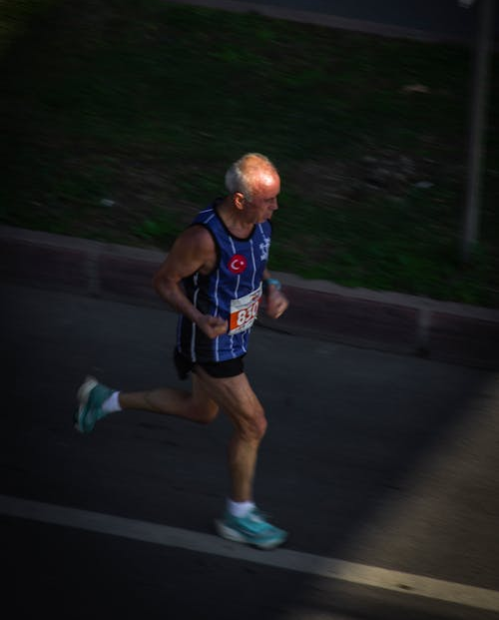
Common training methods for a healthy workout routine
Endurance training
Endurance with aerobic activities, called also endurance or cardio activities. At this type of activities people move large muscles in rhythmic movement for a certain period. Aerobic activities also increase heart and breathing rate.
Activities: running, brisk walking, biking, cross-country skiing, swimming, and dancing. Untrained person can have a training effect already by everyday activities like walking, cycling, climbing stairs.
Notes:
Source Herda TJ, Costa PB, Walter AA, Ryan ED, Hoge KM, Kerksick CM, Stout JR, Cramer JT (2011) Effects of two modes of static stretching on muscle strength and stiffness. Med Sci Sports Exerc 43(9):1777–1784.
:

Slide 23
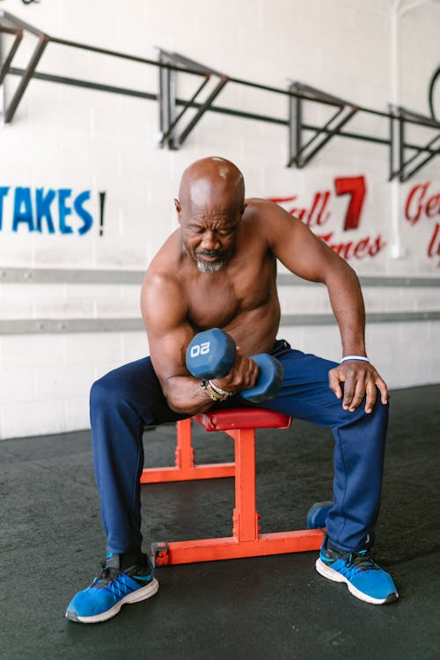
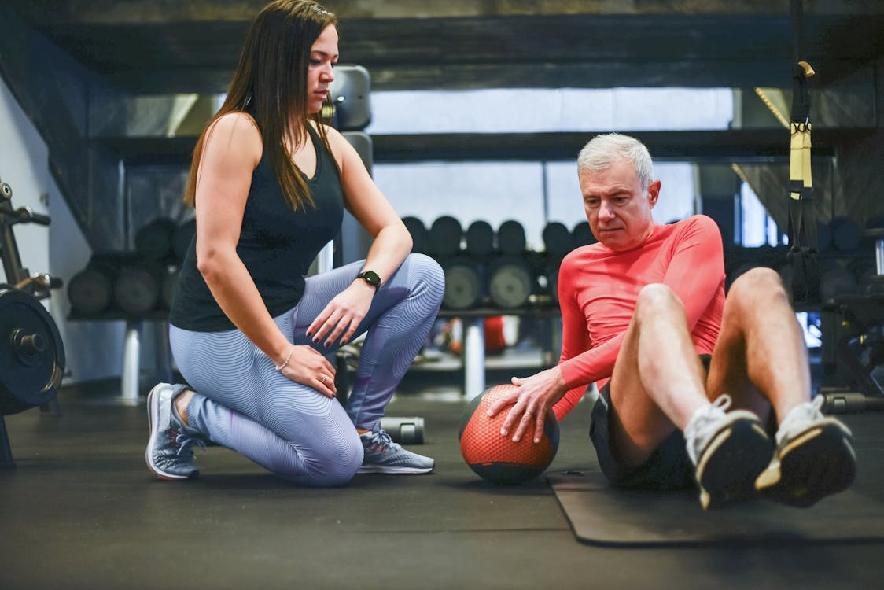
Common training methods for a healthy workout routine
Resistance/Strength Training
Strength training is systematic program of exercise where goal is to maintain or develop muscular system.
Studie show that regular resistance training is good for insulin sensitivity, blood pressure, bone mineral density and content which reduce risk for osteoporosis. For people older that 50 resistance training is more important because is helping with prevention of loss of muscle mass (sarcopenia).
Notes:
Source: Herda TJ, Costa PB, Walter AA, Ryan ED, Hoge KM, Kerksick CM, Stout JR, Cramer JT (2011) Effects of two modes of static stretching on muscle strength and stiffness. Med Sci Sports Exerc 43(9):1777–1784.

Slide 24
Training program
Balance disorders are caused by changes in the blood vessels, central nervous system or locomotor apparatus (joints, spine, muscles), and are also the reason why older people are more prone to injury.
Decrease in muscle strength: muscle mass is estimated to decrease at a rate of 4 % per year after the age of 25. This is a decline in muscle mass, muscle strength and muscle fibre quality.
Reduced endurance is the result of a sedentary lifestyle, i.e. a lack of movement in daily life.
Reduced joint flexibility is a typical consequence of ageing, which is also accelerated by inactivity and weight gain. The consequences are joint stiffness, reduced mobility and susceptibility to injury.
Notes:
Source: https://www.ckzpiran.si/wp-content/uploads/2020/05/vadba.pdf

Slide 25
Exercises
1. Tanding toes raise
Standing, hold on to a chair or kitchen counter. Raise yourself as high as you can on your toes. Hold your weight for a few for a few seconds and then lower your body back to the starting position. Repeat 10-15 times. You can also do this exercise sitting in a chair.
2. Standing heel raise
Standing, hold on to a chair or kitchen counter. Raise yourself as high as you can on your heels. Hold your weight for a few then lower your body back to the starting position. Repeat 10-15 times.
3. Getting up from the chair
Sit upright and straight, slightly closer to the edge of the chair. Spread your knees hip-width apart. Shift the weight of your body onto your feet, especially your heels, and slowly stand up. Try to do this without the help of your hands. With your spine straight, lean forward slightly. Make sure your knees stay stable and in line with the feet. Slowly bend your knees and hips and sit back to the starting position. Repeat 10 times.
Notes:
Source: https://www.ckzpiran.si/wp-content/uploads/2020/05/vadba.pdf

Slide 26
Exercises
4. Standing on one leg
Stand against a chair, possibly a wall or other stable object that can be lost if you lose your balance. Make sure you are standing upright. Raise your right leg as far as it will go and try to stand on your left leg for at least 10 seconds. The weight should be distributed over the entire left foot. Return to the starting position and repeat the exercise three more times. When you have done all the repetitions, do the exercise with the other leg.
Attention! It is easier to stand on one foot when wearing shoes than when we are barefoot.
5. Squatting next to a chair
Stand next to the chair. Straighten your posture. Bend your knees and do a squat. With your spine straight, lean forward slightly. Knees should not extend beyond the tip of the toes. Keep your feet flat on the floor. Return to the starting position and repeat the exercise 10-15 times.
Notes:
Source: https://www.ckzpiran.si/wp-content/uploads/2020/05/vadba.pdf

Slide 27
Exercises
6. Lifting the outstretched leg to the side while standing next to the chair
Keep your posture upright. Slowly raise the right leg out to the side as far as it will go without twisting your hips. The toes of this leg should point straight, not up towards the ceiling. Hold for a few seconds, lower to the starting position and repeat 10 times. Then do the exercise again with the left leg.
7. Lifting the seated leg
Sit upright and straight. Lean back against the backrest with your back resting on the backrest upright. Lift one leg to a horizontal position and hold it for a moment. While the other leg remains bent, with the foot flat on the floor. During the exercise is necessary to hold the edge of the chair with your hands. Repeat 10-15 times for each leg.
Notes:
Source: https://www.ckzpiran.si/wp-content/uploads/2020/05/vadba.pdf

Slide 28



Useful links to local institutions
Skupaj za zdravje. Source: https://www.skupajzazdravje.si/aktivnosti-za-krepitev-zdravja/kdo-izvaja-aktivnosti-za-krepitev-zdravja/
Center za zdravje in razvoj (Centre for health and development Murska Sobota). Source: https://www.czr.si/
Center za krepitev zdravja - Zdravstveni dom Murska Sobota.
Source: https://www.zd-ms.si/osnovno-zdravstvo/center-za-krepitev-zdravja
Notes:
Source: https://www.ckzpiran.si/wp-content/uploads/2020/05/vadba.pdf

Slide 29
Nordic walking
Nordic walking stands out as an enjoyable, sociable and effective exercise where we maintain mobility, strenght and cardiovascular health. It has many advantages and benefits.
Low impact on joints
One of the main concerns older people have about physical activity is the strain on their joints. Nordic walking for the elderly is ideal as it reduces the strain on the knees, hips and ankles compared to traditional walking. The use of poles distributes the weight of the body more evenly, which reduces the strain on the joints while ensuring a good workout.
Notes:
Source: https://vizita.si/zdravje/aktivno-zivljenje/nordijska-hoja-za-starejse.html

Slide 30

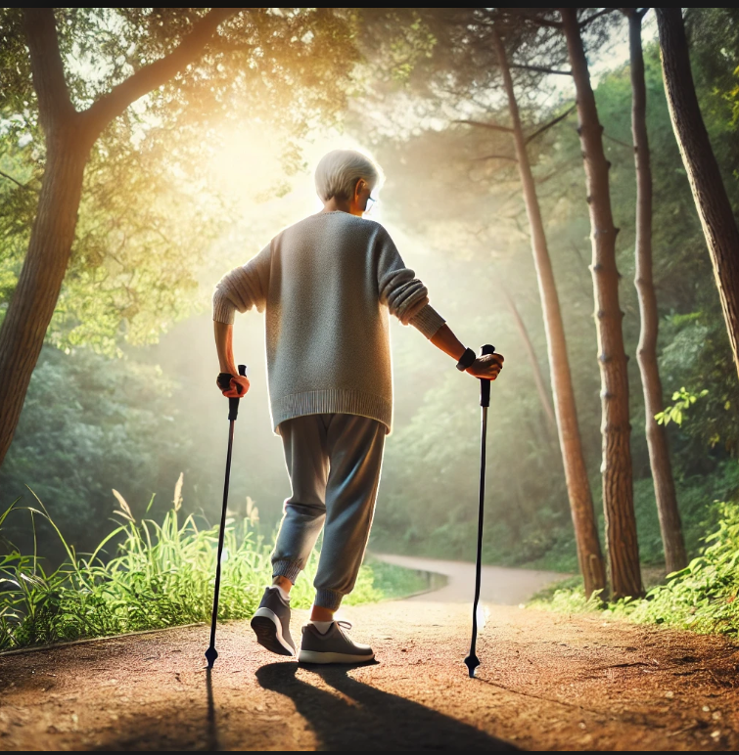
Nordic walking
2. Improved cardiovascular health
For older people, maintaining heart health is essential. Nordic walking involves both the upper and lower body, which speeds up the heart rate and improves circulation. This whole-body activity improves cardiovascular fitness without being too strenuous, making it a perfect option for seniors who need moderate exercise.
3. Improved balance and coordination
Balance problems can become more common as we get older, increasing the risk of falls and injuries. Nordic walking helps improve stability. Poles provide extra support and help older people maintain their balance on uneven ground or slippery surfaces. This increased stability can help reduce the likelihood of falls.
Notes:
Source: https://vizita.si/zdravje/aktivno-zivljenje/nordijska-hoja-za-starejse.html

Slide 31
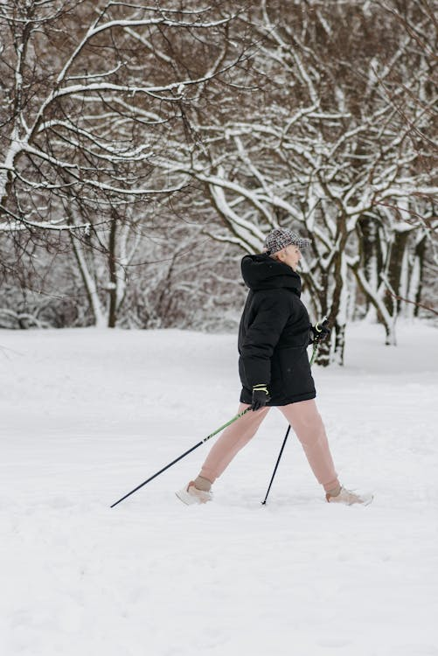
Nordic walking
4. Muscle strength and posture improvement
Muscle mass decreases with age. Nordic walking helps to combat this by engaging key muscle groups in the upper body (arms, shoulders, back) and lower body (legs, hips and trunk). Rhythmic movement also promotes better posture, which is particularly important for older people who struggle with back or shoulder pain. Over time, improved posture can reduce discomfort and help maintain independence.
Notes:
Source: https://vizita.si/zdravje/aktivno-zivljenje/nordijska-hoja-za-starejse.html

Slide 32
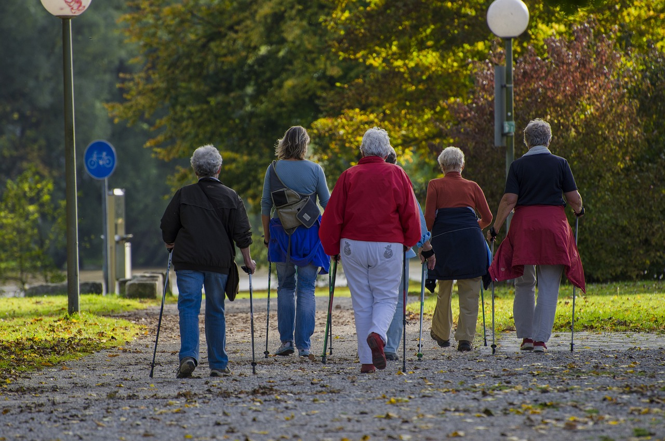
Nordic walking
5. Good mental health and socialisation
Physical activity is closely linked to mental health, especially in older people. Nordic walking allows older people to spend time outdoors, which has been shown to improve mood and reduce feelings of anxiety and depression. Walking in groups adds a social aspect and reduces the feeling of isolation that some older individuals may experience. Social interaction combined with exercise can greatly improve quality of life, which is why Nordic walking is so popular among seniors.
Notes:
Source: https://vizita.si/zdravje/aktivno-zivljenje/nordijska-hoja-za-starejse.html

Slide 33

Nordic walking
For older adults, maintaining independence is often a key goal as they age. Regular physical activity such as Nordic walking helps to promote independence by keeping the body strong, improving balance and increasing overall energy levels.
However, it is still important for older people to consult their doctor before starting any new exercise routine. This ensures that Nordic walking is a safe choice depending on your current health condition, such as arthritis, cardiovascular problems or joint problems.
Notes:
Source: https://vizita.si/zdravje/aktivno-zivljenje/nordijska-hoja-za-starejse.html

Slide 34
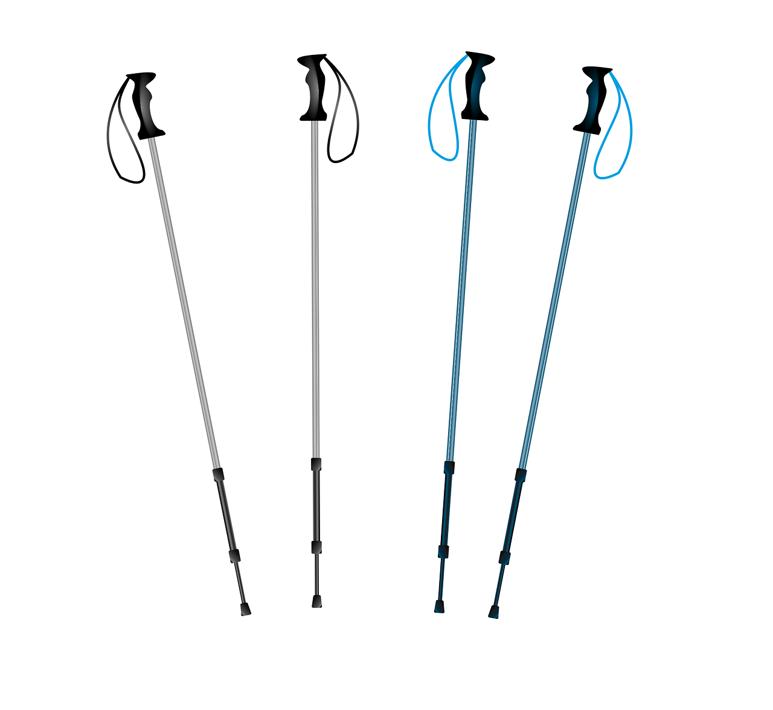
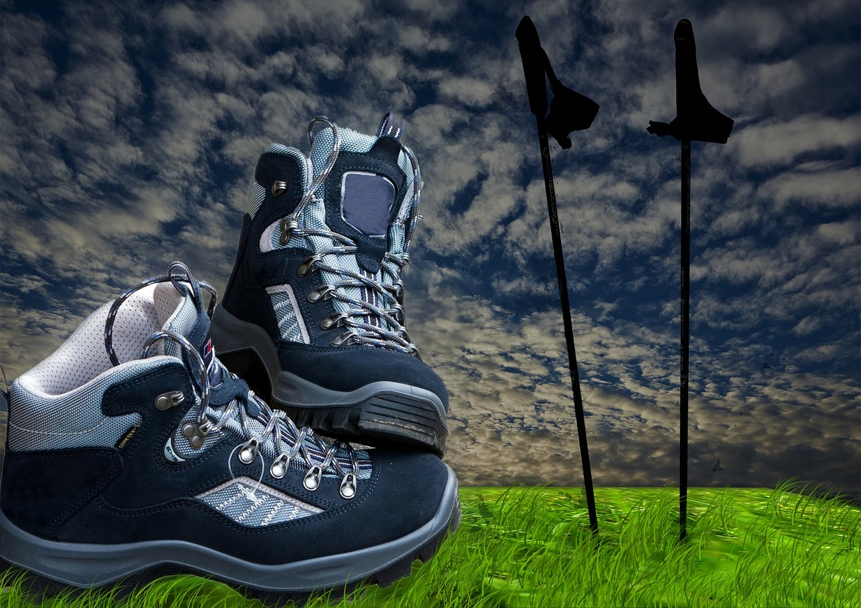
Nordic walking
The right poles and shoes make a big difference. Adjustable poles allow seniors to find the perfect height for their comfort and ergonomic handles provide a firm but gentle grip. Shoes with good support and non-slip soles are essential to maintain stability, especially on uneven paths.
Nordic walking is gentle, but it is important for older people to listen to their bodies. They should start at a comfortable pace and gradually increase the intensity as they feel more confident and ready. Regular rest and hydration are essential, especially for those just starting out.
Notes:
Source: https://vizita.si/zdravje/aktivno-zivljenje/nordijska-hoja-za-starejse.html

Slide 35

Sources and references:
Caspersen, C. J., Powell, K. E., & Christenson, G. M. (1985). Physical Activity, Exercise, and Physical Fitness: Definitions and Distinctions for Health-Related Research. Public Health Reports (1974-), 100(2), 126–131. http://www.jstor.org/stable/20056429
Website of World Healt Organization. Physical activity. Published 26. 6. 2024. Source: https://www.who.int/news-room/fact-sheets/detail/physical-activity
https://www.who.int/multi-media/details/who-guidelines-on-physical-activity-and-sedentary-behaviour, 7. 6 . 2021
ACTIVE: a technical package for increasing physical activity. https://www.who.int/publications/i/item/9789241514804, 15. 10. 2018

Slide 36
Sources and references:
Herda TJ, Costa PB, Walter AA, Ryan ED, Hoge KM, Kerksick CM, Stout JR, Cramer JT (2011) Effects of two modes of static stretching on muscle strength and stiffness. Med Sci Sports Exerc 43(9):1777–1784.
Ketelhut, S., & Ketelhut, R. G. (2020). Type of exercise training and training methods. Advances in Experimental Medicine and Biology, 25–43. https://doi.org/10.1007/978-981-15-1792-1_2
Nordijska hoja za starejše (2024). Source: https://vizita.si/zdravje/aktivno-zivljenje/nordijska-hoja-za-starejse.html, 23. 10. 2024.
Photos: Pixabay.com, Pexels.com and Unsplash.com

