Slide 1



SenSyn - Senior Synergy: Empowering Lifelong Learning and Healthy living through Community Events

Slide 2

MODULE 6: Art, Culture, and Creative Expression
Learning as a way of life - Asking and Encouraging

Slide 3
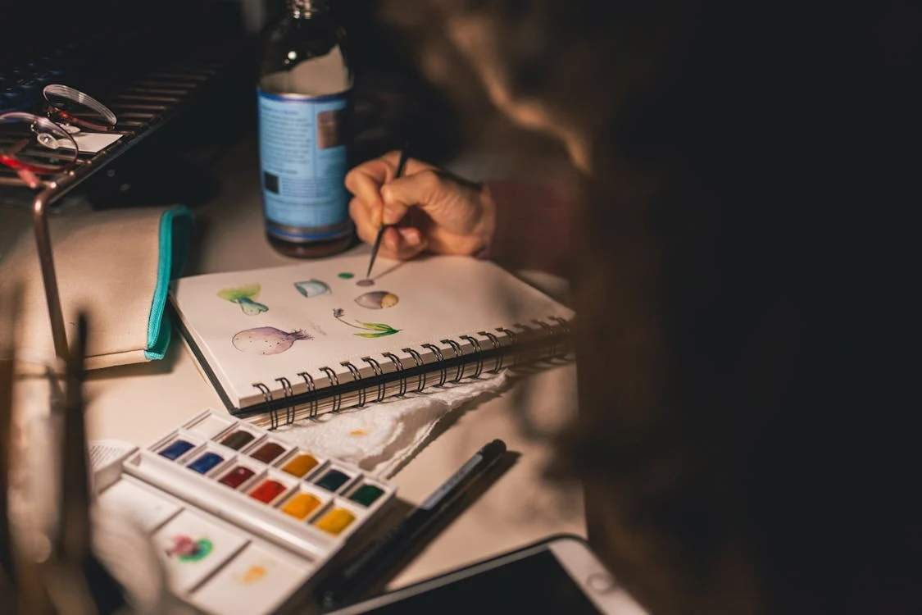

What kind of art or creative activities have brought you joy?
Music, painting, literature, traditional crafts, gardening, caligraphy,
cooking, attending cultural events….
Notes:
Warm-up Question: Start by asking participants about their favorite forms of art or cultural experiences. listening to music, gardening, painting, cooking, or attending cultural events.
Encourage participants to share briefly.

Slide 4
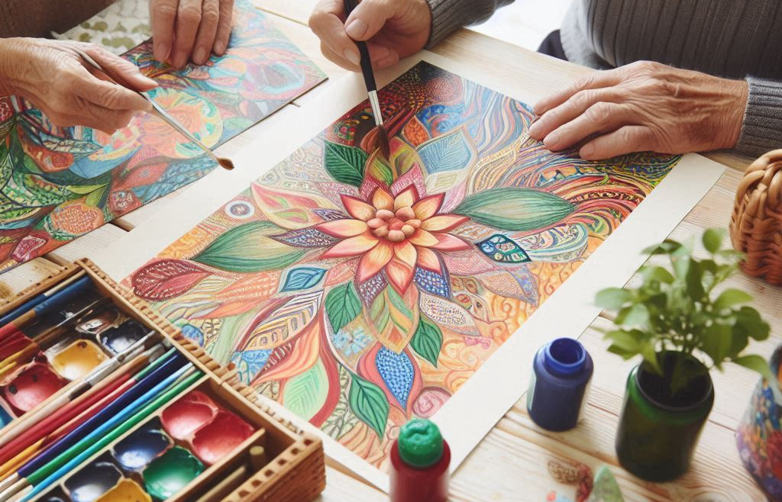
Importance of Art, Culture and Creative Expression for Wellbeing
Did you know that engaging in creative activities regularly can improve happiness, reduce loneliness, and enhance cognitive abilities, making a real difference in our well-being as we age? (National Institute for Aging)
Creative participation can improve mood, boost social interaction, and maintain cognitive and physical abilities
The CultureForHealth project, found that arts-based interventions help reduce stress and anxiety and improve overall quality of life for people of all ages by fostering social connections and healthier lifestyles
The World Health Organization (WHO) has noted that participation in arts can help reduce symptoms of anxiety and depression
Notes:
Prompt: Ask participants whether they have noticed any improvement in their mood when engaging in creative or cultural activities.

Slide 5
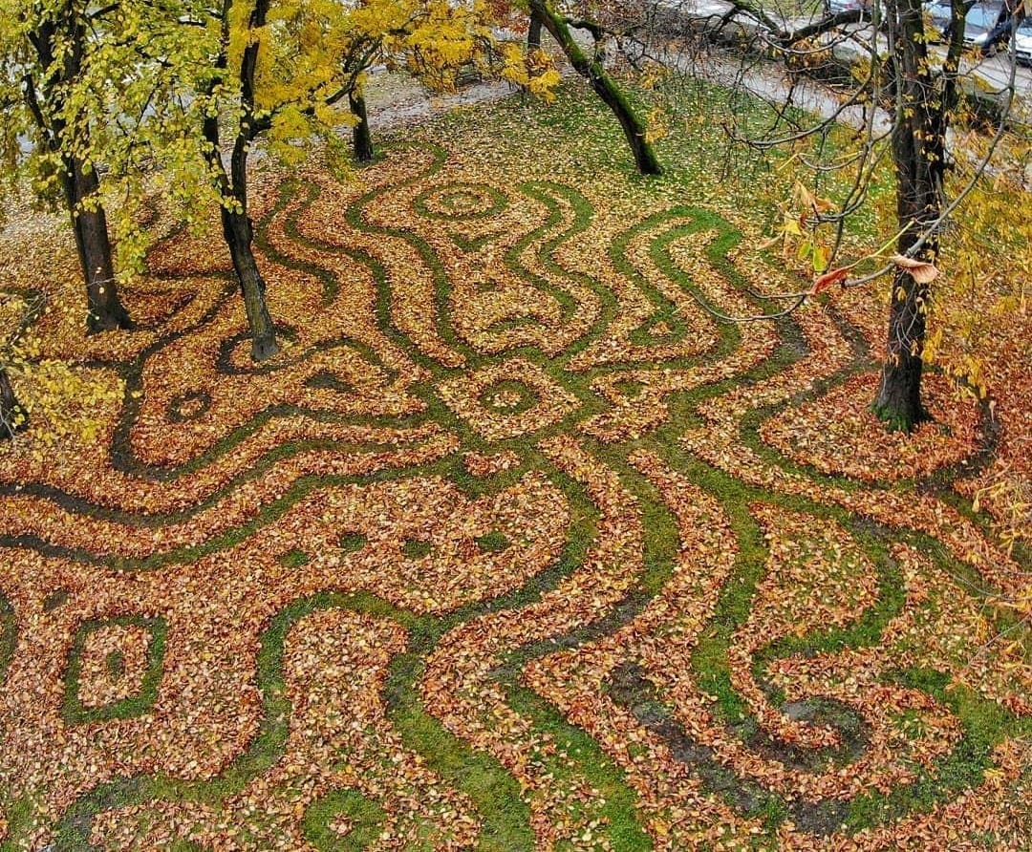
Nikola Faller, sculptor CRO
Even cleaning a garden can be creative ☺
https://lupiga.com/hiperlink/uz-ovog-covjeka-jesen-u-osijeku-je-nesto-posebno-grabljanjem-lisca-do-impresivne-umjetnosti

Slide 6
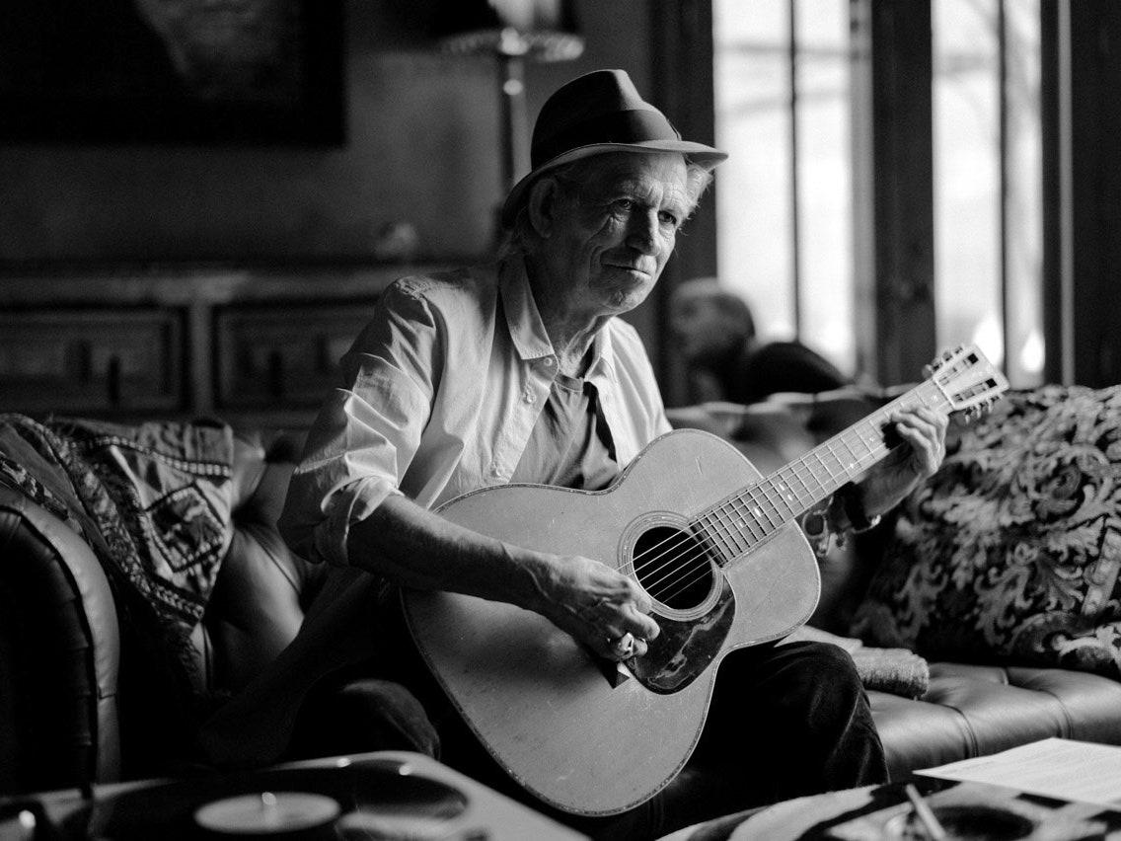

Social Connection
Art and culture foster social bonds, which are crucial for mental and physical health
Notes:
Question to the participants: This photo is the ultimate proof that music has a positive impact on aging. Can you recognize the individual in this photo? ☺

Slide 7
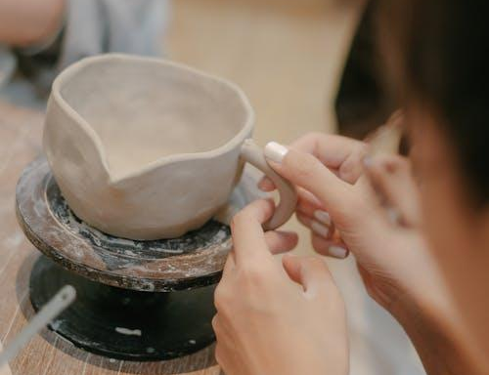
Cognitive Health
Art is a form of creative expression and a tool to keep our minds active.
Handmade Wellbeing project: activities like crafting have been shown to improve hand-eye coordination and cognitive abilities necessary for daily life (EPALE)
Notes:
Question to the participants: Do you know any local art or craft groups that you could join or recommend to others? Let’s make a list together!

Slide 8
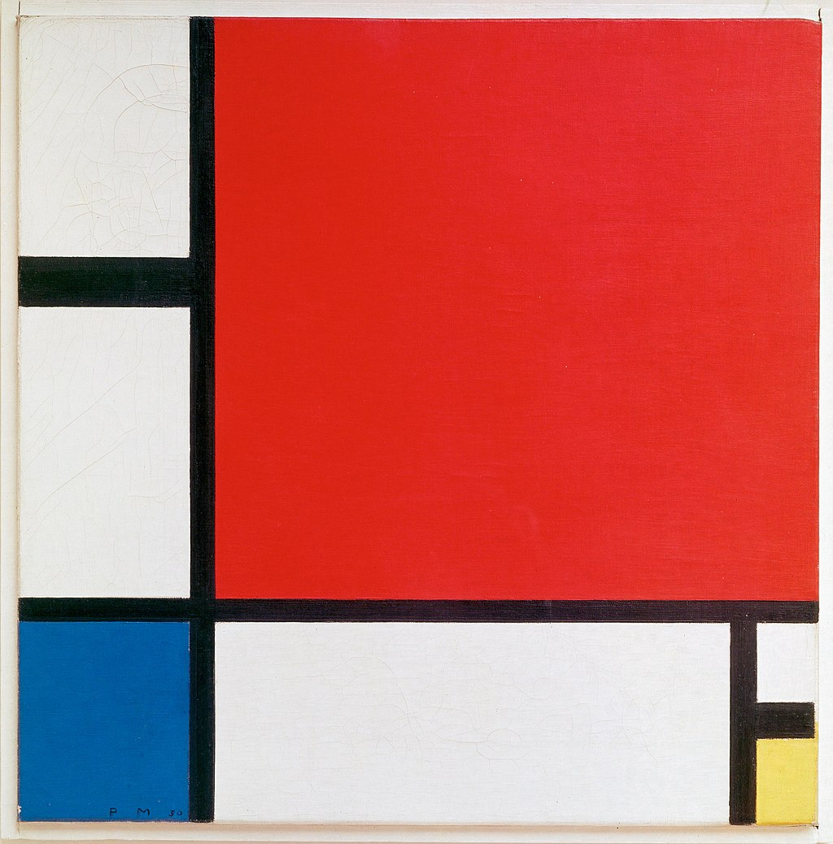
Interactive Exercise
Composition with Red, Blue and Yellow
Piet Mondrian
1930
Oil on canvas
45 cm × 45 cm
Kunsthaus Zürich
Notes:
Prompt: Ask the participants to describe what they see and to interpret it using their imagination. You can select different examples and utilize the full screen to display artwork. Encourage different perspectives—what does the artwork remind them of, how does it make them feel, or what story could it be telling? This activity helps demonstrate how art engages our cognitive functions by involving memory, imagination, and abstract thinking.

Slide 9
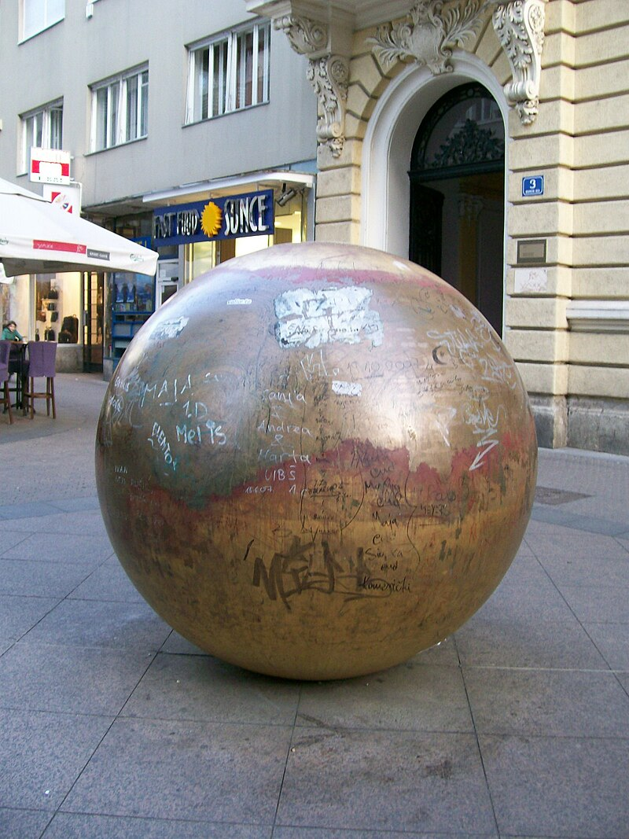
Interactive Exercise
Grounded Sun / Prizemljeno Sunce
Ivan Kožarić, 1971.
Notes:
Prompts: Ask participants what the sculpture makes them think of. Does it evoke warmth, curiosity, or perhaps even something entirely different? They could also discuss the importance of public art and how it interacts with its surroundings. Discuss Street art if appropriate

Slide 10
Interactive Exercise
Jeste li znali za Prizemljen Sunčev sustav?
Prizemljeni Sunčev sustav, ambijentalna umjetnička instalacija koju tvore Prizemljeno sunce Ivana Kožarića i Devet pogleda Davora Preisa
Planeti se nalaze na sljedećim lokacijama i udaljenostima:
Merkur – Margaretska ul. 3; udaljen 88 metara od Sunca
Venera – Trg bana Josipa Jelačića 3; udaljen 167,5 metara od Sunca
Zemlja – Varšavska ul. 9; udaljen 211 metara od Sunca
Mars – Tkalčićeva ul. 21; udaljen 319 metara od Sunca
Jupiter – Voćarska ul. 71; udaljen 1194 metra od Sunca
Saturn – Račićeva ul. 1: udaljen 2170 metara od Sunca
Uran – Siget 9; udaljen 4150 metara od Sunca
Neptun – Kozari 17 (naselje Kozari bok); udaljen 6570 metara od Sunca
Pluton – Aleja Bologne, na nosivom stupu podvožnjaka; udaljen 8880 metara od Sunca
Notes:
Activity: Ask the participants if they know of any similar open-air installations in their city. Discuss.

Slide 11
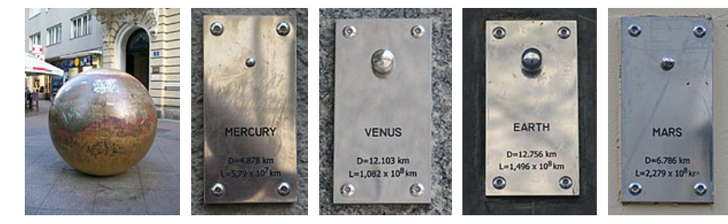
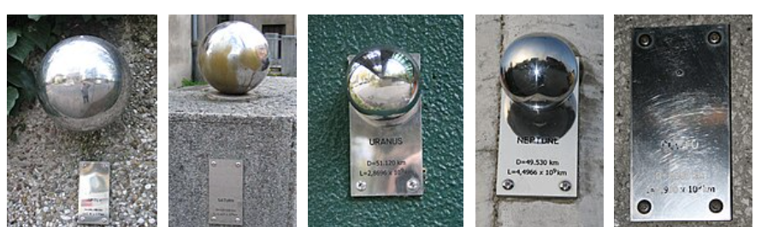
Interactive Exercise
Prizemljeni Sunčev sustav, Zagreb, Davor Preis, 2024.
Notes:
Activity: Ask the participants to describe what they see and to interpret it using their imagination. You can select different examples and utilize the full screen to display artwork. Encourage different perspectives—what does the artwork remind them of, how does it make them feel, or what story could it be telling? This activity helps demonstrate how art engages our cognitive functions by involving memory, imagination, and abstract thinking.

Slide 12
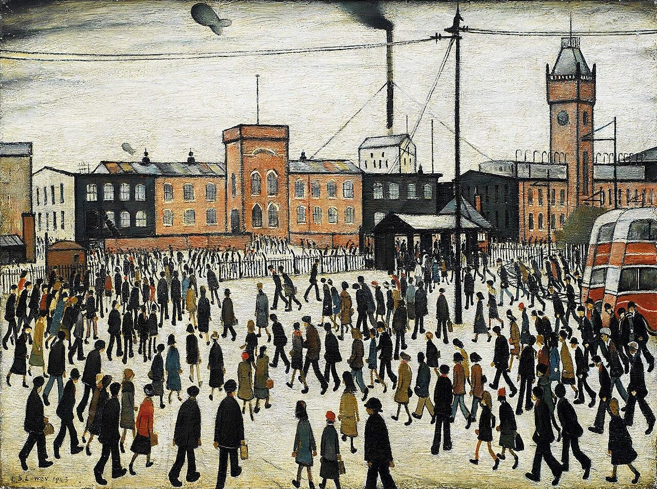
Inspiring examples
Laurence Stephen Lowry
a famous English artist known for his distinctive urban landscapes featuring "matchstick men," worked as a rent collector until his 60s. Although he painted throughout his life, it wasn’t until later in life that his work gained widespread recognition.
Notes:
Activity: Ask the participants to describe what they see and to interpret it using their imagination. You can select different examples and utilize the full screen to display artwork. Encourage different perspectives—what does the artwork remind them of, how does it make them feel, or what story could it be telling? This activity helps demonstrate how art engages our cognitive functions by involving memory, imagination, and abstract thinking.

Slide 13
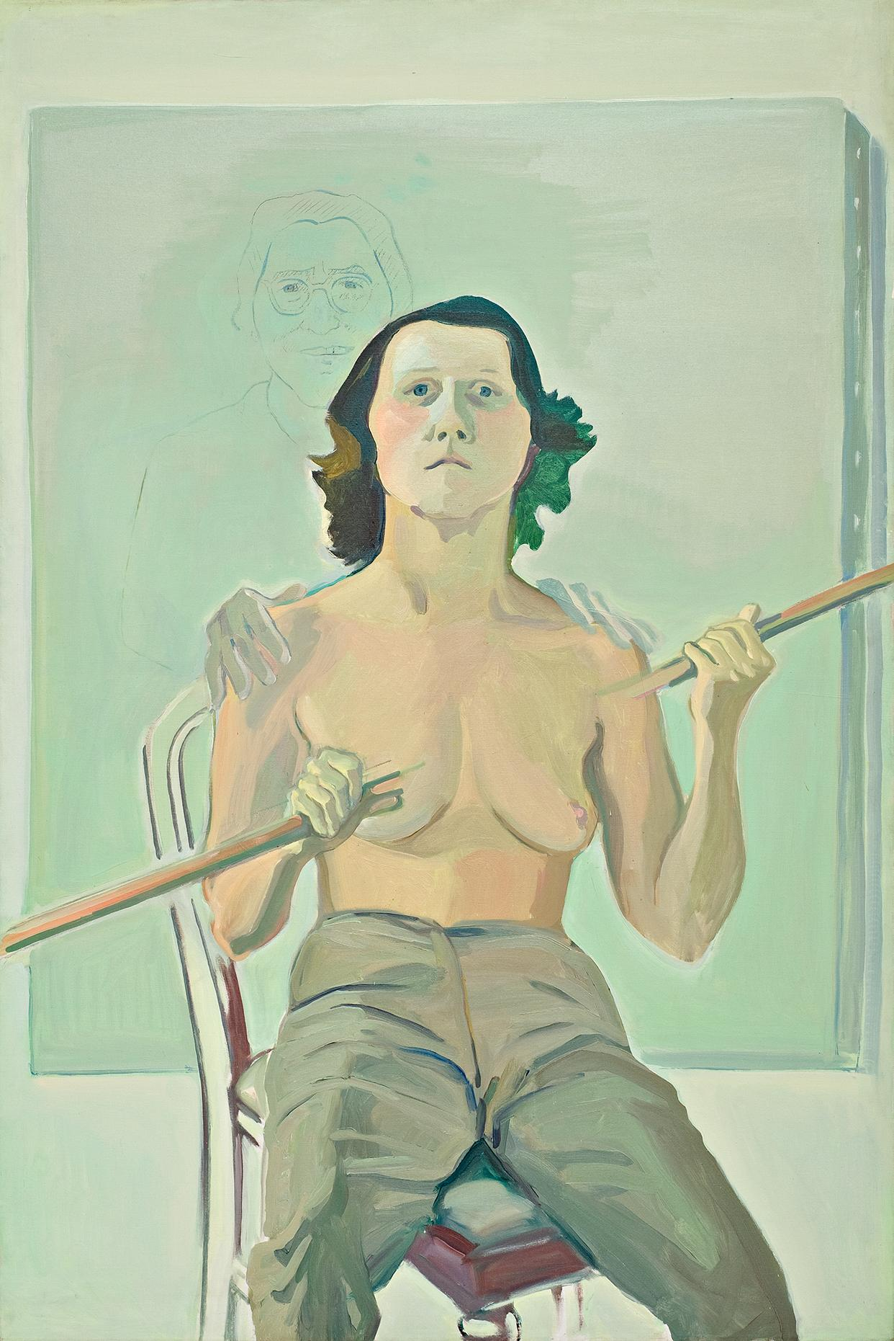
Inspiring examples
Maria Lassnig, an Austrian painter, gained significant recognition in her later years, especially for her "body awareness" paintings. Lassnig’s career flourished after the age of 60 when her work began to receive international attention. She was even awarded the Golden Lion for Lifetime Achievement at the Venice Biennale in 2013, when she was 94 years old.
Notes:
Activity: Ask the participants to describe what they see and to interpret it using their imagination. You can select different examples and utilize the full screen to display artwork. Encourage different perspectives—what does the artwork remind them of, how does it make them feel, or what story could it be telling? This activity helps demonstrate how art engages our cognitive functions by involving memory, imagination, and abstract thinking.

Slide 14
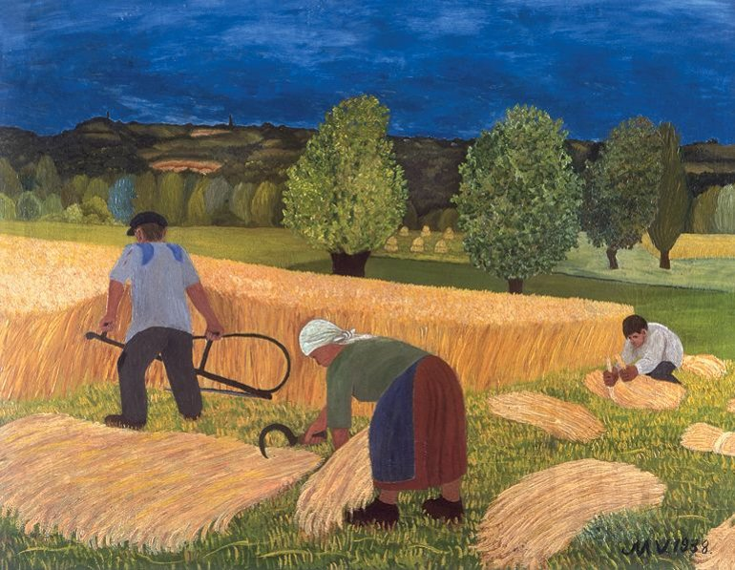
Inspiring examples
Mirko Virius, HR
Virius was part of the Hlebine School, a Croatian naïve art movement. He began painting relatively late in life, after meeting prominent painters like Ivan Generalić and Franjo Mraz in the late 1930s. Virius was a self-taught artist who only painted for a few years, but during that time, he created a substantial body of work that gained recognition for its vivid portrayal of rural life in Croatia.
Notes:
Prompt: What other famous picture does this picture remind you of?

Slide 15
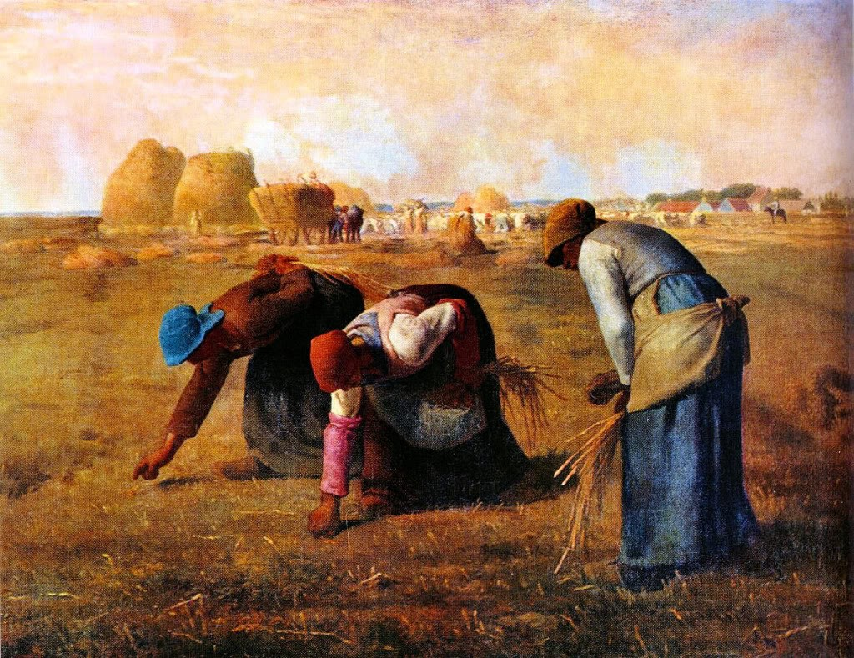
Jean-François Millet, France (1814-1875)
Millet's "The Gleaners" is one of the most iconic representations of rural labor in art history. It depicts three peasant women gleaning the last bits of grain after the harvest, portraying their hard work in a realistic and empathetic manner.
Notes:
Activity:

Slide 16
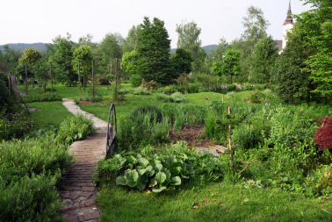
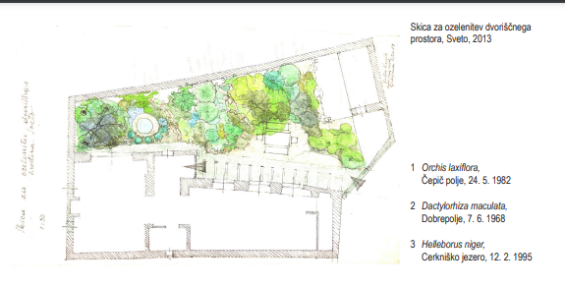
Juta Krulc (SI)
She was primarily known as a landscape architect but became recognized for her artwork later in her life. Juta Krulc continued to work actively into her senior years, creating notable contributions to Slovenian landscape design and art.

Slide 17

Charles Bradley
Known as the "Screaming Eagle of Soul," Bradley's career didn't take off until he was 62 years old. Before that, he worked various jobs, including as a cook and handyman, while performing James Brown covers in small clubs. It was only in his sixties that he released his debut album "No Time For Dreaming," which catapulted him to fame with his powerful, soulful voice and emotional performances.
https://www.youtube.com/watch?v=bChAGgUyEFQ
All of these artists found their creative voice later in life.
It’s proof that there’s no age limit to discovering and pursuing your passions.

Slide 18

Discussion:
Creativity has no age limit. Whether you choose to sing, paint, or write, what matters is that you enjoy it and keep learning new things.
Invite participants to think about which creative activity they would like to explore more after today. This could be something they mentioned earlier during the motivational exercise.
This concludes the theoretical part of the presentation. Next, it would be ideal to smoothly transition into preparing for the museum tour by setting up expectations and giving them a sense of excitement.
Notes:
Comment: I planned to visit the local museum, but alternatively, you can visit virtual museums (following slides)

Slide 19

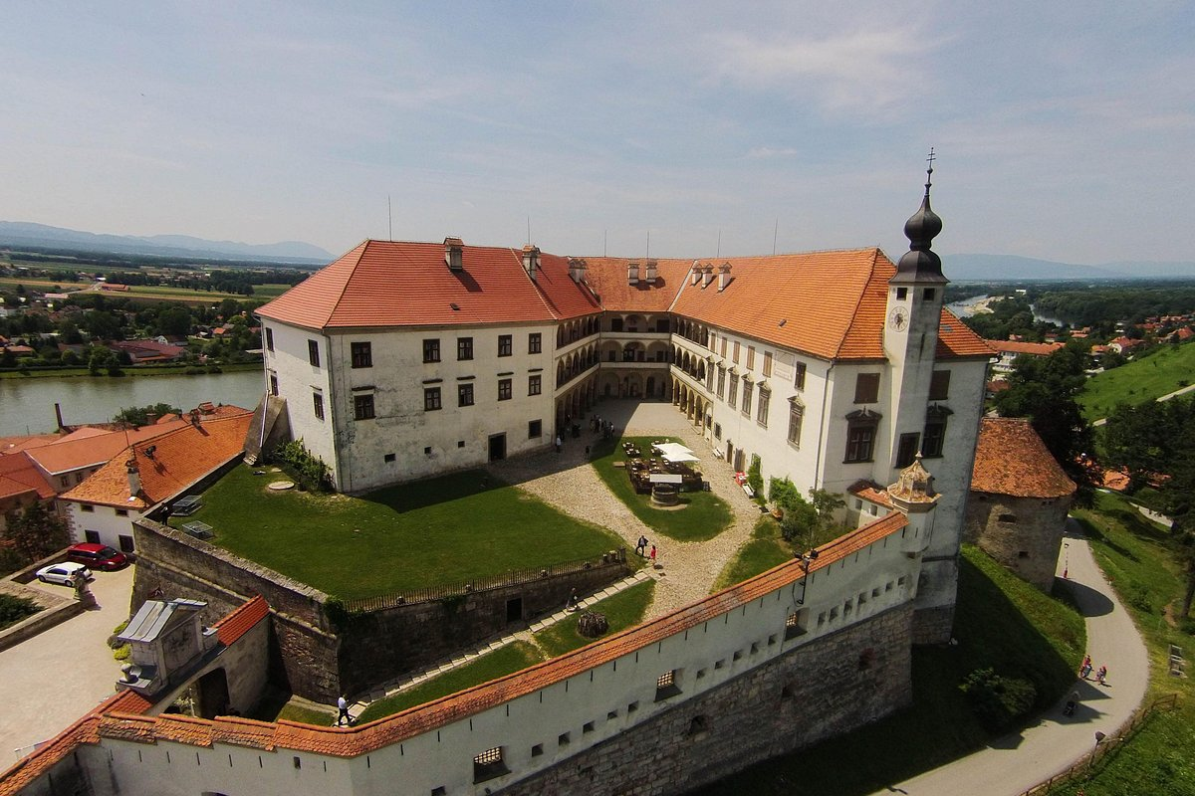
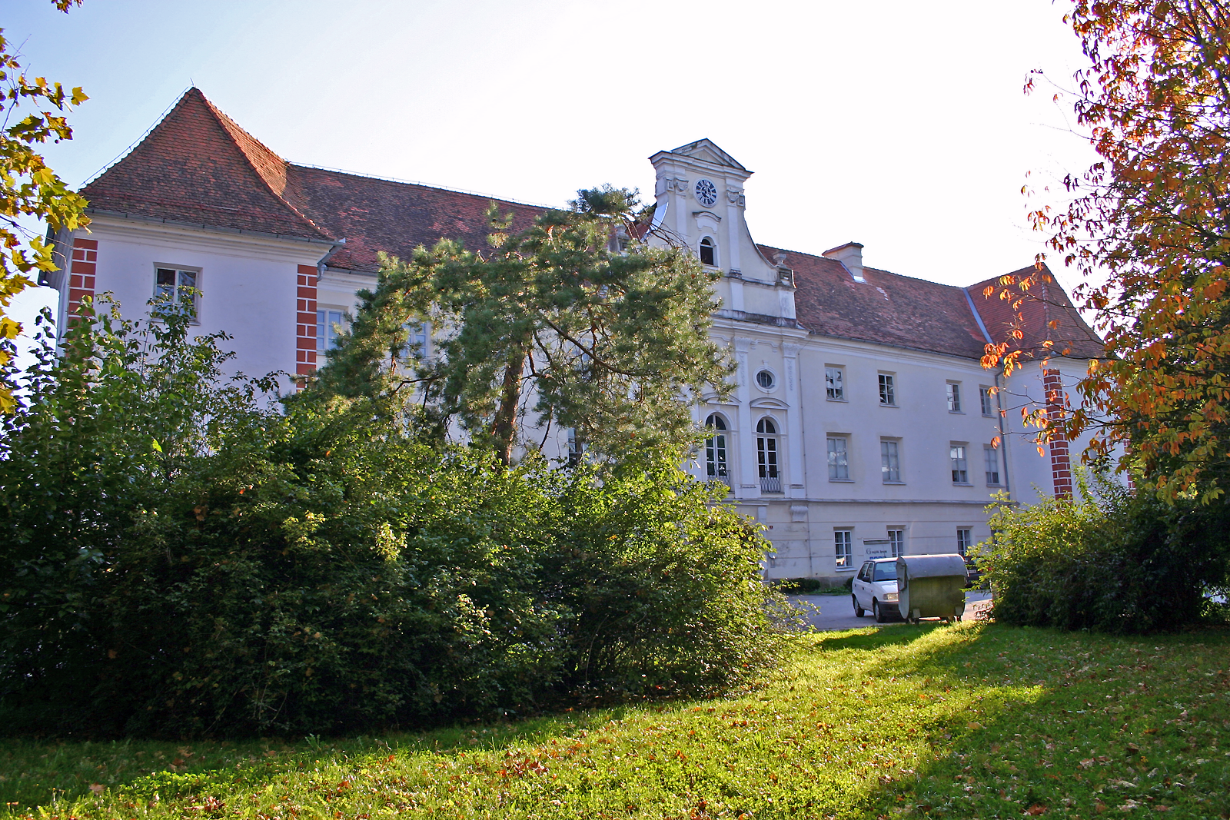
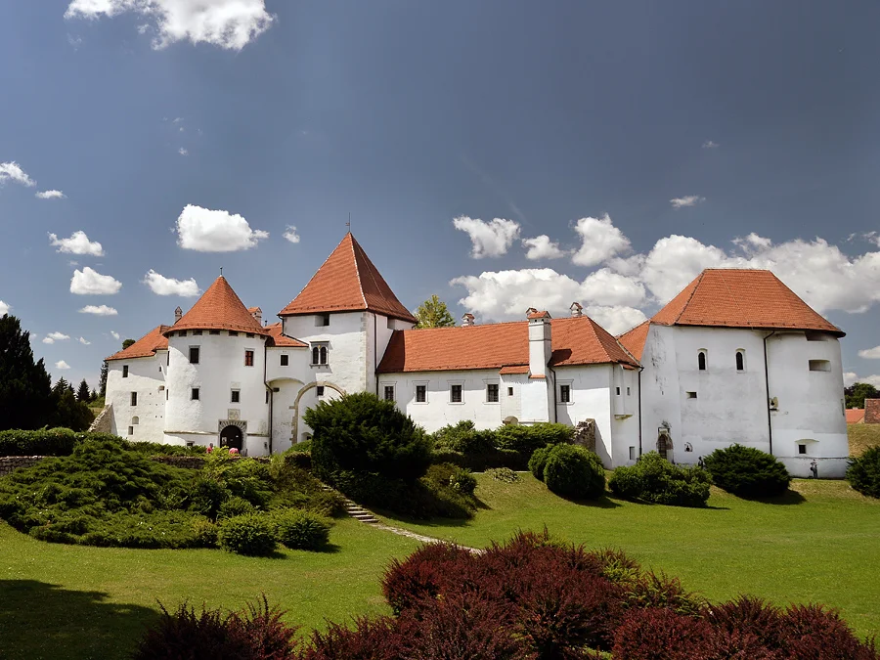
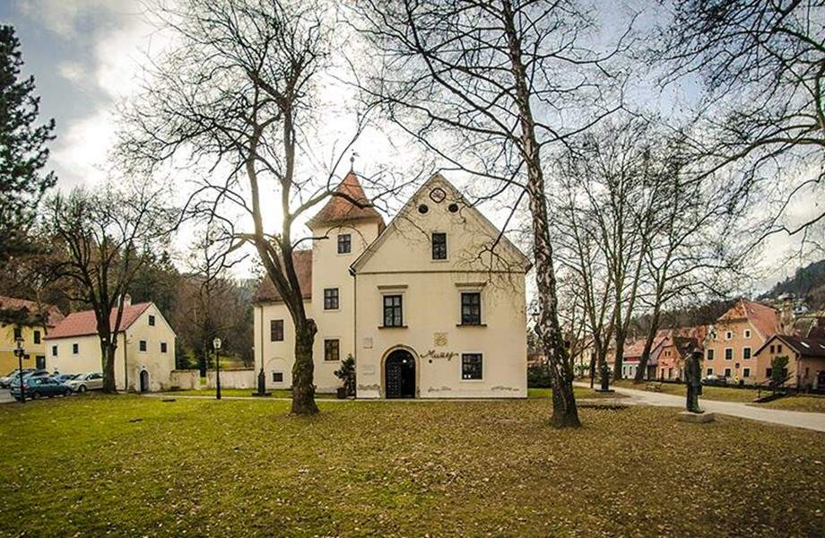
Visit to local museum – field trip
When was the last time you visited a museum? What kind of exhibition did you see? Was it focused on art, history, or perhaps something else entirely?
Museums are wonderful spaces for exploring, learning, and connecting with culture. Think about how often you go to exhibitions or similar cultural places—maybe you visit regularly, or perhaps it's been a while. No matter how long it has been, this visit will be a great opportunity to immerse ourselves in art and history once again.
Notes:
Comment: Typically, people do not visit a permanent exhibition more than once. Therefore, our choice will be the historical exhibition in the Old City Varazdin.

Slide 20
Exploring Virtual Museums:
Alternative to the field trip
Google Arts & Culture:
A free platform that offers virtual tours of many of the world’s most famous museums. You can explore the Louvre, the British Museum, the Van Gogh Museum, and much more.
What You Can See: High-resolution images of artworks, detailed virtual tours of galleries, and even interesting features like zoom-in details to explore brushstrokes and textures.
https://artsandculture.google.com/
Notes:
Comment: Inform participants about visiting virtual museums like Louvre or British Museum, and suggest finding local options as well.
Activity: Encourage participants to navigate to the website on their devices to explore a museum of their choice.

Slide 21
Exploring Virtual Museums:
Alternative to the field trip
The Louvre (Paris, France):
Louvre offers a number of interactive tours on their website, letting you "walk" through the halls of the world’s largest art museum.What You Can Explore: Take a virtual walk through exhibitions, including collections from Egyptian antiquities to famous masterpieces like the Mona Lisa.
A free platform that offers virtual tours of many of the world’s most famous museums.
The Louvre Virtual Tours
https://www.louvre.fr/en/online-tours#virtual-tours
Notes:
Comment: Inform participants about visiting virtual museums like Louvre or British Museum, and suggest finding local options as well.
Activity: Encourage participants to navigate to the website on their devices to explore a museum of their choice.

Slide 22
Exploring Virtual Museums:
Alternative to the field trip
The Vatican Museum:
The Vatican Museums provide an immersive virtual tour, allowing visitors to see stunning rooms like the Sistine Chapel, which features Michelangelo’s famous ceiling.
How It Helps: This is perfect for those unable to make the trip but still interested in seeing some of the most beautiful art and architecture in the world.
http://www.museivaticani.va/content/museivaticani/en/collezioni/musei/tour-virtuali-elenco.html
Notes:
Comment: Inform participants about visiting virtual museums like Louvre or British Museum, and suggest finding local options as well.
Activity: Encourage participants to navigate to the website on their devices to explore a museum of their choice.

Slide 23
How to use Google maps as for virtual cultural visits:
Alternative to the field trip
Pyramids in Giza
Street view Pyramids of Giza
Notes:
Comment: explaint how to use a Street View for this option or explore photos by local virtual guides

Slide 24
Exploring Virtual Museums:
Alternative to the field trip
Local Museums Offering Virtual Tours:
Many local and national museums have developed their own virtual experiences, allowing people to engage with regional history and culture without leaving home.
Recommend participants to explore online offerings from nearby museums like the Museum of Contemporary Art Zagreb or Mimara Museum.
Notes:
Comment: replace with local museums
Prompt: Participants should write down one creative activity they plan to try and share it with the group, if they feel comfortable.

Slide 25


Thank you for your attention!

Slide 26
Sources and references:
https://smarthistory.org/
Art Education for Older Adults: Rationale, Issues, and Strategies, Melanie Davenport, Pamela Harris Lawton, Marjorie Manifold
"European Art: A Neuroarthistory", John Onians
International Journal of Lifelong Learning in Art Education
Art Therapy and Creative Coping Techniques for Older Adults, Susan I. Buchalter

