Slide 1



SenSyn - Senior Synergy: Empowering Lifelong Learning and Healthy living through Community Events

Slide 2


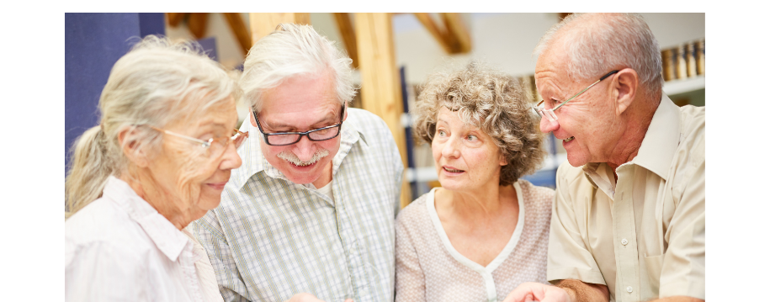

MODULE 7: SOCIAL SKILLS AND COMMUNICATION

Slide 3

SOCIAL SKILLS AND COMMUNICATION

Slide 4

SOCIAL SKILLS AND COMMUNICATION
Social skills and communication are important aspect of every human being. They allow individuals to interact with others and transmit information. Improved social skills and communication help seniors to enhance their ability to connect with others, leads to better emotional and cognitive health, and promotes a more engaged, independent, and satisfying life.

Slide 5
WHAT ARE SOCIAL SKILLS?
Behaviours that promote effective communication and satisfying relationships between people.
Social skills can be simple, such as making eye contact, or complex, such as being able to join an activity or ask a friend for help.
Making new contacts
Being able to empathise
Building friendship
Negotiate
Resolve conflict
Listen
Cooperate
Express feelings and thoughts
Notes:
Source: https://www.tosemjaz.net/razisci/custva-in-psihicne-stiske/socialne-vescine/

Slide 6
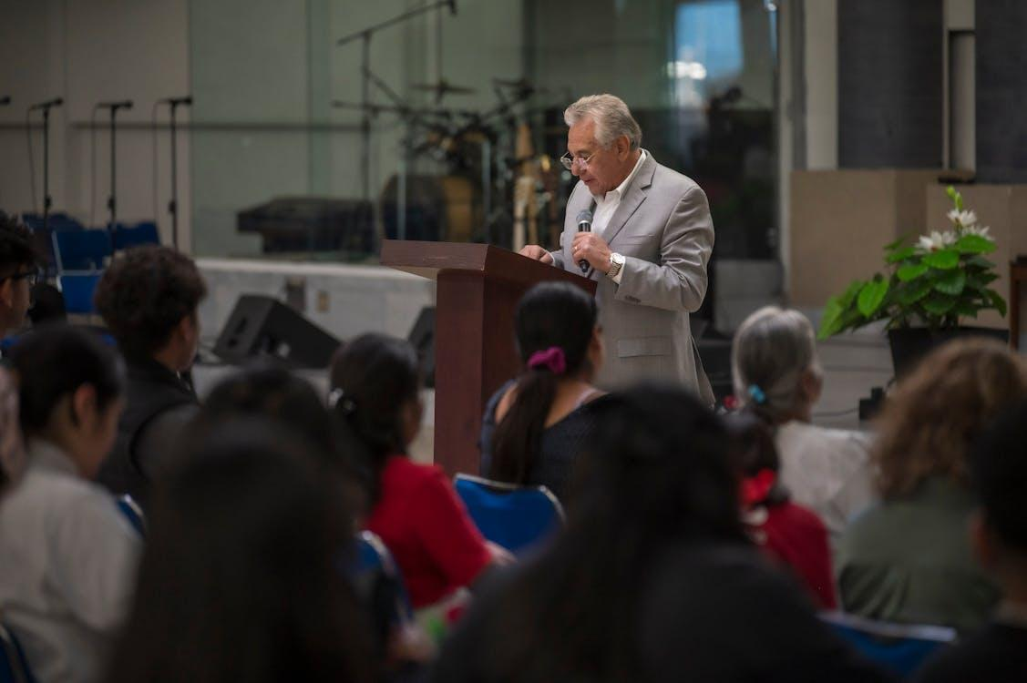

WHAT IS COMMUNICATION?
Communication is the expression of our thoughts, views, beliefs, desires and feelings using words and non-verbal gestures.
We use different channels to communicate: speech, the written word, bodily gestures, behaviour, etc.
Communication helps people to manage their relationships, to relieve problems and to relax.
Notes:
Source: https://www.brstpsihologija.si/skrivnosti-dobre-medosebne-komunikacije/

Slide 7
TYPES OF COMMUNICATION
One-way or two-way communication
Verbal and
Non-verbal communication
Conscious vs. Unconscious communication
Notes:
Source: https://www.brstpsihologija.si/skrivnosti-dobre-medosebne-komunikacije/

Slide 8
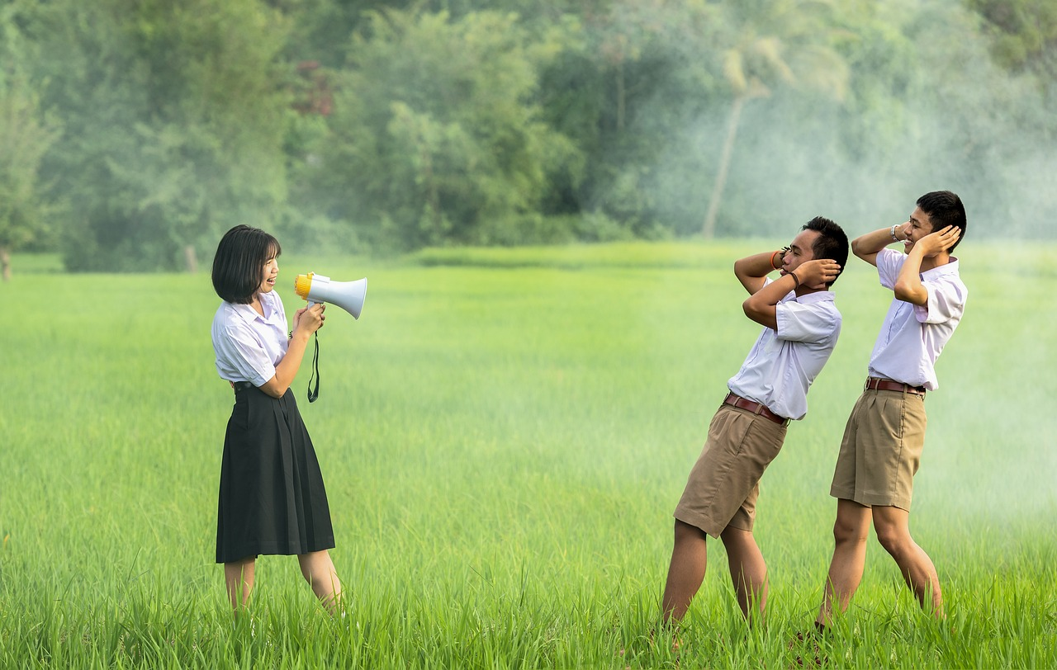
TYPES OF COMMUNICATION
One-way communication | Two-way communication
Communicate something to someone without expecting their response. | Communicating to someone and receiving their response.
Notes:
Source: https://www.brstpsihologija.si/skrivnosti-dobre-medosebne-komunikacije/

Slide 9

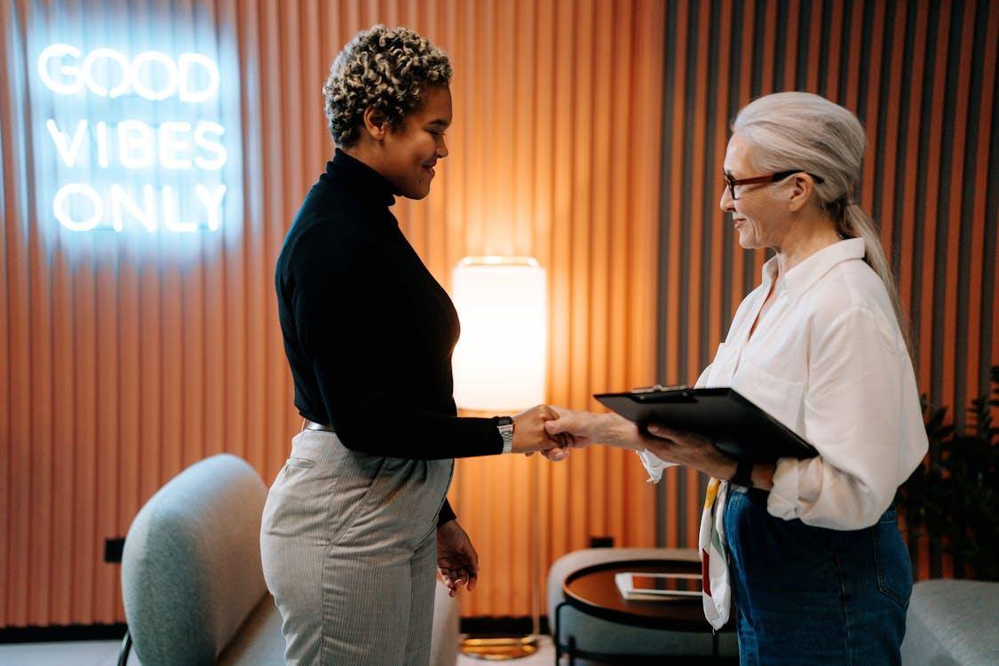
TYPES OF COMMUNICATION
Verbal | Non-verbal
Communication with use of words. | Non-verbal is what we communicate through our appearance, behaviour, physical gestures.
Notes:
Source: https://www.brstpsihologija.si/skrivnosti-dobre-medosebne-komunikacije/

Slide 10
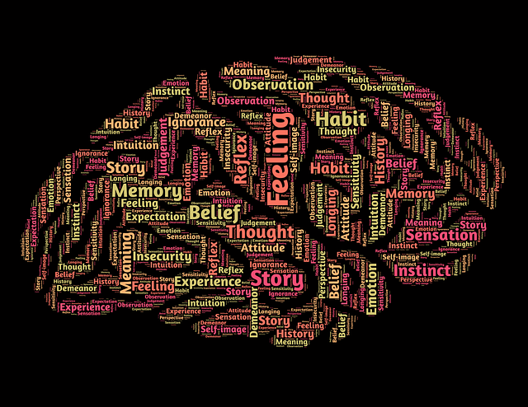
TYPES OF COMMUNICATION
Conscious communication | Unconscious communication
Decision to do something, to communicate exactly what we want to communicate. | Communicating something without being aware (certain body gesture).
Notes:
Source: https://www.brstpsihologija.si/skrivnosti-dobre-medosebne-komunikacije/

Slide 11

Digital communication
Instant interaction
Global reach
Cost-Effective
Multimedia integration
Accessibility
Data tracking
Security risks
Environmental impact

Slide 12
Digital communication
Instantaneous Interaction: Digital communication allows for real-time interaction, enabling people to connect instantly through messaging apps, video calls, and social media.
Global Reach: It breaks down geographical barriers, allowing individuals and businesses to communicate with people all over the world.
Multimedia Integration: It supports various forms of media, including text, images, videos, and audio, making communication more engaging and effective.
Notes:
Source: https://www.theknowledgeacademy.com/blog/digital-communication/

Slide 13
Digital communication
Accessibility: Digital platforms can be designed to be accessible to people with disabilities, using features like screen readers and voice commands.
Data Tracking: Digital communication tools often come with analytics capabilities, allowing users to track engagement and effectiveness.
Security Risks: Despite its benefits, digital communication can be vulnerable to security breaches and cyberattacks, highlighting the need for robust cybersecurity measures.
Environmental Impact: By reducing the need for paper and physical travel, digital communication can help lower the environmental footprint.
Cost-Effective: Digital communication is often more affordable than traditional methods, reducing the need for physical materials like paper and postage.
Notes:
Source: https://clearinfo.in/blog/advantages-and-disadvantages-of-digital-communication/

Slide 14
Digital communication
Increased connectivity
Access to information
Digital communication tools like email, social media, and video calls help seniors stay connected with family and friends, reducing feelings of isolation.
The internet provides seniors with access to a wealth of information, from health resources to news updates, which can enhance their knowledge and independence.

Slide 15
Digital communication
Telehealth services
Digital literacy
Digital communication enables seniors to access telehealth services, allowing them to consult with healthcare providers from the comfort of their homes.
Many seniors face challenges with digital literacy, including understanding how to use devices and navigate the internet. Providing digital literacy programs can help bridge this gap.

Slide 16
Digital communication
Security and privacy concerns
Accessibility issues
Seniors are often targets for online scams and cybercrimes. It’s crucial to educate them about online safety and privacy measures.
Physical impairments such as poor vision or arthritis can make using digital devices challenging for seniors. Designing accessible technology is essential.

Slide 17
Digital communication
Cost and access
Intergenerational support
The cost of devices and internet services can be a barrier for some seniors. Ensuring affordable access is important for digital inclusion.
Younger generations can play a key role in helping seniors learn and adapt to digital technologies, fostering intergenerational bonds and mutual learning.

Slide 18
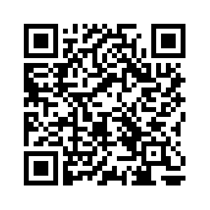
Test your digital skills
EUROPASS DIGITAL SKILLS TEST
Simple test where you can test your digital competences.
OR SCAN QR-CODE
CLICK AND FIND OUT
Notes:
Source: https://europass.europa.eu/en/europass-tools/test-your-digital-skills

Slide 19
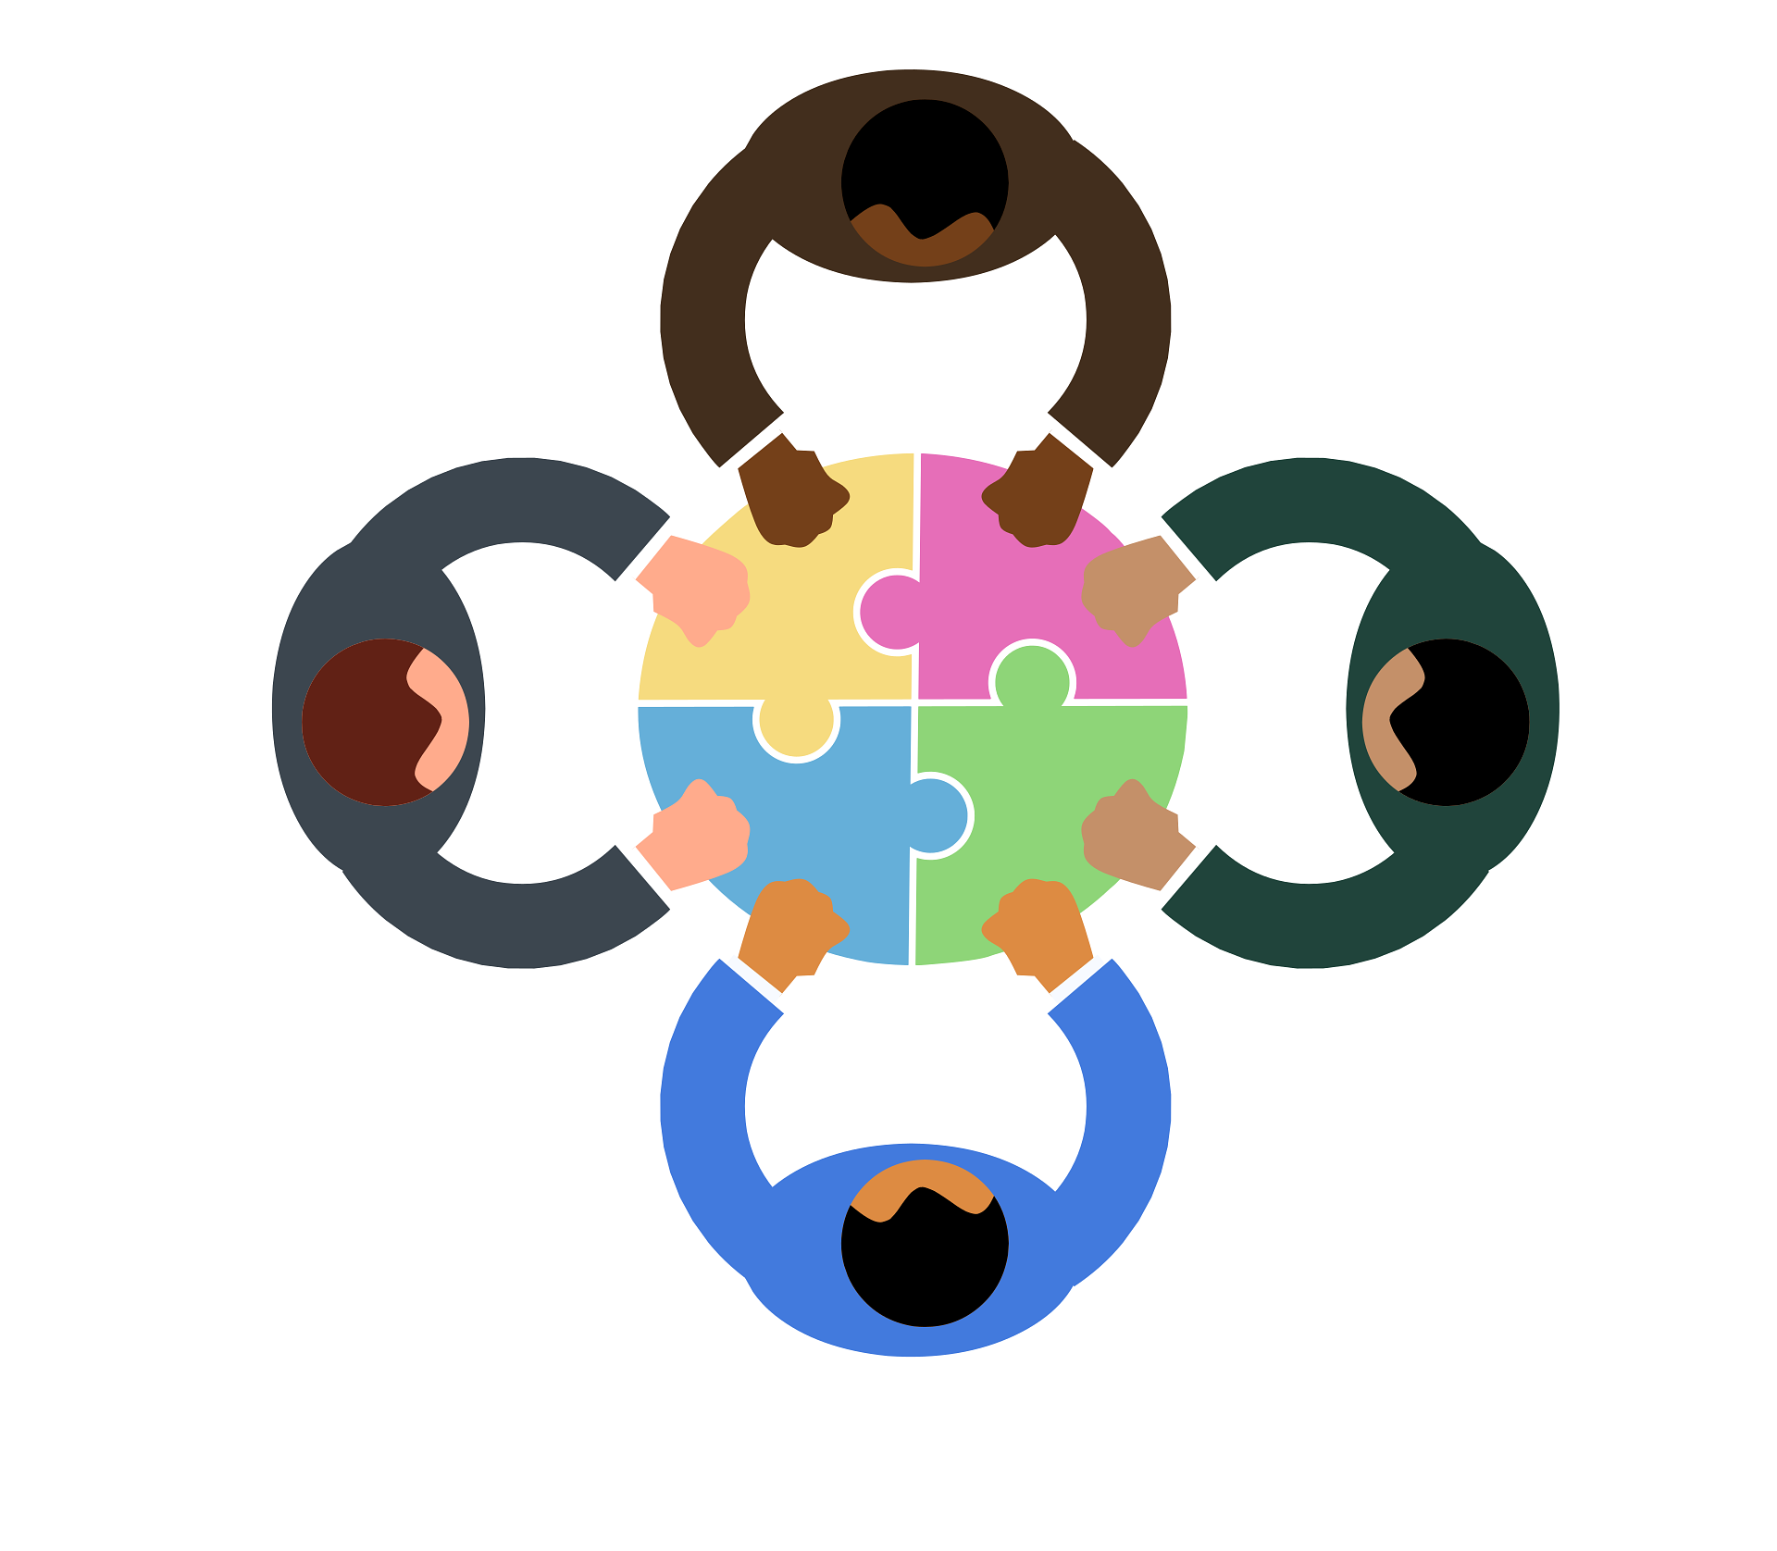
Elements of communication
We know more definitions about communication where several key elements can be affecting the process.
Sender
Message
Encoding
Channel
Receiver
Decoding
Feedback
Context
Noise
Notes:
Source: https://www.prezent.ai/zenpedia/communication-elements

Slide 20
Elements of communication
SENDER
Person who plays a crucial role and initiates communication. It must considerate how message will be received by the audience.
MESSAGE
„The message is the information, idea, or feeling that the sender wants to communicate“
With message we are sending informations, ideas, feelings through different forms, such as spoken or written words, gestures and body language.
ENCODING
Sender is using internal feelings to select right words, tone, non-verbal cues to the process and
Ensures that communication is clear.
Notes:
Source: https://www.prezent.ai/zenpedia/communication-elements

Slide 21
Elements of communication
CHANNEL
A Message is transmitter through the medium which has an impact to the receiving message.
Channel can be face-to-face conversations, different calls (telephone, video call), text messages, social media etc.
RECEIVER
Receiver can be individual or more people for whom message is intended. It is influenced by different experiences and perceptions which affect communication process.
DECODING
Is very important for communication process because involves interpretation of sender‘s message. Important for receivers is to understand sound and language which alter the meaning of the message.
Notes:
Source: https://www.prezent.ai/zenpedia/communication-elements

Slide 22
Elements of communication
FEEDBACK
Is the receiver‘s response to the sender and can be verbal or non-verbal. It gives the sender a return information about effectiveness of their communication.
CONTEXT
It refers to environment where communication takes place. Example: physical location, cultural background, situational factors. It can influence how message is interpreted or understood.
Notes:
Source: https://www.prezent.ai/zenpedia/communication-elements

Slide 23
Elements of communication
NOISE
Internal or external interference which disrupt the communication process.
Examples:
Physical noise: background sound
Psychological noise: preconceived notions or stress
Semantic noise: misunderstanding due to ambiguity of language
Other: technological noise (poor internet connections, software problems, technical issues)
Notes:
Source: https://www.prezent.ai/zenpedia/communication-elements

Slide 24
Communication styles
Assertive
Passive
Passive-Aggressive
Aggressive
Notes:
Most know 4 communication styles.

Slide 25
Guess: Communication styles
Assertive
Aggressive
Clear and respectful expression of thoughts, feelings, needs. | Reluctance to express one‘s own opinions or needs. | Forceful and confrontational language. | Elements of passivity and hostility.
Honest, direct communication and active listening. | Avoid confrontation – may lead to poor self-advocacy and misunderstanding. | Dominate conversations, disregard others‘ opinions, verbal attacks. | Use of sarcasm, backhanded compliments, subtle sabotage.
Understanding and constructive way of solving conflicts. | Unmet personal needs and desires. | Hostility and conflict communication. Less effective for dialogues. | Creates confusion and does not communicate true feelings.
Considered most effective form of communication. | While it may prevent immediate conflict, it can result in unmet personal needs and desires. | Conflictive and less effective. | Confusion, true feelings not openly communicated.
Passive
Passive-aggressive
Notes:
Source: https://www.theknowledgeacademy.com/blog/verbal-communication/

Slide 26

What is your most common communication style?
Why?

Slide 27

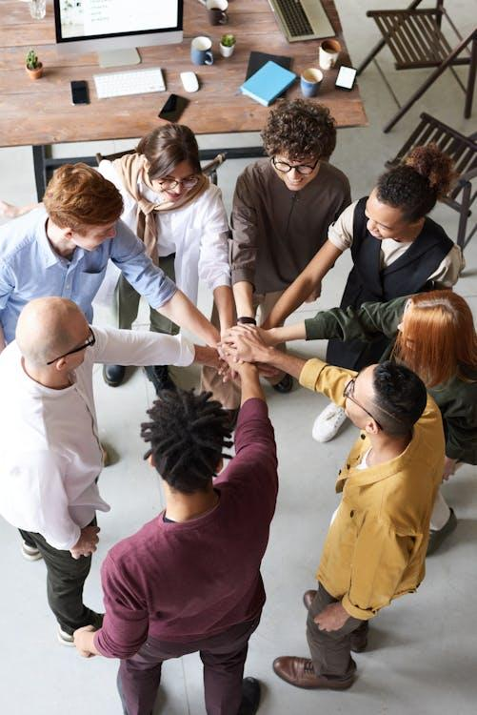
SOCIAL SKILLS AND COMMUNICATION IN RETIREMENT
Seniors tend to experience a decrease in social interactions after they retire compared to when they were employed.
The transition to retirement often results in changes to daily routines and the loss of structured social environments, such as workplace interactions, which can lead to increased isolation and loneliness.

Slide 28
SOCIAL SKILLS AND COMMUNICATION IN RETIREMENT
Maintaining social connections during retirement can significantly enhance seniors' quality of life, contributing to better cognitive function, emotional health, and even physical health.
Engaging in social activities like joining clubs, pursuing hobbies, volunteering, and participating in community programs can help mitigate the risks of isolation and loneliness by providing opportunities for interaction and creating a sense of purpose.

Slide 29
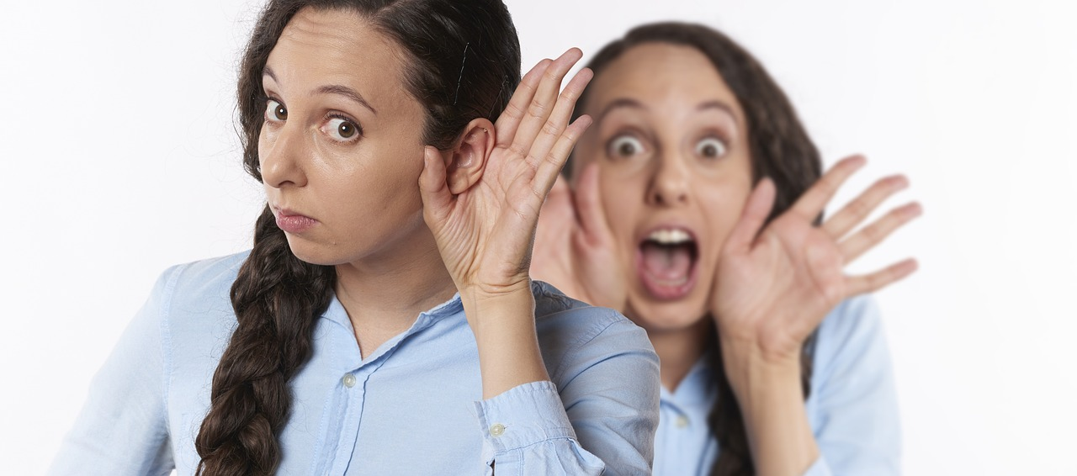
Barriers of communication
Hearing loss
It is a common misconception that all older adults suffer from hearing loss. Many people do not even try to communicate with older people because they assume they cannot hear them anyway. While some older people do start to lose their hearing, you can help yourself with a hearing aid. When communicating with an older person with hearing loss, make sure you are both focused and looking at each other. This will help your loved one read your facial expressions and understand more clearly what you are saying.
Notes:
Source: https://senior24.si/komunikacijske-ovire-starejsih-izzivi-in-nasveti-za-ucinkovito-komunikacijo/

Slide 30
Barriers of communication
Speech disorders
Some medical conditions, such as stroke, Parkinson's disease or other neurological conditions, can cause communication difficulties in older people. In this case, it is very important to remember that just because your loved one cannot form words clearly, it does not mean that they cannot listen, think or feel. Communication in this case may require extra effort, but it is still possible.
Notes:
Source: https://senior24.si/komunikacijske-ovire-starejsih-izzivi-in-nasveti-za-ucinkovito-komunikacijo/

Slide 31
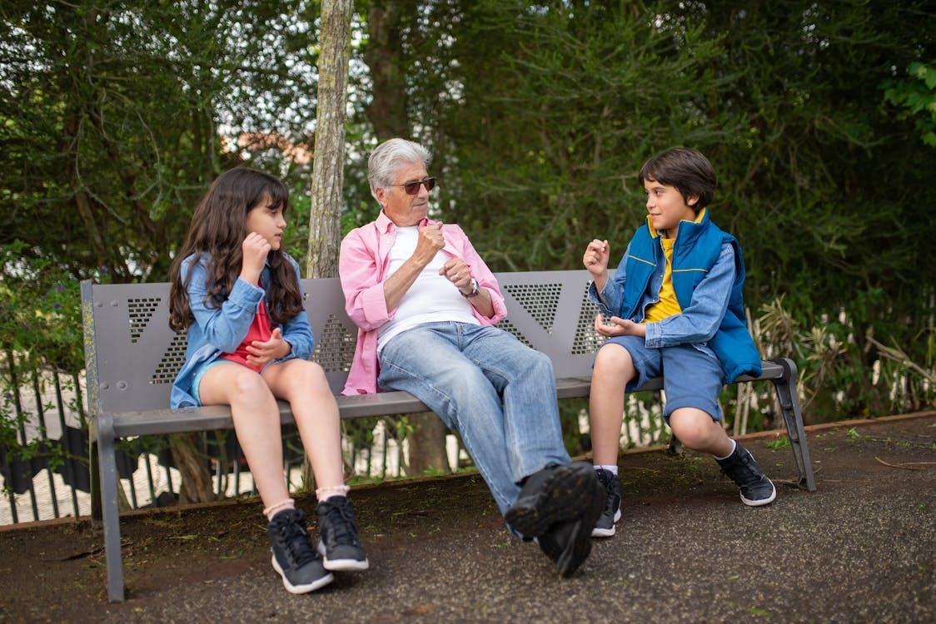
Barriers of communication
Language and understanding
Language barriers can relate to specific terminology, e. g. medical, where other people have problem understanding it. Differences we can find between generation gaps, where grandchildren, e. g. teenagers can speak languages which they usually find on TV, radio, other internet channels. Parents and grandparent have problem understanding that language which brings a barrier to communication.
Notes:
Source: https://senior24.si/komunikacijske-ovire-starejsih-izzivi-in-nasveti-za-ucinkovito-komunikacijo/

Slide 32
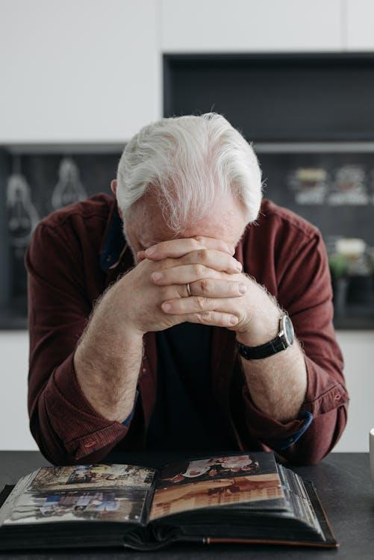
Barriers of communication
Cognitive challenges
Talking to a person who is suffering from an illness such as Alzheimer's or dementia can be particularly difficult.
They may find it difficult to understand you or may forget the conversation halfway through and start again.
It is important to remember that the conversation is real and important to your loved one while the conversation is taking place.
Notes:
Source: https://senior24.si/komunikacijske-ovire-starejsih-izzivi-in-nasveti-za-ucinkovito-komunikacijo/

Slide 33
What other barriers can you think of?

Slide 34


What can we do

Slide 35
ENHANCING SOCIAL SKILLS AND COMMUNICATION IN RETIREMENT
Strong communication skills help seniors maintain social connections, preventing feelings of loneliness and isolation. Engaging in meaningful conversations with family, friends, and community members can provide emotional support and a sense of belonging.
Seniors who communicate effectively are more likely to stay socially active, participate in group activities, and build new friendships, which positively impacts mental health.
Reduce social isolation

Slide 36
SOCIAL SKILLS AND COMMUNICATION IN RETIREMENT
Engaging in social interactions can keep the mind sharp and improve cognitive function. Conversations require seniors to process information, think critically, and recall memories, which can be beneficial for brain health.
Effective communication encourages lifelong learning and mental stimulation, which can potentially slow cognitive decline associated with aging.
Improve cognitive health

Slide 37
SOCIAL SKILLS AND COMMUNICATION IN RETIREMENT
Being able to express emotions, share experiences, and discuss concerns can relieve stress and promote emotional well-being. Communication allows seniors to articulate their needs and feelings, which can reduce anxiety and improve mood.
Social skills help seniors engage in meaningful and empathetic conversations, providing opportunities for mutual support and companionship.
Boost emotional
well-being

Slide 38
SOCIAL SKILLS AND COMMUNICATION IN RETIREMENT
Effective communication enables seniors to advocate for their needs, whether it’s expressing preferences in healthcare settings, making decisions, or managing daily life. This sense of autonomy fosters empowerment and independence.
Clear communication can help seniors navigate services, understand instructions, and interact with healthcare providers more confidently, leading to better care and quality of life.
Promote independence and empowerment

Slide 39
SOCIAL SKILLS AND COMMUNICATION IN RETIREMENT
Seniors with strong social skills are more likely to join social clubs, fitness groups, or community centers, encouraging physical activity and promoting a healthier lifestyle.
Group activities and social gatherings provide both mental and physical benefits, reducing the risk of depression and encouraging a more active and fulfilling life.
Encourage physical activity and social engagement

Slide 40
SOCIAL SKILLS AND COMMUNICATION IN RETIREMENT
Social skills help seniors maintain healthy communication with family members, allowing them to stay connected with children, grandchildren, and other relatives. This strengthens familial bonds, provides a support system, and keeps them involved in family life.
Understanding how to communicate across different generations (e.g., using digital communication tools like smartphones) can bridge the gap between seniors and younger family members.
Build stronger family relations

Slide 41
SOCIAL SKILLS AND COMMUNICATION
Possibilities for seniors in local environment – MURSKA SOBOTA
Knjižnica (PIŠK)
Univerza za tretje življenjsko obdobje
MOMS + krajevne skupnosti + mestne četrti (srečanje starejših občanov)
Hiša sadeži družbe
Študijski krožki
Possibilities
Mensana medgeneracijsko središče
Dom starejših
Društvo upokojencev MS
Center za starostnike

Slide 42
SOCIAL SKILLS AND COMMUNICATION
Additional activities that can help promote social skills among seniors:
1. Group Discussions - Encourage open communication and sharing of ideas.
Activity: Choose a topic of interest (e.g., current events, hobbies) and facilitate a group discussion.
Ensure everyone has a chance to speak.
Benefit: Enhances verbal communication and listening skills, and fosters a sense of community.
2. Book Club - Promote discussion and critical thinking.
Activity: Form a book club where participants read a book and then meet to discuss it.
Encourage them to share their thoughts and opinions.
Benefit: Improves conversational skills and provides a platform for social interaction.
3. Volunteer Projects - Build teamwork and a sense of purpose.
Activity: Organize volunteer activities such as community clean-ups, helping at local shelters, or assisting in community events.
Benefit: Encourages teamwork, empathy, and social responsibility.

Slide 43
SOCIAL SKILLS AND COMMUNICATION
Additional activities that can help promote social skills among seniors:
4. Art and Craft Workshops - Foster creativity and collaboration.
Activity: Conduct workshops where participants can create art or crafts together. They can share their work and discuss their creative process.
Benefit: Enhances communication through shared activities and boosts self-esteem.
5. Game Nights - Promote fun and interaction.
Activity: Organize game nights with board games, card games, or trivia. Encourage friendly competition and teamwork.
Benefit: Improves social interaction and provides a relaxed environment for communication.
6. Cooking Classes - Encourage collaboration and sharing.
Activity: Host cooking classes where participants can learn new recipes and cook together. Participants share their culinary experiences and enjoy the meals they prepare.
Benefit: Promotes teamwork, sharing, and social bonding.

Slide 44
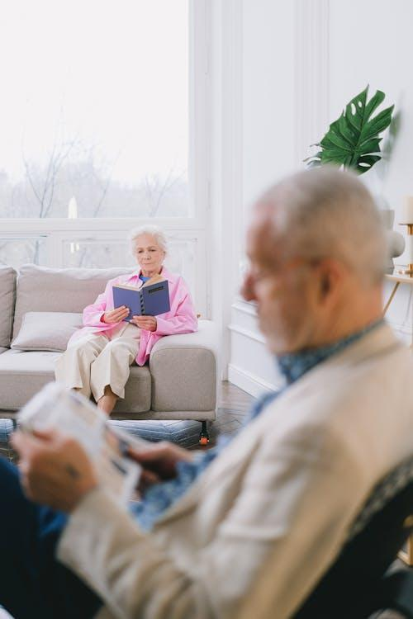
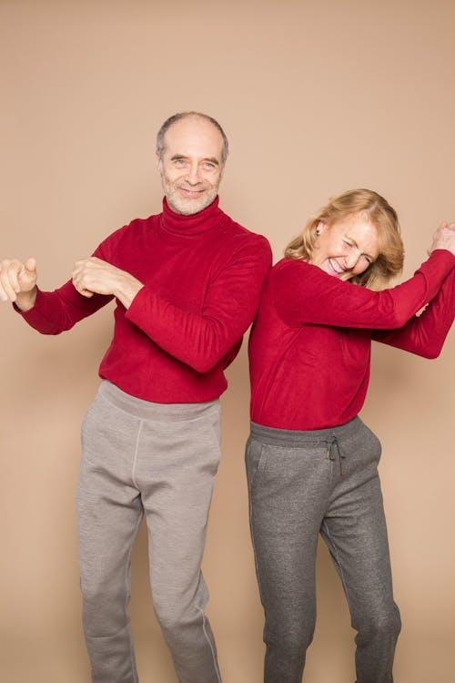
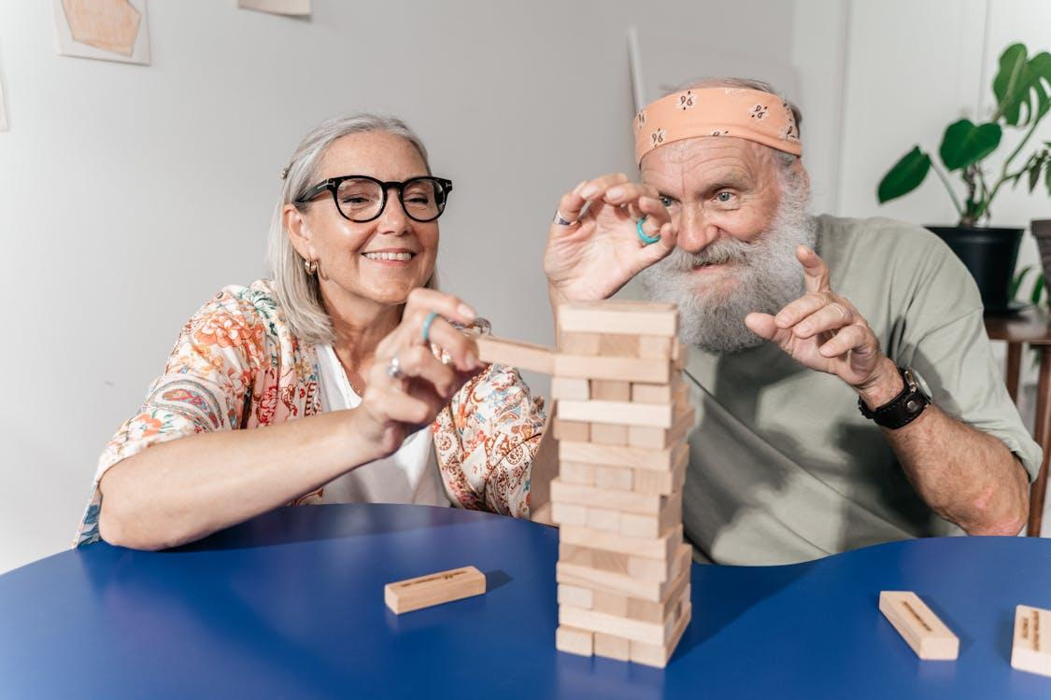
SOCIAL SKILLS AND COMMUNICATION
Additional activities that can help promote social skills among seniors:
7. Music and Dance Sessions - Enhance social interaction through shared interests.
Activity: Organize music or dance sessions where participants can enjoy and participate in musical activities or dance together.
Benefit: Encourages physical activity, social interaction, and enjoyment.

Slide 45
WORKSHOP

Slide 46
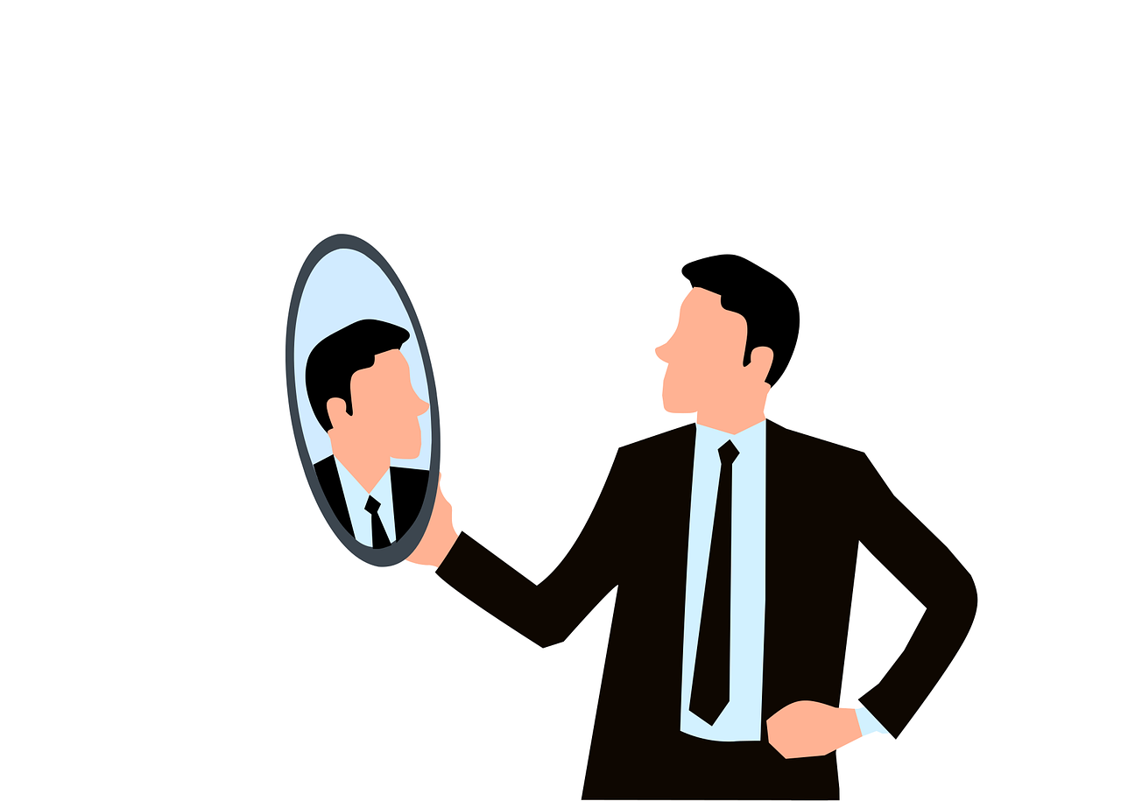
Individuals

Slide 47
PERSONAL VALUES AND COMMUNICATION ALIGNMENT
Objective: Help participants explore how their personal values align or conflict with their communication patterns.
Instructions: Ask participants to write down three core values that are important to them (e.g., respect, honesty, kindness). Then, they should reflect on how often their communication style aligns with these values in various situations. For example, if kindness is a core value, they might consider whether their tone in family discussions reflects kindness.
Reflection: Encourage them to identify one recent conversation where they felt they communicated in a way that was aligned with these values and one where they felt there was a misalignment. Ask them to consider why each situation occurred and what they could do to improve in the future.

Slide 48
LETTER TO MY YOUNGER SELF ABOUT COMMUNICATION
Objective: Reflect on how personal growth has shaped current communication habits.
Instructions: Participants imagine they are writing a letter to a younger version of themselves, offering advice on handling challenging conversations, expressing emotions, and interacting with others. They should reflect on communication skills they’ve gained over the years and challenges they might have faced differently with today’s insights.
Reflection: Ask participants to focus on one key lesson from their letter and consider how they can apply this wisdom to enhance their current communication. This can lead to a greater appreciation of their growth and inspire them to refine their communication further.

Slide 49

Pairs or Groups

Slide 50
ACTIVE LISTENING PRACTICE
Objective: Practice listening skills in pairs or small groups.
Instructions:
Form pairs and discuss a topic: a hobby, music, food, health …
One person talks for 2-3 minutes, others listen without interruptions.
When speaker finishes, the listener has to summarize what they heard, without adding any opinions or advice.
Discussion: Compare in the pairs or groups, how it felt to actively listen and how it was to think of a response.
Benefit: Enhances emphaty and improves listening skills.

Slide 51
GROUP DISCUSSION: Barriers to effective communication
Objective: identify common barriers to communication and discuss strategies to overcome them.
Instructions:
Facilitate a discussion on barriers such as distractions, language differences, physical impairments, and assumptions. In topic include also connection with family and friends in a digital age.
Encourage participants to share personal experiences and suggest ways to improve communication in those situations.
Benefit: Provides a deeper understanding of communication challenges and fosters peer learning.

Slide 52


Thank you for your attention!

Slide 53
Sources and references:
Skrivnosti dobre medosebne komunikacije. Kaja Strniša. Source: https://www.brstpsihologija.si/skrivnosti-dobre-medosebne-komunikacije
Verbal Comunication: A Complete Guide (2023). Eliza Taylor. Source: https://www.theknowledgeacademy.com/blog/verbal-communication/
Komunikacijske ovire starejših: Izzivi in nasveti za učinkovito komunikacijo (A.K.). Source: https://senior24.si/komunikacijske-ovire-starejsih-izzivi-in-nasveti-za-ucinkovito-komunikacijo/ , published 11. 12. 2023.
Communication process: 9 Essential elements of communication. Raya Bothra. Source: https://www.prezent.ai/zenpedia/communication-elements
15 Advantages & Disadvantages of Digital Communication + Examples. Aditya Soni. Source: https://clearinfo.in/blog/advantages-and-disadvantages-of-digital-communication/
Sienna Roberts. Source: https://www.theknowledgeacademy.com/blog/digital-communication/ , published 18. 7. 2023.
Test your digital skills. Source: https://europass.europa.eu/en/europass-tools/test-your-digital-skills
Photos: Pixabay.com and Pexels.com

Slide 54
Sources and references:
15 Advantages & Disadvantages of Digital Communication + Examples. Aditya Soni. Source: https://clearinfo.in/blog/advantages-and-disadvantages-of-digital-communication/
Communication process: 9 Essential elements of communication. Raya Bothra. Source: https://www.prezent.ai/zenpedia/communication-elements
Komunikacijske ovire starejših: Izzivi in nasveti za učinkovito komunikacijo (A.K.). Source: https://senior24.si/komunikacijske-ovire-starejsih-izzivi-in-nasveti-za-ucinkovito-komunikacijo/ , published 11. 12. 2023.
Sienna Roberts. Source: https://www.theknowledgeacademy.com/blog/digital-communication/ , published 18. 7. 2023.
Skrivnosti dobre medosebne komunikacije. Kaja Strniša. Source: https://www.brstpsihologija.si/skrivnosti-dobre-medosebne-komunikacije
Test your digital skills. Source: https://europass.europa.eu/en/europass-tools/test-your-digital-skills
Verbal Comunication: A Complete Guide (2023). Eliza Taylor. Source: https://www.theknowledgeacademy.com/blog/verbal-communication/
Photos: Pixabay.com and Pexels.com

